Slide 1
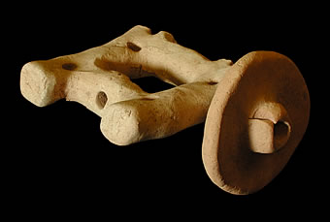
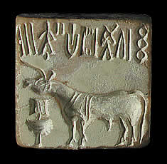
Unlocking the Secrets of Mohenjodaro
Chapter 14
pages 133 – 141
http://www.mohenjodaro.net/index.html

Slide 2
14.1 Introduction
Mohenjodaro was located in the Indus River valley.
Mohenjodaro means “place or hill of the dead”
It had a citadel, or fort for protection.
Many other towns also were clustered near the Sarasvati River.
These settlements became known as the Indus-Sarasvati civilization.
It is also called the Harappan civilization.
The cities of Harappa and Mohenjodaro were the two great centers of this civilization.
http://www.mohenjodaro.net/index.html

Slide 3
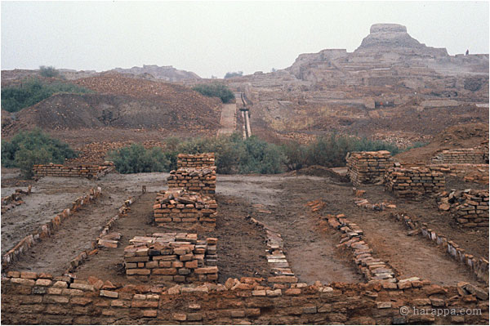

Slide 4
14.2 The Mystery of Mohenjodaro
Mohenjodaro was a large city built on the banks of the Indus River.
The streets were lined with houses and workshops made of mud bricks.
Population of 50,000 at one time.
It had an advanced culture.
It was carefully planned.
The great mystery is why did they disappear?
No one knows for sure.
Possibly invaders from the north.
Possibly an earthquake changed the river’s course.

Slide 5
14.3 Weights and Scale
Archeologists suggest that the people used grain as money.
A large building called a granary was discovered.
A granary is a place to store grain.
Weights and scales were found inside the granary.
These tools were possibly used to measure amounts of grain.
http://www.mohenjodaro.net/index.html

Slide 6
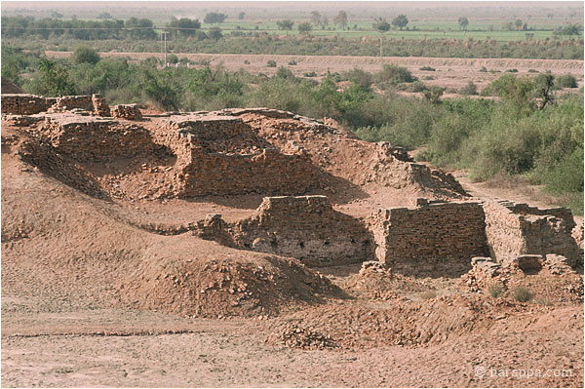

Slide 7
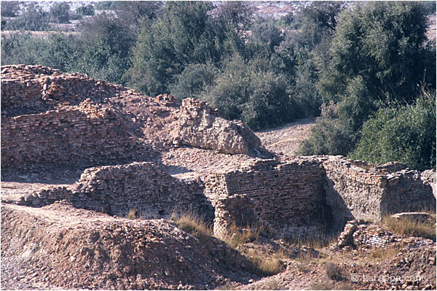

Slide 8
14.4 The Great Bath
The Great Bath was a pool built of waterproof brick.
It was 39 feet long and 8 feet deep.
The pool was used to bathe.
Archeologists believe that it was possibly used for religious rituals.
http://www.mohenjodaro.net/index.html

Slide 9
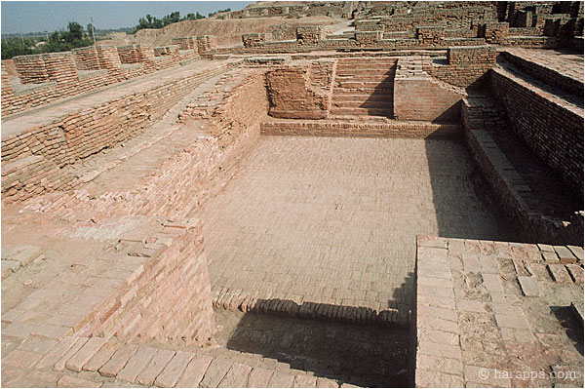

Slide 10
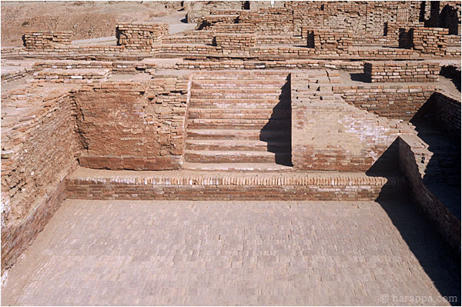

Slide 11
14.5 Statue and Beads
A 7 inch stone statue of a man from Mohenjodaro was discovered.
The statue shows what the men of Mohenjodaro could have possibly looked like.
Beautiful stone beads in many shapes and colors have been found throughout Mohenjodaro.
Women probably wore them in necklaces, bracelets, earrings and rings.

Slide 12
14.6 Seals
Small stone seals are among the most mysterious Mohenjodaro’s artifacts.
No one knows what they were used for.
Possible uses of the seals:
Pressed into wax to show ownership
Charms to keep away evil
They have been found in large numbers.
Seals are covered with pictographs.
Over 400 pictographs have been discovered.
http://www.mohenjodaro.net/index.html

Slide 13
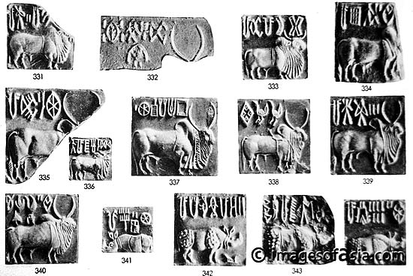

Slide 14
14.7 Sewer System
The complex sewer system of Mohenjodaro was a great achievement.
2000 years would pass before another system like it would be developed in ancient Rome.
It provided indoor plumbing for both rich and poor.
Deep wells stored water for all residents.

Slide 15
14.8 Homes
Most homes were/had:
Flat roofs
2 stories high.
Made of mud bricks
1 – 12 rooms
Used alabaster (mineral) as windows
The back of the homes open into a courtyard

Slide 16
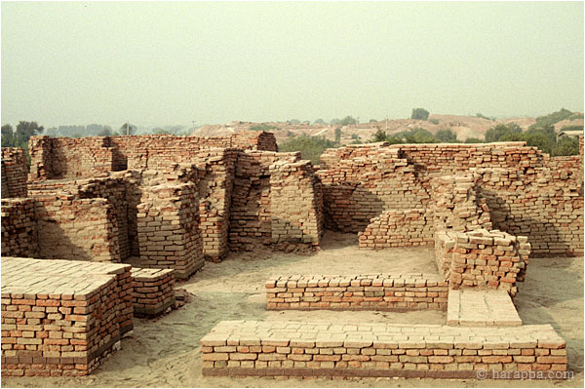

Slide 17
14.9 Games
The people enjoyed games.
Archeologists have uncovered dice, stone balls, grooved clay tracks and stone game boards.
The game of chess was probably invented in India.

Slide 18
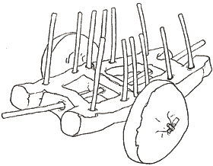
Many small carts made of clay have been found at Indus Valley sites. Archaeologists believe that they were probably toys for children. Since no full-sized carts have ever been found, these small toys give us an idea of what real carts might have looked like in an Indus Valley town.
This is a wheel and cart base from a toy cart found at Mohenjo-daro. When it was complete, it probably would have looked like this drawing.

Slide 19
14.10 Clay Models
Archeologists have found small clay models all around Mohenjodaro.
The models may have been toys.
The models could show what life was like around Mohenjodaro.

Slide 20
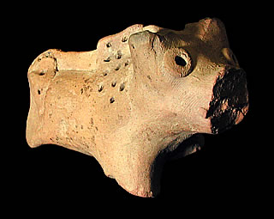
Many terracotta figurines have been found at Mohenjodaro and other Indus Valley sites. Some people believe that they may have been connected with religious beliefs, while others believe that they were representations of people or animals in those cities.

Slide 21
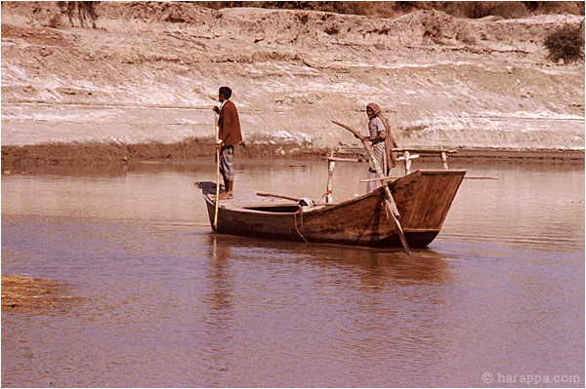

Slide 22
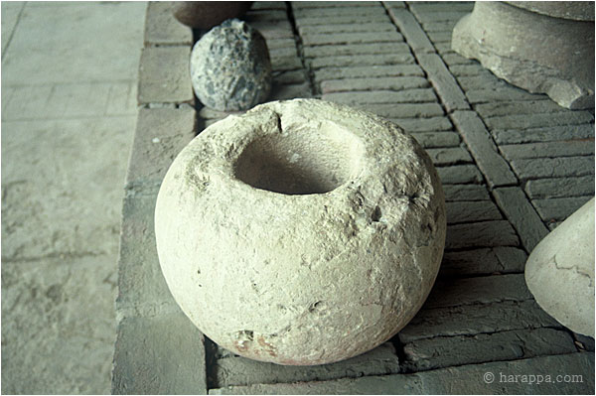

Slide 23
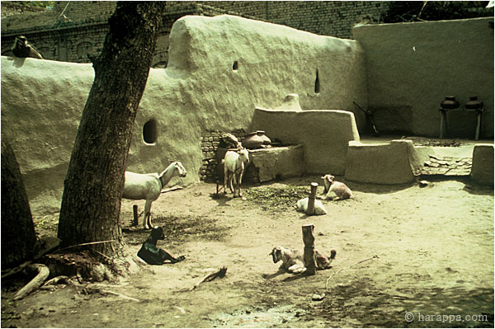

Slide 24
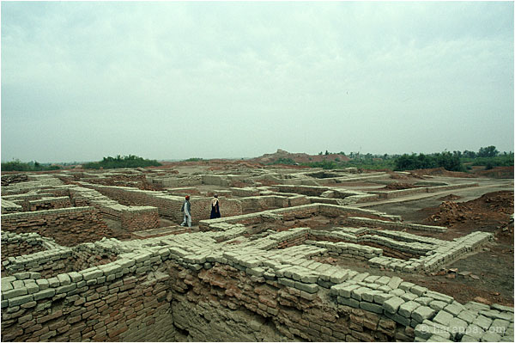

Slide 25
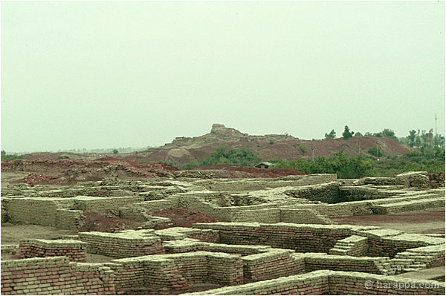

Slide 26
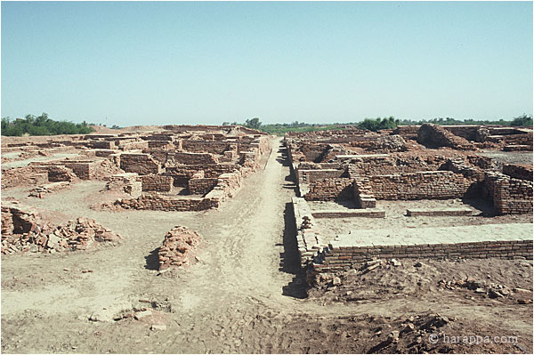

Slide 27
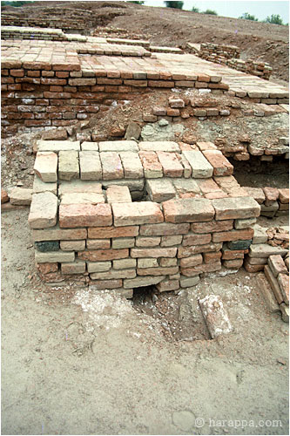

Slide 28
