Slide 1
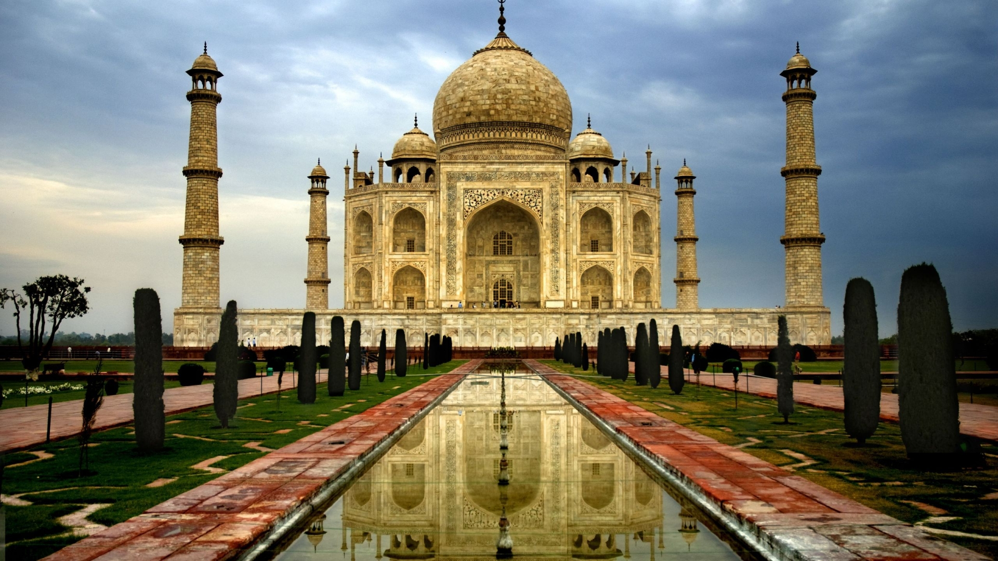
Learning About Hindu Beliefs Chapter 15 History Alive!
Pages 143-151

Slide 2
15.1 Introduction
Hinduism – India’s first major ____________.
One of the basic beliefs of Hinduism is ________________. Dharma stands for Law, obligation, and duty.
To follow one’s dharma means to perform one’s duties and so to _______ as one should.

Slide 3
15.2 The Origins of Hinduism
Hinduism is a very ________________ religion.
Hinduism began before ______________ history.
No single ______________________ founded it.
Most likely, Hinduism is a blend of Aryan beliefs and beliefs of the people they _______________.
Vedas – a collection of Hindu sacred __________.
Sanskrit – an ancient _______________ of India.
Modern-day Hinduism is very _______________.
All Hindus share certain beliefs.
Vedas remain sacred
Brahmanism – an ancient Indian religion in which the Brahmins are the __________ class.

Slide 4
15.3 Hinduism and the Caste System
Hinduism was not just a _________ in ancient India. It was a way of __________.
caste – a class, or group, in Hindu society.
Priests
Rulers and Warriors
Herders and Merchants
Servants
Untouchables
The caste system affected all aspects of people’s ____________________.

Slide 5
15.4 Hindu Beliefs About Brahman
__________________is the Hindu name for a supreme power, or divine force, that is greater than all the other gods.
To Hindus, only Brahman exists ___________.
Everything else in the world changes, from the passing seasons to living things that eventually ___________.

Slide 6
15.5 Hindu Beliefs About Multiple Gods
There are _______ gods and goddesses in Hindu stories and worship.
Today, the most important Hindu gods are Brahma, Vishnu and Shiva. Each god controls one aspect of the ____________________.
Brahma – ___________________ it
Vishnu – ____________________ it
Shiva – _____________________ it
Devi – embodies the ___________ powers of the universe

Slide 7
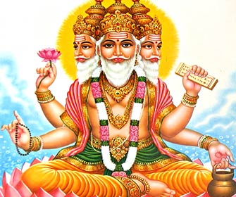
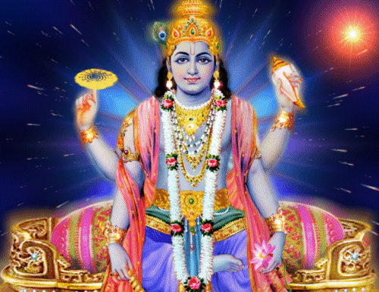
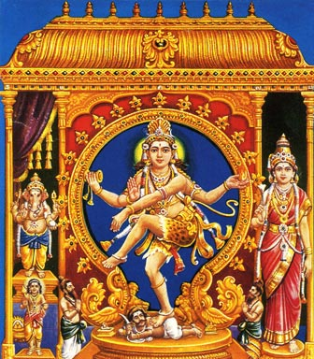
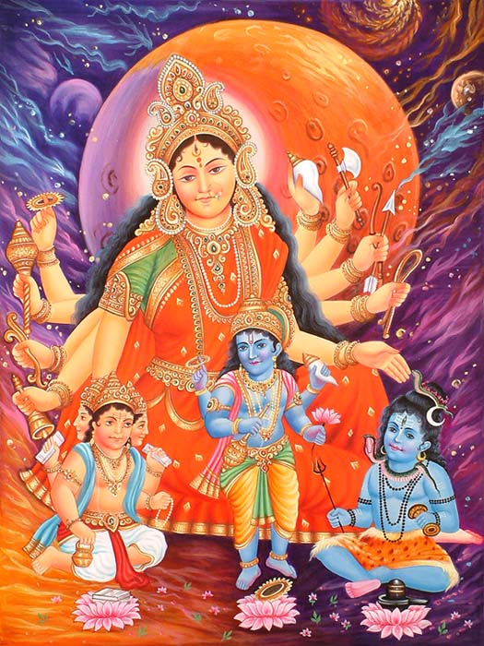

Slide 8
15.6 Hindu Beliefs About Dharma
Dharma is a very important _________ in Hinduism.
To follow one’s dharma means to perform one’s duties and so to live as one should.
Hindu’s believed that when everyone followed the dharma of their class, _______ would be in harmony.
Hinduism values ______________, sharing good with others and caring for one’s ___________.
Hindus believe that all life is __________________.
_________ are especially important to India life.
Cows gave people milk, butter, transportation and clothing.
Hindus were taught not to ____________ cows.

Slide 9
15.7 Hindu Beliefs About Karma
In Hindu belief, the law of karma governs what happens to people’s ____________ after death.
Karma was made up of all the good and evil that a person had ______________ in past lives.
Today, Indian law ____________ the rights of all people, and the caste system is much less ______.
The ideas of karma and rebirth remain a central part of ________________________.

Slide 10
15.8 Hindu Beliefs About Samsara
Samsara – continuous cycle of _____, death, and rebirth.
Reincarnation – the belief that a person’s should
is reborn into a new body after _____________.
Pilgrimage – a ________________ to a holy place.
Faithful Hindus still make pilgrimages today.
The _______________ River is still one of the most holy places in India.
Modern Hindus bathe in its waters as an act of _____________________ and purification.

Slide 11
Chapter 15 Summary
India’s first major religion
Five basic beliefs of Hinduism
Brahman
Multiple Gods
Dharma
Karma
Samsara
Hindu beliefs continue to affect daily life in India
Worship in temples
Make pilgrimages
Celebrate religious festivals
Practice meditation
Nonviolence remain important ideals in India
Avoid eating meat and doing harm to animals

