Slide 1
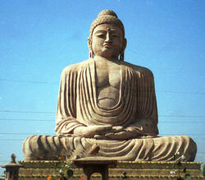
Chapter 19 section 3 Origins of Buddhism
Pages 484 - 489

Slide 2
The Main Ideas
Siddhartha Gautama searched for wisdom in many ways.
The teachings of Buddhism deal with finding ______________.
Buddhism spread far from where it began in _______________.

Slide 3
The BIG Idea
Buddhism began in India and became a major ___________.

Slide 4
The Quest for Answers
Siddhartha Gautama was born around _______ BC in northern India.
Siddhartha was a ____________.
He looked around and saw much _______ and ______________ in the world.
He began asking questions about the meaning of human ______________.
He left behind his family and traveled around India to look for ______________.
No one could give him convincing answers.

Slide 5
The Buddha Finds Enlightenment
According to legend, Siddhartha spent ______ years wandering throughout _______a looking for answers.
He fasted, meditated and went without washing in order to clear his ____________.
After ____ weeks of meditating, he suddenly had the answers he’d been looking for.
He realized human ___________ comes from these things:
________________ what we like but do not have
_____________ to keep what we like & already have,
Not _____________ what we dislike but have.

Slide 6
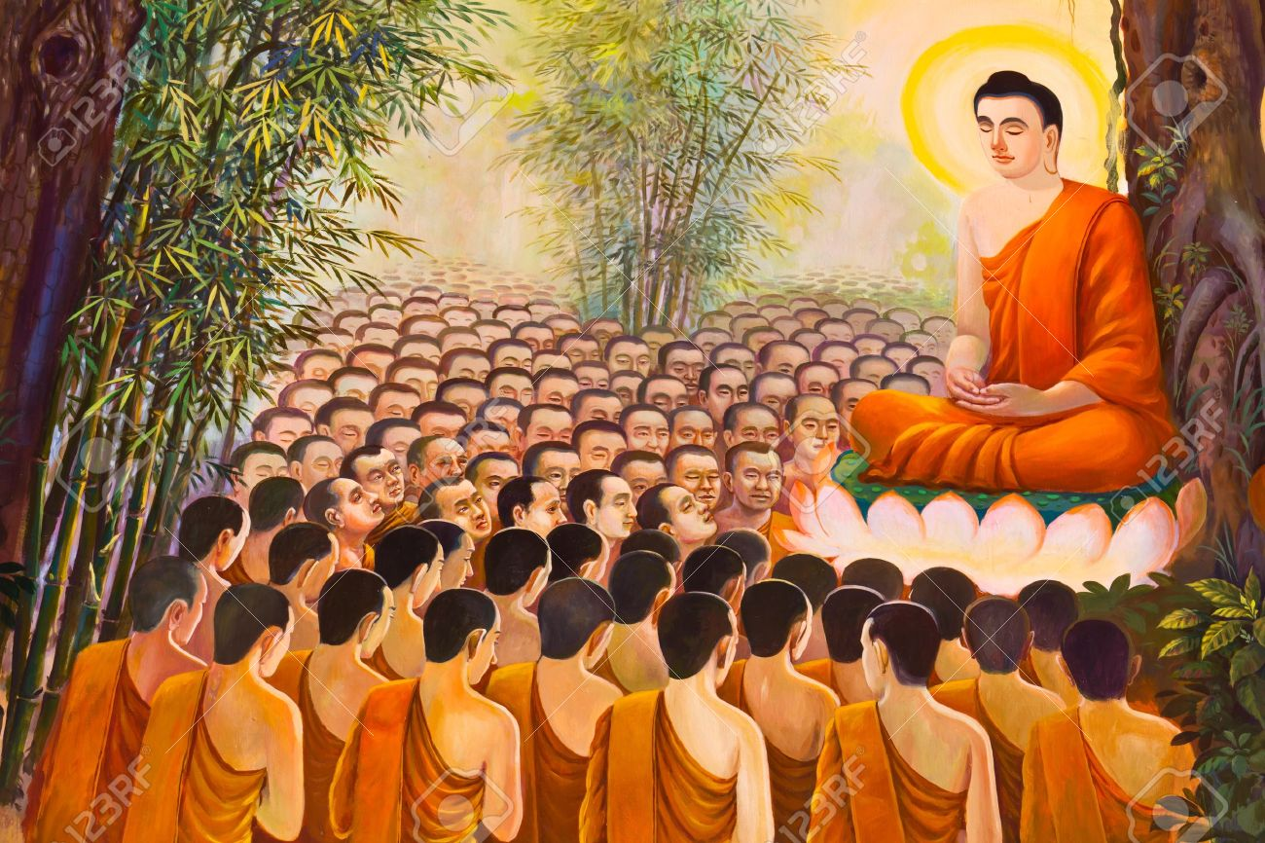
The Buddha Finds Enlightenment (continued)
Siddhartha Gautama found ____________ under a __________.
From that point on, he would be called the ___________ or the “Enlightened ______”
He spent the rest of his ______ traveling across _____ and teaching people his ideas.

Slide 7
Teachings of Buddhism
Buddha was raised ______, and many of his teachings reflected Hindu ideas.
Like Hinduism, he believed that people should act ________ and treat others well.

Slide 8
Four Noble Truths
At the heart of Buddha’s teachings were _____ guiding principles. These became known as the Four __________Truths:
Suffering and _______________ are a part of human life.
_______________ comes from our desires for pleasure and material goods (our wants).
People can ____________ their desires and ignorance and reach nirvana (state of perfect peace)
People can overcome ignorance and desire by following and __________ path that leads to wisdom, enlightenment, and salvation.

Slide 10
Challenging Hindu Ideas
Buddha rejected many of the ideas in the Vedas. For example:
He challenged the authority of the Hindu ___________.
Buddha was opposed to the ________ system. This won him ___________ of the masses!
Buddha did not reject the Hindu teachings of ___________. He felt people who did not reach nirvana would have to be reborn time and time again until they achieved it.
By his death in ____ BC, the Buddha’s influence was spreading throughout India.

Slide 11
Buddhism Spreads in India
Buddha’s followers spread his teachings throughout ____________.
Within 200 years of the Buddha’s death, Buddhism had spread through most of India.
Buddhism continued to grow over the centuries. Eventually, it spread via the __________ into China, then __________ and Japan.

