Slide 1
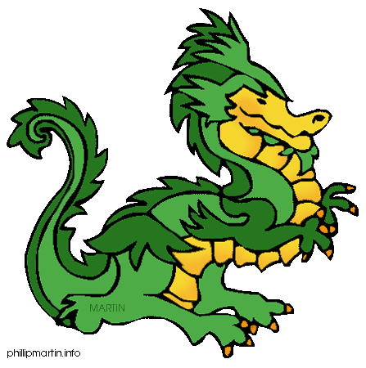
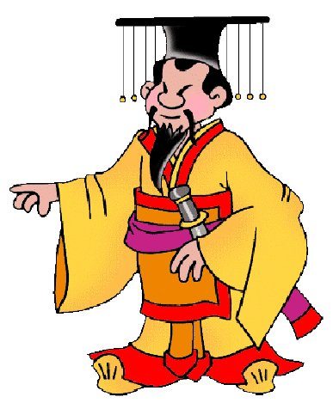
Chapter 22 The First Emperor of China
History Alive!
Pages 215 - 221

Slide 2
22.2 Creating an Empire
Prince Zheng became king at age______.
He would later change his name to Qin Shihuangdi, or ______________________.
Greatly influence by ______________.
Harsh punishments with strict laws and strong ____________________.
He exiled his own _________ fearing that she was plotting against him!

Slide 3
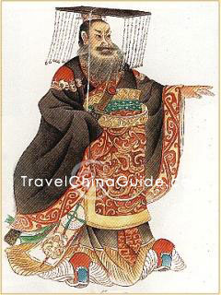

Slide 4
22.3 Standardizing the Culture
Emperor Qin wanted to _______ China.
He _______________cultural practices.
Unified system of ____________.
Based on _____________ beliefs.
To make it easier to trade he standardized:
________________________
______________ & _________________
Simplified ___________________
Only _____________________ approved characters!

Slide 5
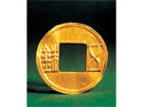
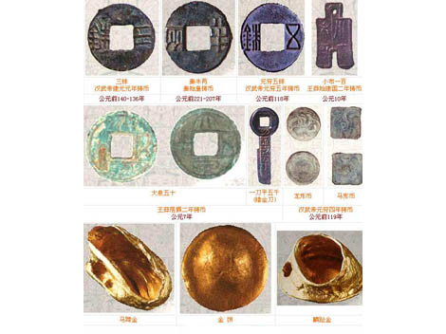
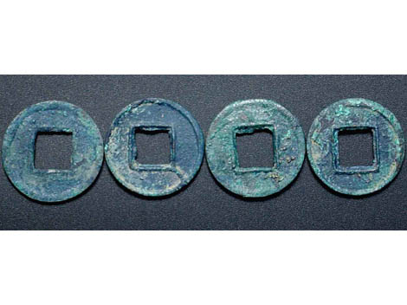

Slide 6
22.4 Protecting the Northern Border
To protect his empire from ___________, Qin ordered a long _____ to be built along China’s ________________ border.
Few traces of the Great Wall ________ today.
Made of layers of __________ pounded into wooden frames.
Construction took _________ years.
Workforce of ________________ men.
Tens of thousands __________ during construction.
The wall proved very effective at stopping ________________________.

Slide 7
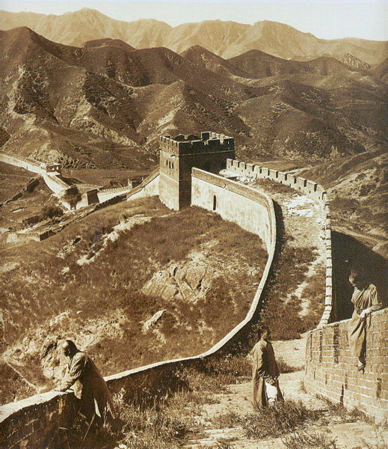

Slide 8
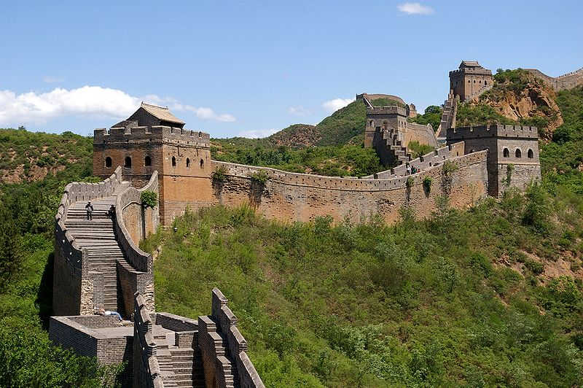

Slide 9
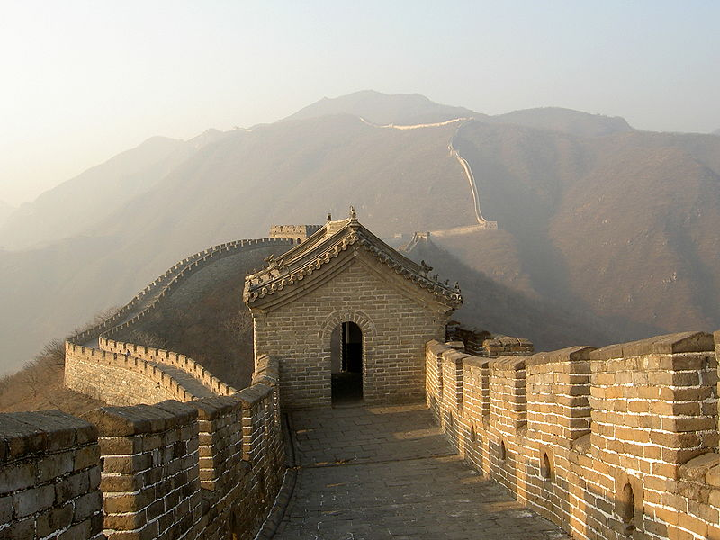

Slide 10
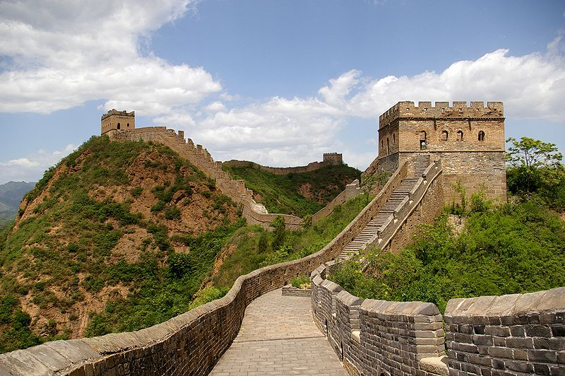

Slide 11
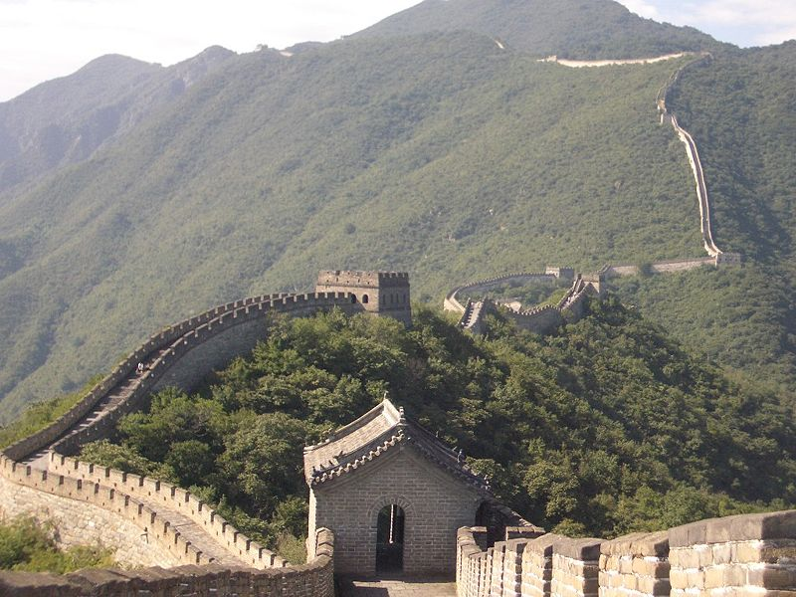

Slide 12
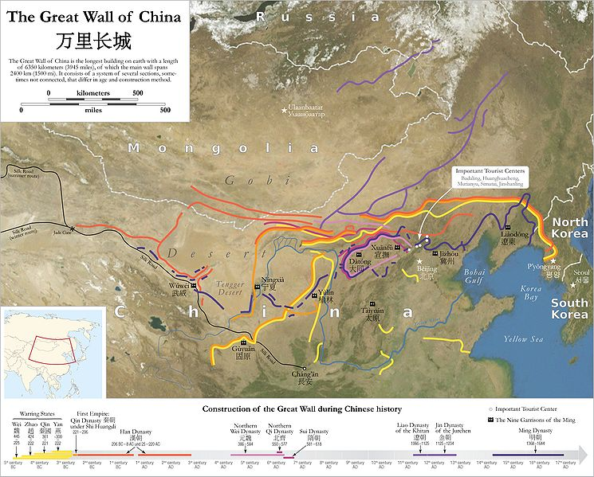

Slide 13
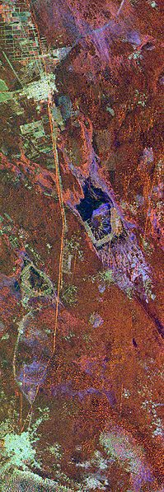

Slide 14
22.5 Ending Opposition
Qin’s changes to China were especially _________________ with Confucian scholars who believe in proper behavior not ___________ rule.
Emperor Qin ordered all ______________ books across China to be _____________.
Anyone who discussed ancient teachings or criticized him would be put to _____________.
Qin’s own ____ was put into forced labor because he criticized the killing of the ___________.

Slide 15
22.6 The Emperor’s Death and the End of the Qin Dynasty
Emperor Qin ruled for only ______ years before his _______________.
No one knows the cause of his __________.
700,000 workers built his elaborate _______.
It was not ___________________ until 1974 only 45 years ago!
It contained jewels, tools, rare objects and the __________________________.
The army consists of _____________ life-size clay figures – no two are _________________!

Slide 16
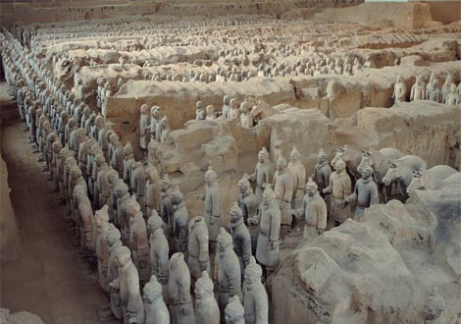

Slide 17
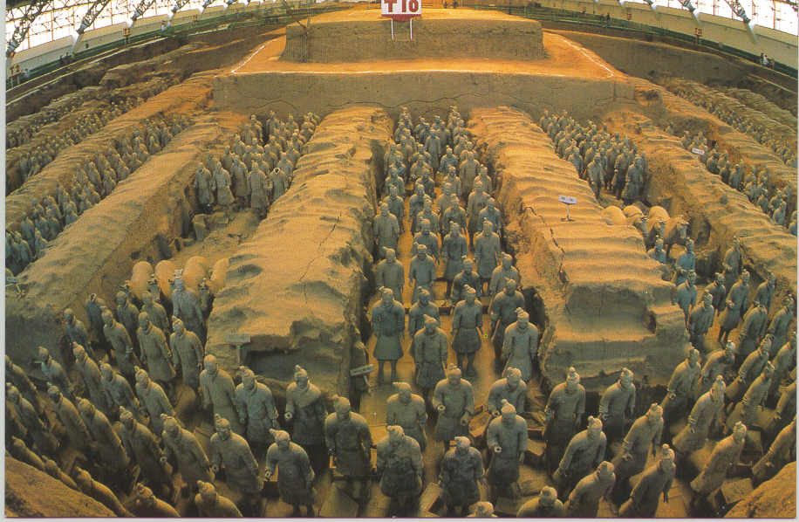

Slide 18
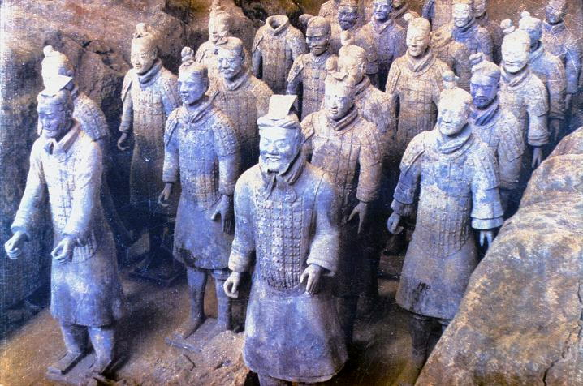

Slide 19
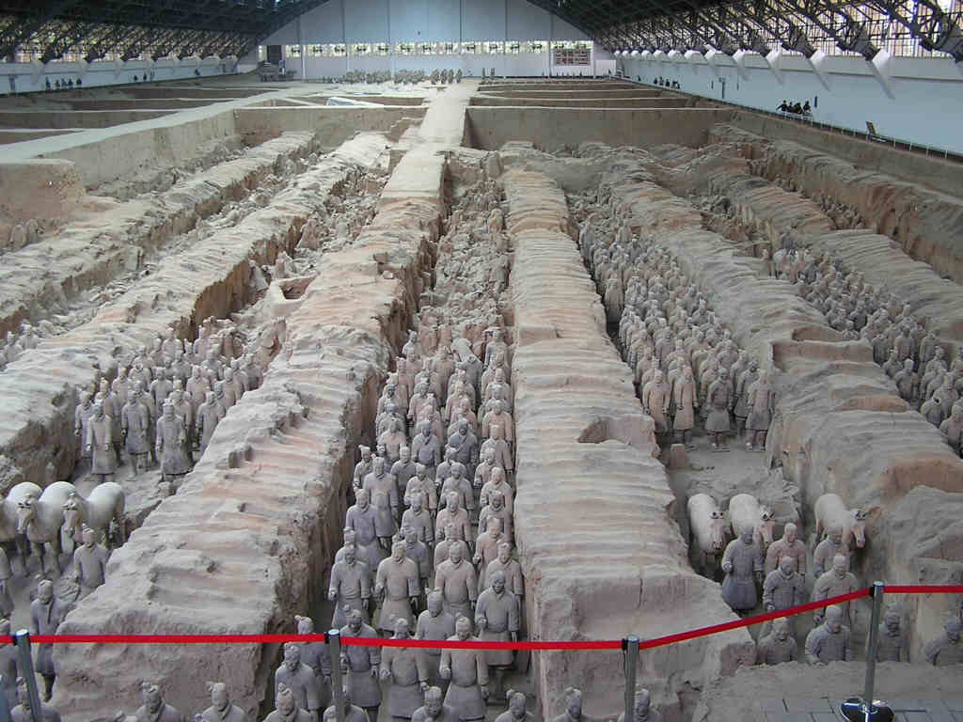

Slide 20
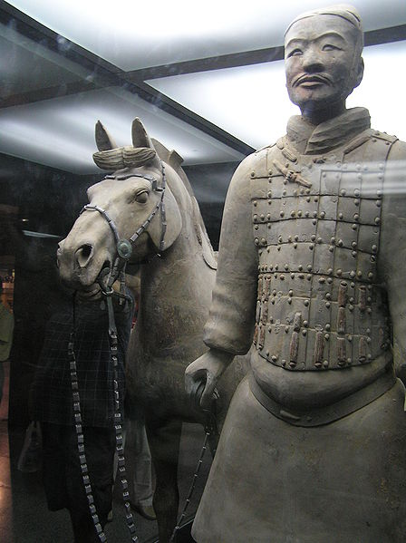

Slide 21
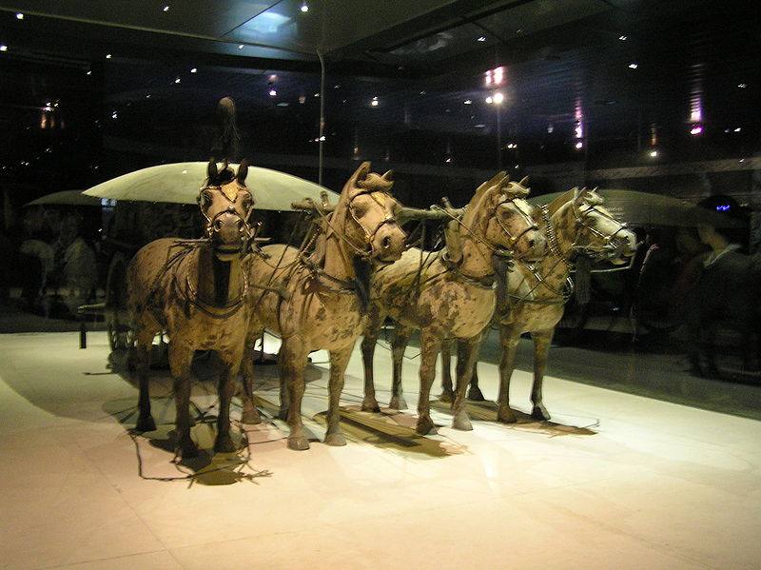

Slide 22
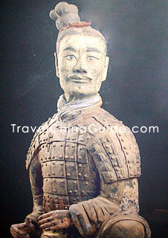

Slide 23
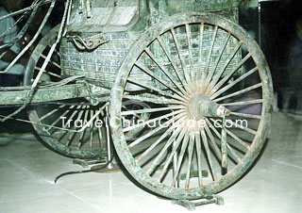

Slide 24
22.6 continued
Emperor Qin said his dynasty would last _________________ years….it fell apart shortly after his _____________.
His harsh rule caused much _________.
Civil war followed as various leaders struggled for _________________.
Finally, ________________, a peasant leader, established the ______________ dynasty.

