Slide 1
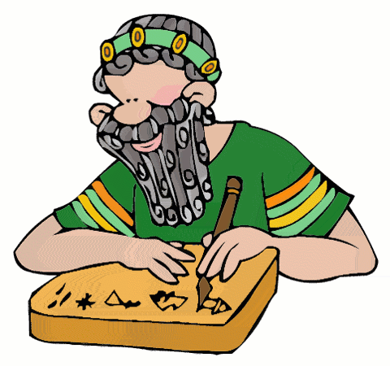
Chapter 5 Section 2 The Rise of Sumer
Pages 122-126

Slide 2
The Main Idea
1. The Sumerians created the world’s first advanced society
2. Religion played a major role in Sumerian society.

Slide 3
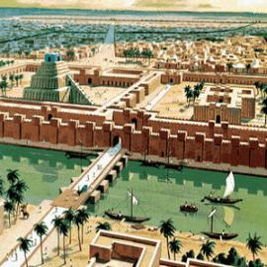
The BIG Idea
The Sumerians developed the first civilization in Mesopotamia

Slide 4
City-States of Sumer
Most people in Sumer were ______________.
A city-state consisted of a central city and all the __________________ around it.
Stronger city-state controlled ___________ areas.
City-states in Sumer fought each other to gain more ______________.
They built ____________ around their cities for _________________.

Slide 5
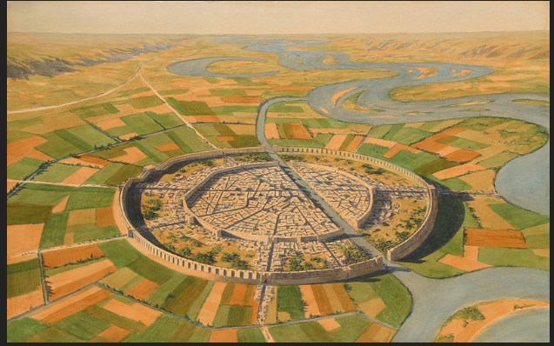

Slide 6
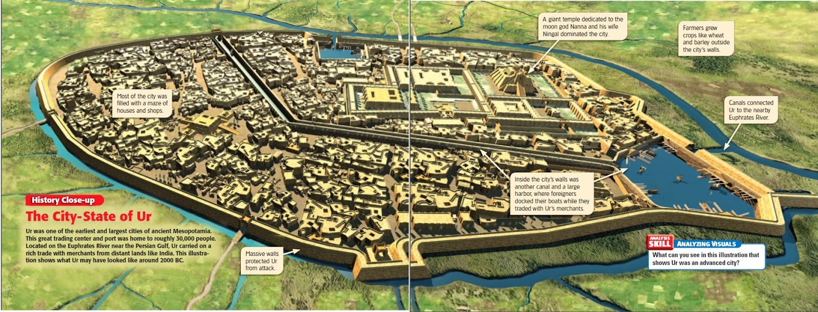

Slide 7
Rise of the Akkadian Empire
The Akkadian Empire developed to the North of Sumer along the Tigris and Euphrates Rivers
The Akkadian ruler, Sargon, defeated the city-states of ________________.
________________ established the world’s first empire, or land with different territories and peoples under a _______________ rule.

Slide 8
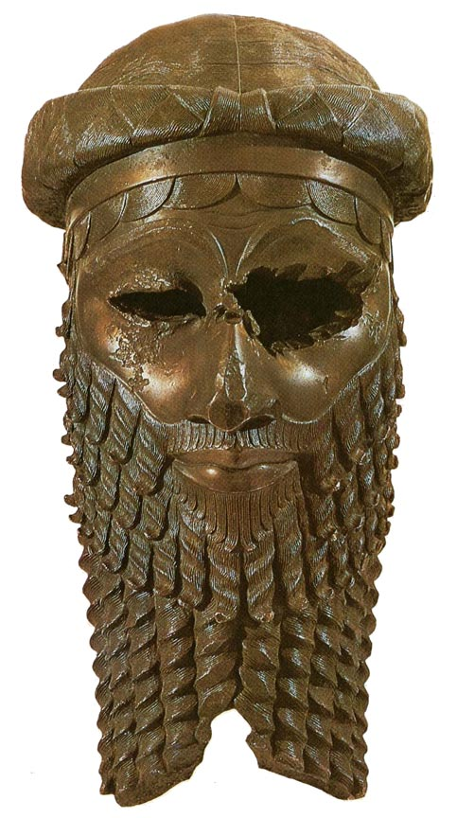
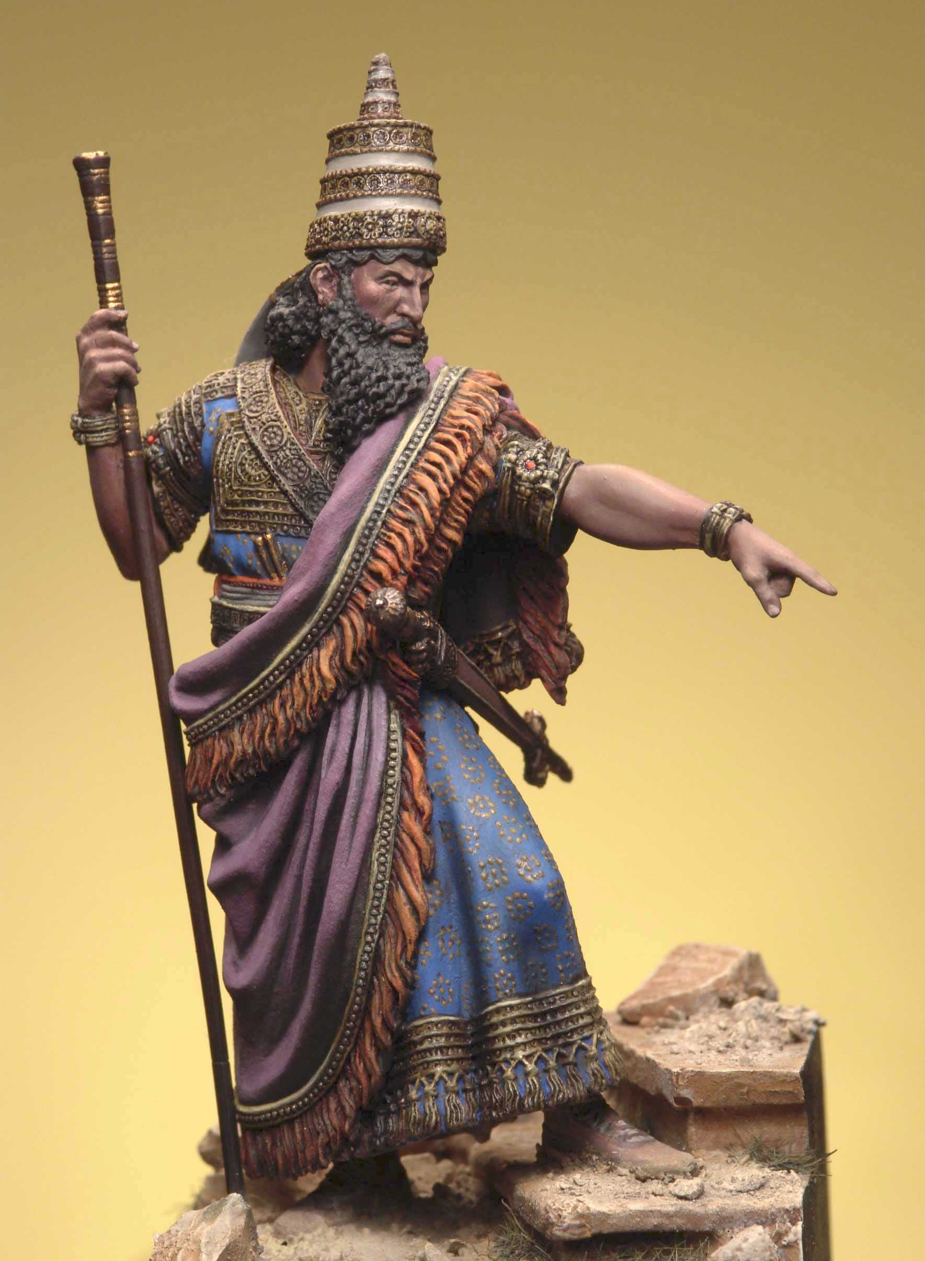

Slide 9
Religion Shapes Society
Religion was very ____________________ in Sumerian society.
It played a role in nearly every aspect of ______________.
Religion was the basis for _________ of Sumerian ______________.

Slide 10
Sumerian Religion
The Sumerians practices polytheism, the worship of many gods.
Monotheism – the worship of only one god.
Each city-state considered one god to be a special protector.
Every Sumerian had to serve and worship the gods.
Priests, people who performed or led religious ceremonies, had great status in society.

Slide 11
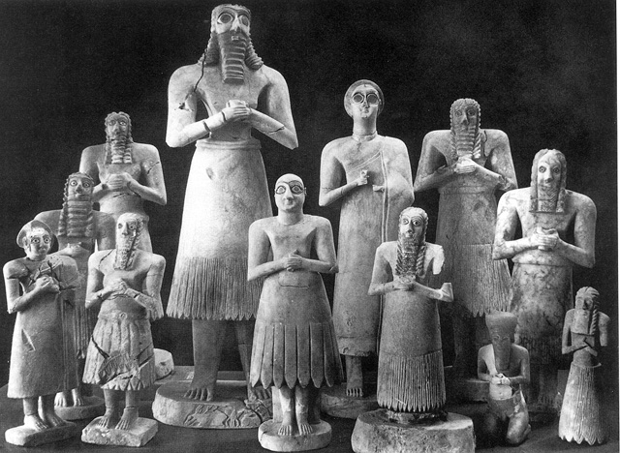

Slide 12
Sumerian Social Order
Social Hierarchy, the division of society by rank or ____________.
Kings were at the ____________.
Sumer claimed that they had been chosen by the ____________ to rule.
Priests were just below the King.
Skilled craftworks
Merchants and ___________
Farmers and ______________
Slaves were at the _________ of the social order.

Slide 14
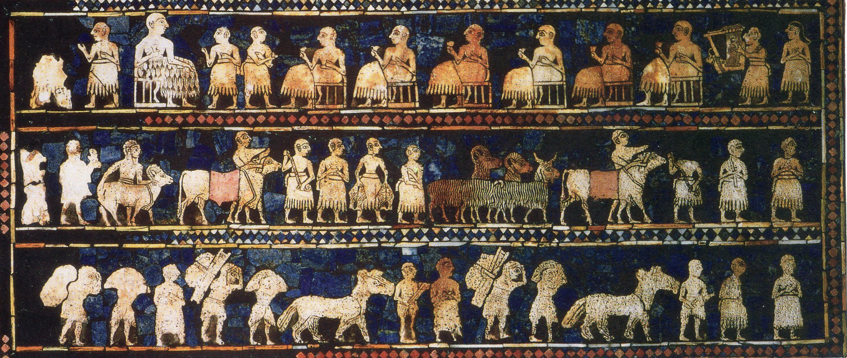

Slide 15
Men and Women in Sumer
Men held _______ power and made _______.
Men usually were allowed to be ______________.
Women took care of the ______ and children.
Some wealthy women were allowed to be educated.
Some ______________ woman were priestesses.

Slide 16
Review Questions
How was Sargon able to build the first empire?
What is polytheism? monotheism?
Why would rulers benefit if they claimed to be chosen by the gods?
What purpose did the wall around the city serve?
Why do you think the temple is the largest building in Ur?

