Slide 1
Origins of Christianity
Chap 6 Section 2
Pages 152-159

Slide 2
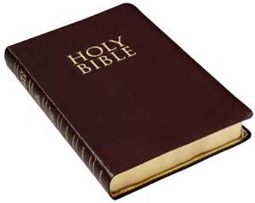
Jesus of Nazareth
Jesus was the man many people believed was the Messiah.
Messiah- a great leader the ancient Jews predicted would come to restore the greatness of Israel.
Christianity- religion in which Jesus’s life and teachings are based.
We know very little about the life of Jesus. Most of what historians do know comes from the bible.
Bible-The holy book of Christianity
The Christian Bible is made up of two parts:
1.Old Testament- same as Hebrew Bible
2.New Testament- the account of life and teachings of Jesus and the early history of Christianity

Slide 3
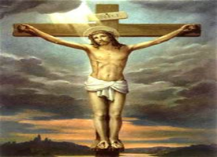
Birth and Crucifixion of Jesus
Jesus was born in Bethlehem
As a young man Jesus lived in Nazareth and probably studied to be a carpenter
He studied Judaism
At the age of 30 he was travelling and teaching Jewish beliefs
His teachings challenged the authority of political and religious leaders
He was arrested and executed for this
He was crucified
Crucified-a type of execution where a person is nailed to a cross

Slide 4
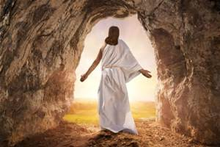
Resurrection
According to Christian beliefs, Jesus rose from the dead and vanished from his tomb three days after he was crucified.
Resurrection- to rise from the dead
Christians believed that the resurrection was a sign that Jesus was the Messiah (messenger of God) and the son of God. They began to call him Jesus Christ. Christos means Messiah in Greek. This is where the words Christianity and Christians developed.

Slide 5
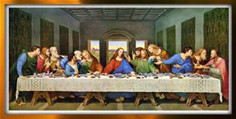
Jesus’s Followers
Apostles-12 men who Jesus chose to receive special teaching.
The apostles were often sent to spread Jesus’s teachings. They continued this after his death.
Gospels- 4 accounts written about Jesus’s life and teachings. These are in the New Testament.
Paul-probably the most important person in the spread of Christianity. He practiced Judaism until he saw a blinding light and the voice of Jesus calling out to him. He then converted to Christianity and spent his whole life traveling and writing to help spread Christianity. He was named as a saint for his work.
Saint- a person known and admired for his or her holiness.

Slide 6
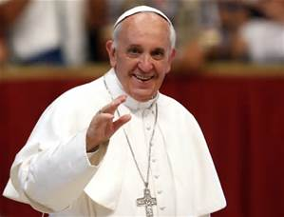
Spread of Christianity
Many Roman leaders became concerned that Christianity was becoming so popular. Officials often arrested and killed Christians who refused to worship the Gods of Rome. This was called persecution.
At times, Christianity was banned from practice in Rome.
Christians often met in secret with bishops (local Christian leaders)from each city.
Eventually the most honored bishop from Rome became known as the Pope. Many people in the west came to see him as the leader of the whole Christian church.
Constantine was the first Roman emperor to accept Christianity. His support of Christianity led to the growth of the religion in Rome and around the world.
Today’s current pope is Pope Frances of Argentina for the Roman Catholic Church.

