Slide 1
Geography Themes and Essential Elements
Section 2
Pages 10 - 15

Slide 2
MAIN IDEAS
The five themes of geography help us organize our studies of the world.

Slide 3
The Five Themes of Geography
The five major themes of geography are:
____________________________________
____________________________________
____________________________________
_________________________________ and
_____________________________________

Slide 4
The Five Themes of Geography
Location: The theme of location describes where something is.
Place: Place describes the features that make a site unique.
Regions: Regions are areas that share common characteristics.
Movement: This theme looks at how and why people and things move.
Human-Environment Interaction: People interact with their environments in many ways.

Slide 5
The Five Themes of Geography
LOCATION
Every point on Earth has a location, a description of where it is.
A specific description like an address is called an absolute location.
A general description of where a place lies is called its relative location (Canada is north of USA).

Slide 6
The Five Themes of Geography
PLACE
Place refers to an area’s landscape, the features that define the area and make it different from other places.
For example, land, climate, and people.
Together, they give a place its own character.

Slide 7
The Five Themes of Geography
HUMAN-ENVIRONMENT INTERACTION
Geographers want to understand how people interact with their environment-how people and their physical environment affect each other.
An area’s environment includes its land, water, climate, plants and animals.
People interact with their environment is many ways. For example, people clear forests, drain wetlands, and build dams to control flooding.
Physical environments affect how people live. For example, people wear thick clothing in cold climates, and build hurricane ‘proof’ structures in coastal areas.

Slide 8
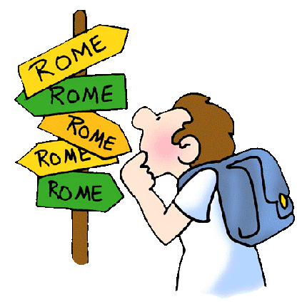
The Five Themes of Geography
MOVEMENT
Geographers want to know why and how people are moving.
Do people move to find work or to find a better climate.
Geographers also study the roads and routes that make movement so common.

Slide 9
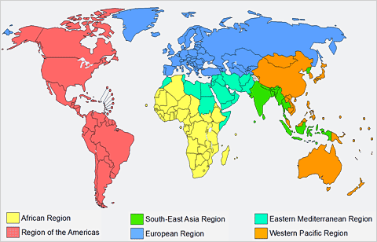
The Five Themes of Geography
REGIONS
Creating regions also makes it easier to compare places.
Comparisons help geographers learn why each place has developed the way it has.

Slide 10
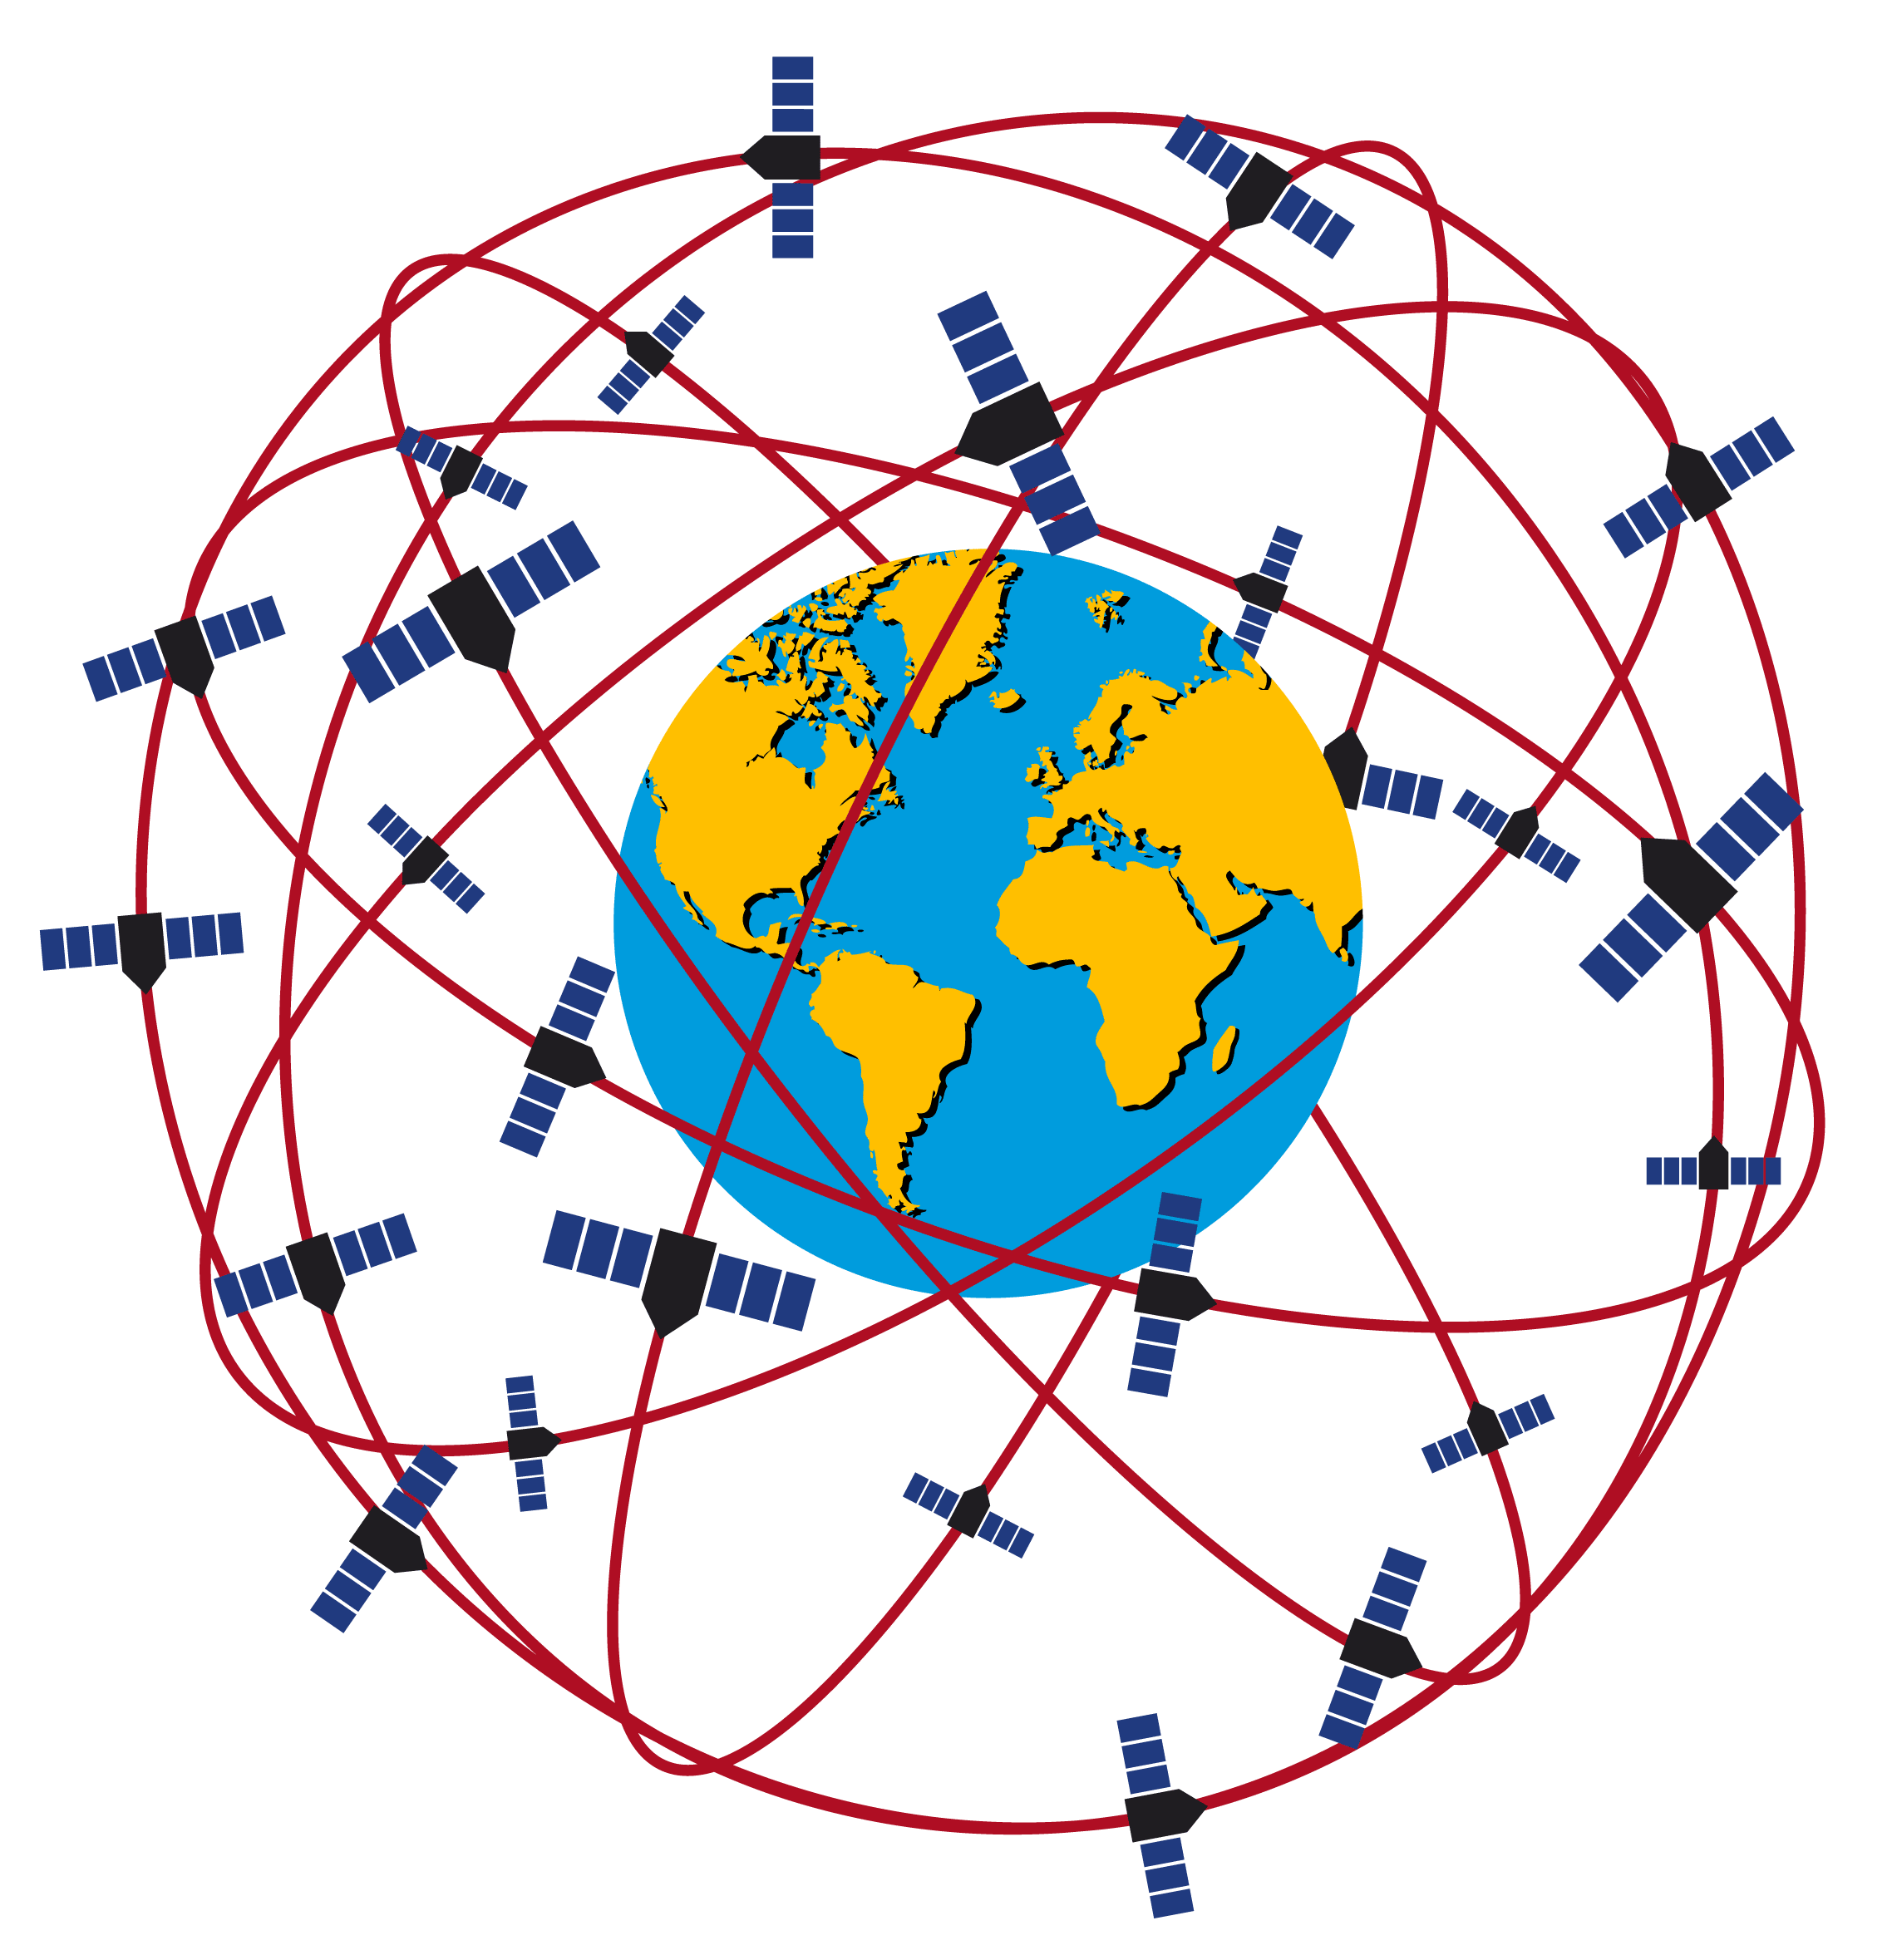
Analyzing Satellite Images
Satellite images are among the geographer’s most valuable tools.
Geographers use two basic types of these images.
True color – these images are like photographs.
Infrared – these are based on heat patterns.

Slide 11
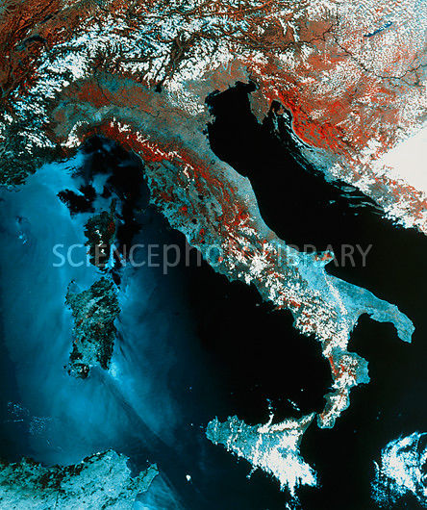
Infrared Satellite image

Slide 12
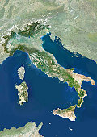
True Color satellite image

Slide 13
Review Items
How are the five themes of geography helpful to geographers?
What are some common interactions between people and their environments?
Which one of the following does not belong: location, place human-environment, language, movement, regions?
Give an example of absolute location.
Give an example of relative location.
What are two examples of people’s actions that are an effect of their environment?

