Slide 1
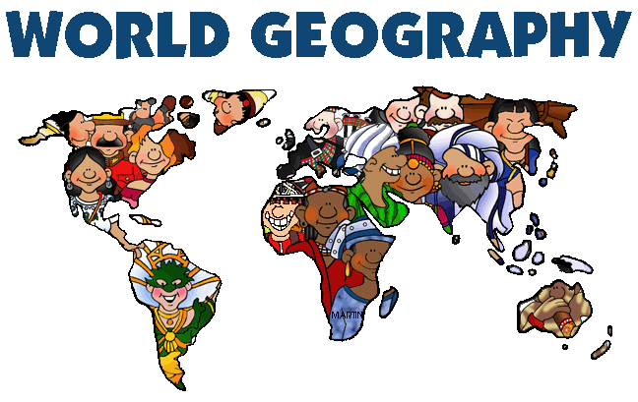
The Branches of Geography
Section 3
Pages 16-20

Slide 2
Main Idea
Physical geography is the study of landforms, water bodies and other physical features.
Human geography focus on people, their cultures, and the landscapes they create.
Other branches of geography examine specific aspects of the physical or human world.

Slide 3
The BIG Idea
Geography is divided into two main branches
1. Physical Geography
2. Human Geography

Slide 4
Physical Geography
Physical geography is the study of the world’s physical features – it’s landforms, bodies of water, climates, soils and plants.
Every place in the world has its own unique combination of these features.

Slide 5
The physical world
Physical geographers want to know what causes the different shapes on Earth.
For example, they want to know why mountain ranges rise up where they do and what causes rivers to flow in certain directions.
Physical geographers take detailed measurements and track any changes that occur over time.

Slide 6
Uses of Physical Geography
One of the major reasons that geographers study the physical world – to learn how it works.
Studying the changes that take place on our planet can help us prepare to live with those changes.
Physical geographers help us adjust to the dangers and changes of our world.

Slide 7
Human Geography
Human geography is the study of the world’s people, communities and landscapes.
It is the second major branch of geography.

Slide 8
The human world
Human geographers study the world’s people, past and present.
They look at:
Where people live and why?
Why some places have more people than other areas?
What jobs people do?
What crops do people grow?

Slide 9
Uses of Human Geography
Human geographers study how people in various places address their needs.
They help people design their cities and towns.
They often work with groups and government agencies who want to protect the environment.

Slide 10
Other fields of geography
Cartography – the science of making maps.
Most maps today are made using computers and satellite images.
Hydrology – the study of water on Earth.
They study the world’s river systems and rainfall patterns.
They work to measure and protect the world’s supply of water.
Meteorology – the study of weather and what causes it.
They use information to predict the weather.

