Slide 1
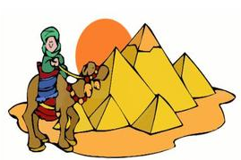
Chapter 11 section 3 The Middle and New Kingdoms
Pages 291 - 296

Slide 2
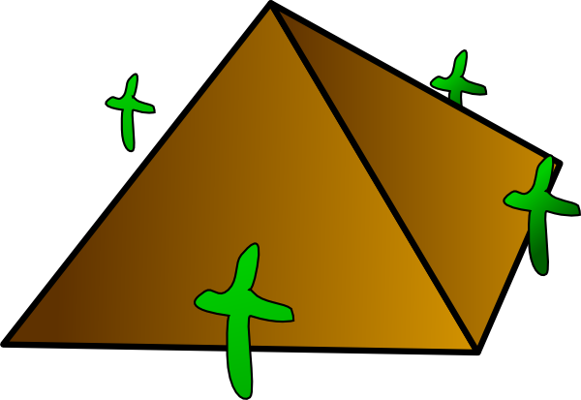
Main Ideas
The Middle Kingdom was a period of stable government between periods of disorder.
The New Kingdom was the peak of Egyptian trade and military power, but its greatness did not last.
Work and daily life differed among Egypt’s social classes.

Slide 3
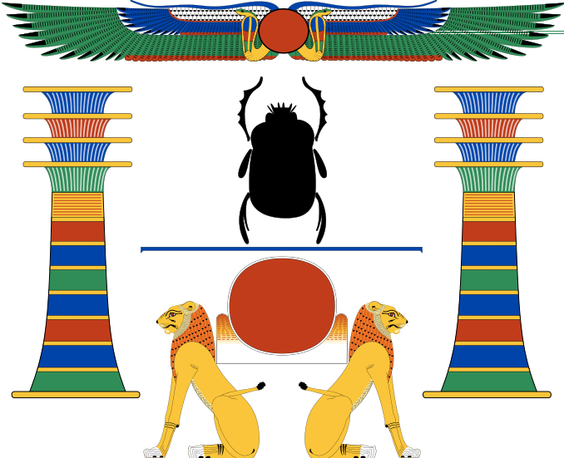
The BIG Idea
During the Middle and New Kingdoms, order and greatness were restored in Egypt.

Slide 4
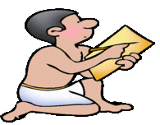
Work and Daily Life
As Egypt’s population grew, it’s
society became even more complex.
Scribes
After priests and government officials, scribes were the most respected people in ancient Egypt.
Scribes kept records and accounts for government officials and temples.
Many scribes became wealthy because they did not have to pay taxes!

Slide 5
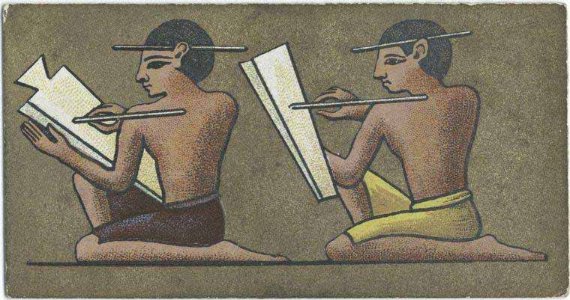

Slide 6
Artisans, Artists and Architects
Artisans made statues, furniture, jewelry, pottery and shoes.
Most worked for the government or temples.
Egypt’s artisans were admired and often paid fairly well.
Talented architects could rise to become high government officials.
Artists worked in the deep burial chambers of the pharaohs’ tombs painting pictures.

Slide 7
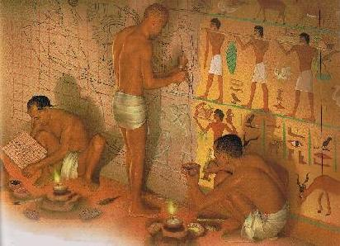
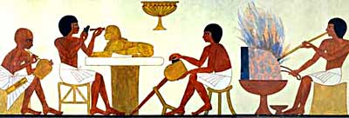

Slide 8
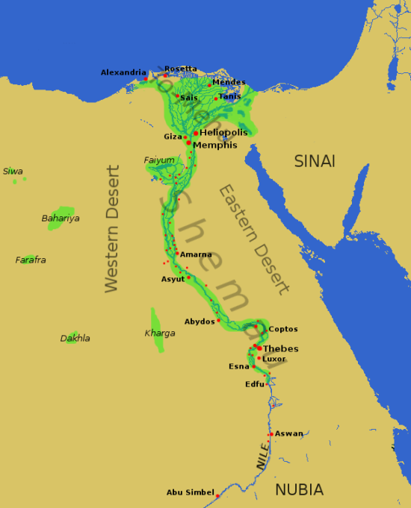
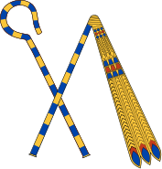
Merchants and Traders
Only a small number of Egyptians became merchants and traders.

Slide 9
Soldiers
The military offered a chance to rise in social status.
Soldiers received land as payment.
Soldiers were allowed to keep any treasure they captured in war.
Soldiers who excelled could be promoted to officer positions.

Slide 10
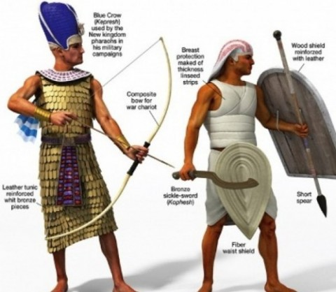

Slide 11
Farmers and Other Peasants
These hardworking people made up the vast majority of Egypt’s population.
Farmers had to give some of their crops to the pharaoh as taxes.
The taxes were to pay for the use of the land.
Under Egyptian law, the pharaoh controlled all land in the kingdom.
All peasants, including farmers, were also subject to the pharaoh’s commands to work on any project he wanted built.
For example, building pyramids, mining gold, building temples or fighting in the army.
Workers were paid in grain.

Slide 12
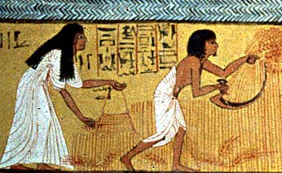

Slide 13
Slaves
There were few slaves in Egyptian society.
They were considered lower than farmers.
Many slaves were convicted criminals or prisoners captured in war.
Egyptian slaves did have some rights.
In some cases, slaves could earn their freedom.

Slide 14
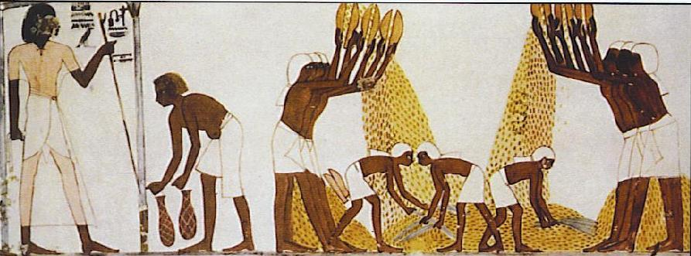

Slide 15
Family Life in Egypt
Family life was very important in Egyptian society.
Most Egyptians lived in their own homes.
Egyptian women had a number of legal rights.
They could own land, divorce and make contracts.
Most children, boys and girls, received some education – math, sports and writing.
At age 14, boys left school to enter their father’s profession.

Slide 16
