Slide 1
Chapter 11 section 4 Egyptian Achievements
Pages 298 - 303

Slide 2
Main Ideas
Egyptian writing used symbols called hieroglyphics.
Egypt’s great temples were lavishly decorated
Egyptian art filled tombs.

Slide 3
The BIG Idea
The Egyptians made lasting achievements in writing, art and architecture.

Slide 4
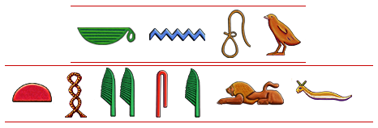
Egyptian Writing
The Egyptian writing system, or hieroglyphics, were one of the world’s first ______________ systems.

Slide 5
Writing in Ancient Egypt
Earliest known examples of Egyptian writing are from around ___________ B.C.
Egyptians learned how to make ______________, a long-lasting, paper like material made from _______________.
The hieroglyphic writing system used more than _________ symbols, mostly pictures of objects.
Hieroglyphics could be written horizontally or __________________.

Slide 6
The Rosetta Stone
In 1799, a French ___________ discovered a huge __________ slab inscribed with hieroglyphics, Greek and a later form of Egyptian.
The message was the ________ in all three languages.
Scholars who knew Greek were able to figure out what the hieroglyphics said.

Slide 7
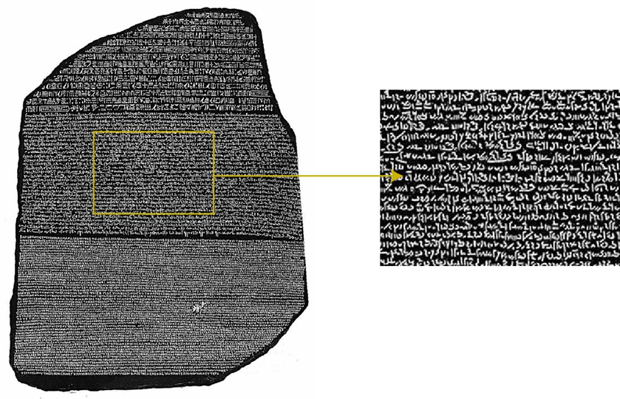
ROSETTA STONE

Slide 8
Egyptian Texts
Because papyrus did not _________ in Egypt’s dry climate, many ancient Egyptian texts still ____________.
These texts include, medical manuals, historical records, science text, and even literary works such as The Book of the ____________.

Slide 9
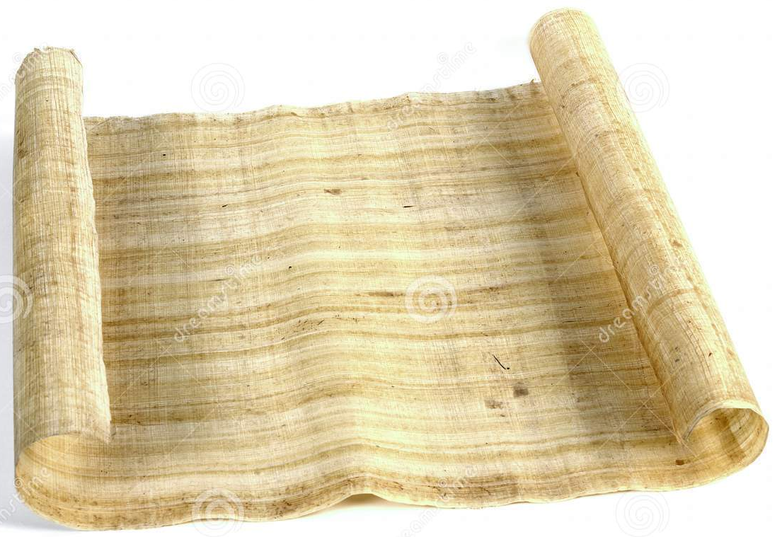
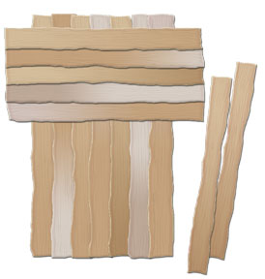
PAPYRUS

Slide 10
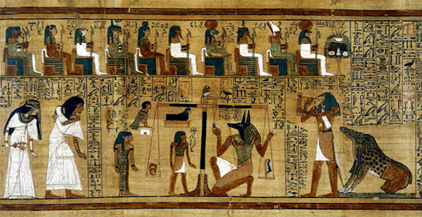
The Book of the Dead

Slide 11
Egypt’s Great Temples
Egyptians built massive ________________.
These are considered some of the most spectacular sites in Egypt today.
Egyptians believed that temples were the _______________ of the gods.
Similar features of many temples:
Rows of ______________ and obelisks lined the entrances.
The Temple of Karnak, Abu Simbel and Luxor are just a few of the great temples of Egypt.

Slide 12
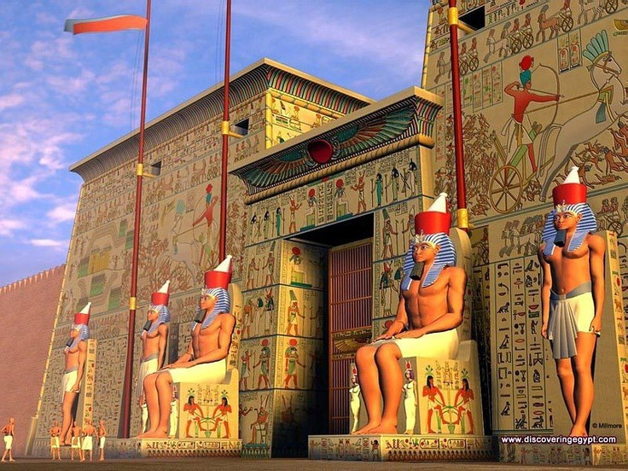

Slide 13
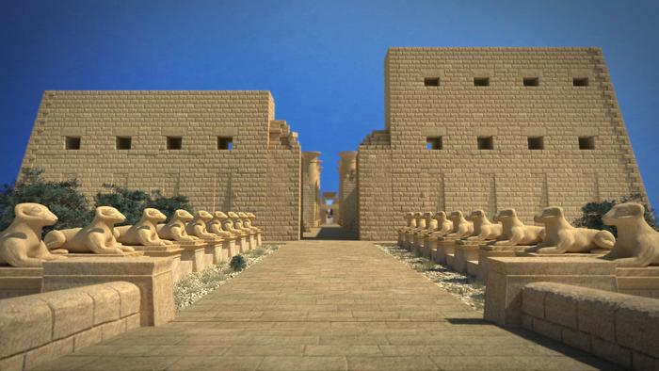

Slide 14
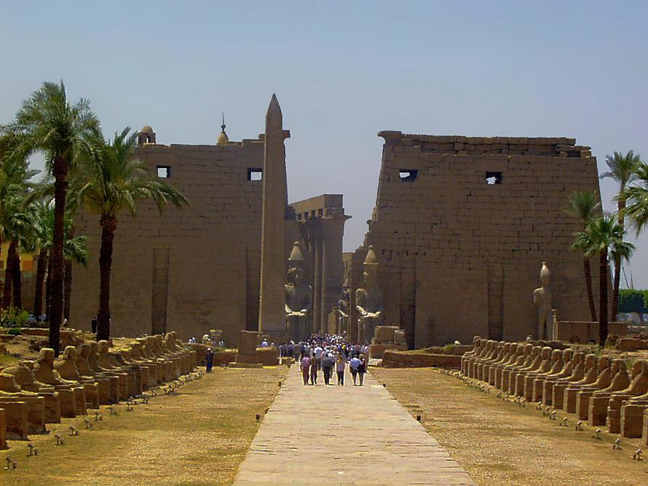

Slide 15
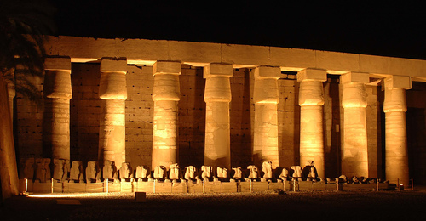

Slide 16
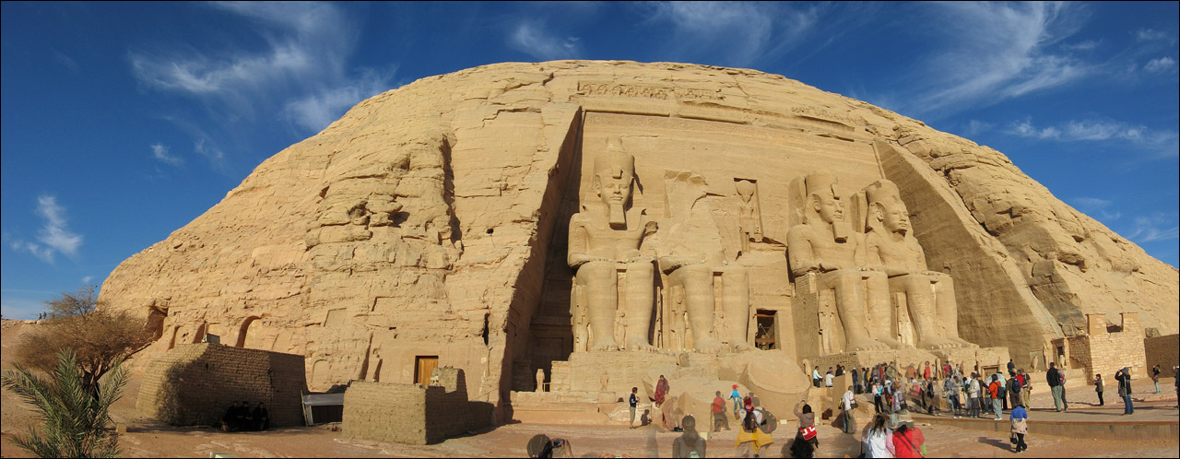

Slide 17
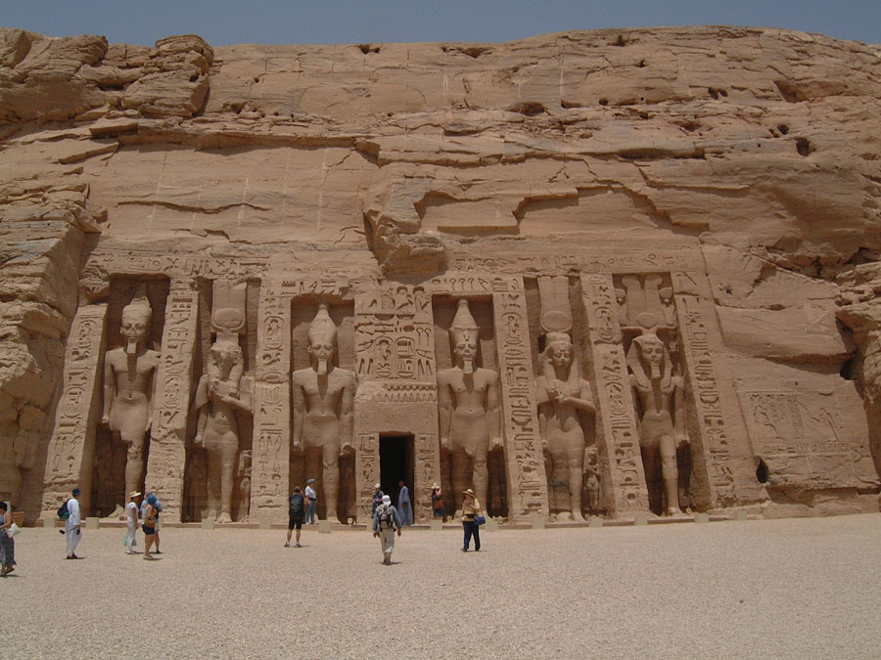

Slide 18
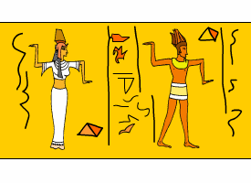
Egyptian Art
One reason Egypt’s temples are so popular is because of the __________ they contain.
Many of their greatest works were created to fill the ____________ of pharaohs and other nobles.

Slide 19
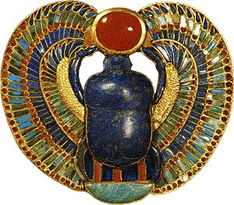
Paintings
Egyptian art was filled with lively, _____________ scenes.
Most Egyptian’s never _____ the paintings.
Only kings, priests and important people could enter temples and tombs.
Egyptian paintings has a ______________ style.

Slide 20
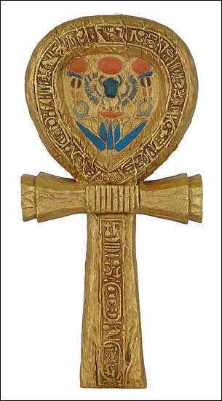
Carvings and Jewelry
The Egyptians were also skilled stoneworkers.
Many tombs included huge ___________ and detailed carvings.
In _______, archaeologist Howard Carter discovered the tomb of King ________. Unlike most Egyptian tombs, it had never been _____ and was still filled with treasures.

Slide 21
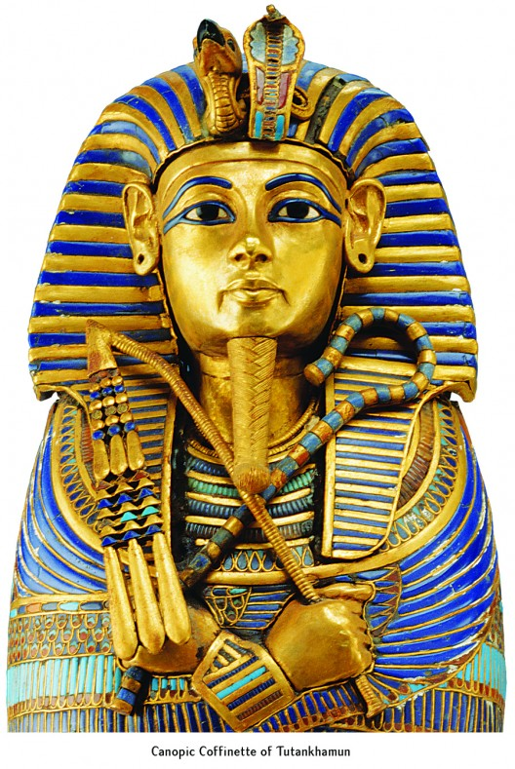

Slide 22
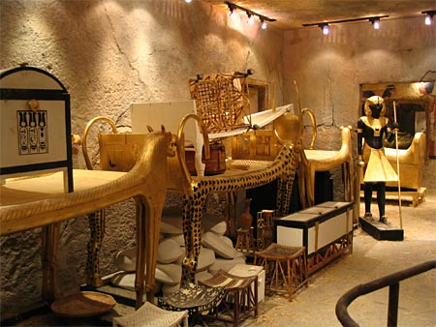

Slide 23
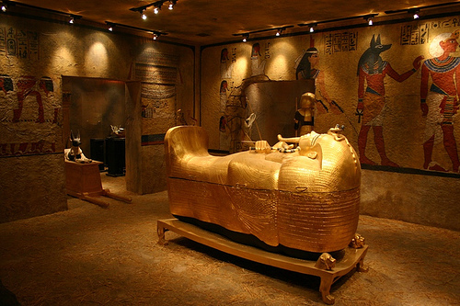

Slide 24
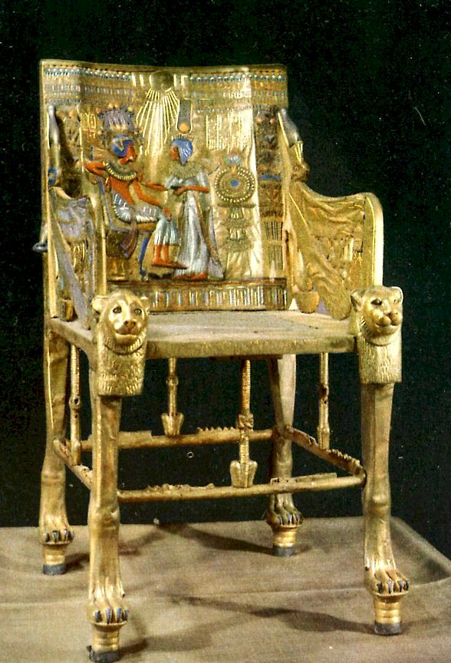
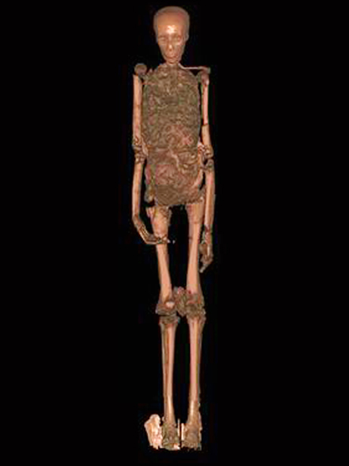

Slide 25
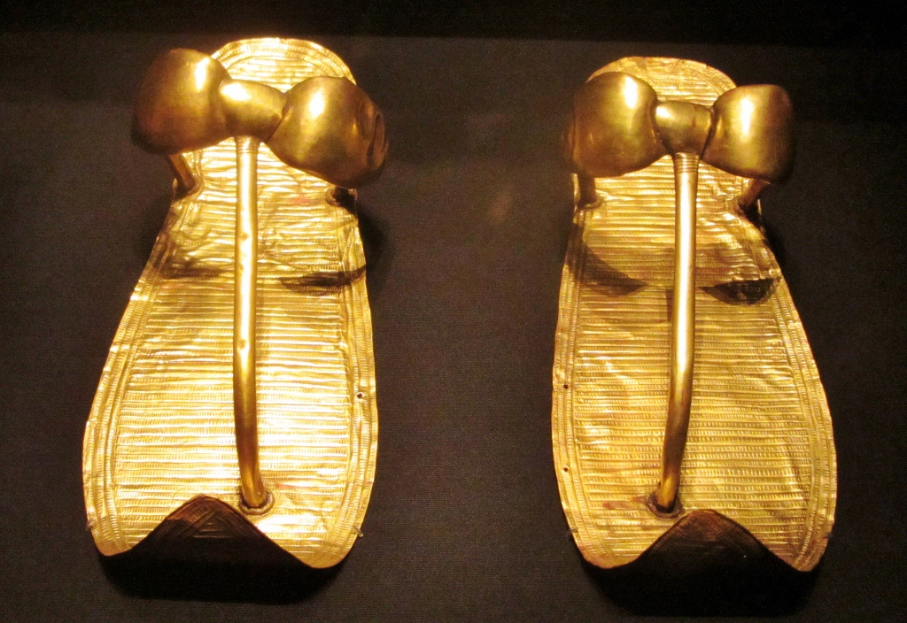

Slide 26
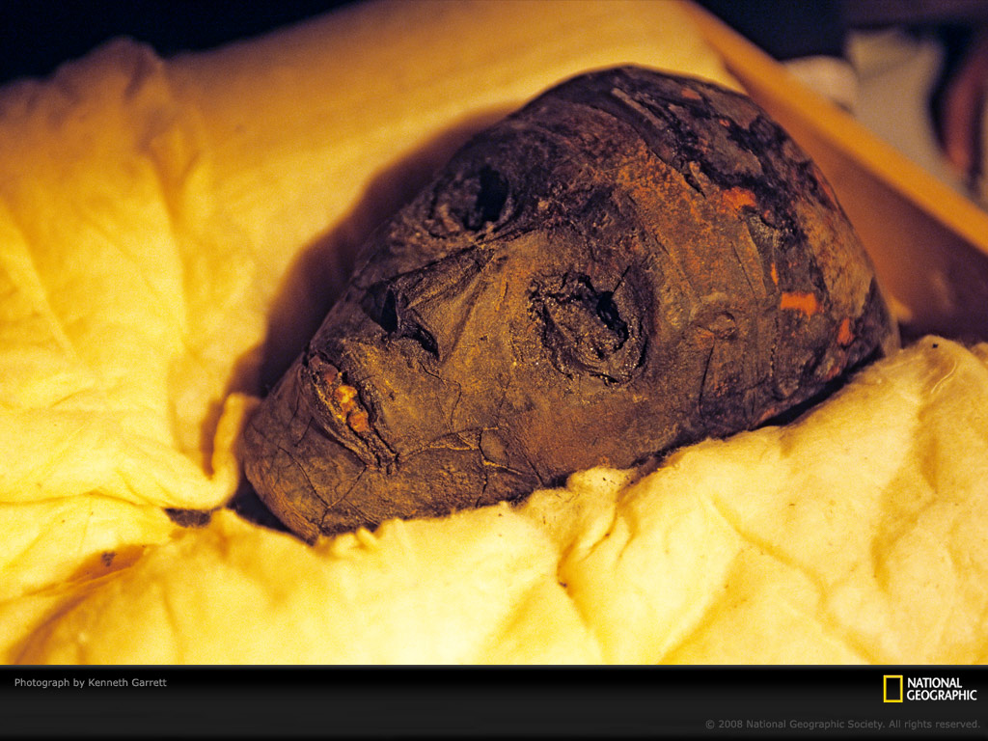

Slide 27
