Slide 1
Chapter 19 China
History Alive!
Pages 182 - 193

Slide 2
19.1 Introduction
It’s easy to use words like highest, largest, and longest when talking about China’s _____________________.
China’s climate is just as _______________ as its physical features.
China is a land of _______________________.

Slide 3
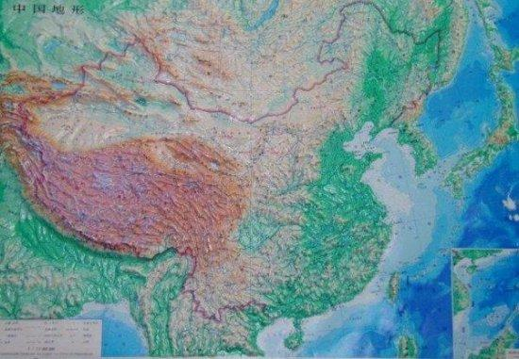

Slide 4
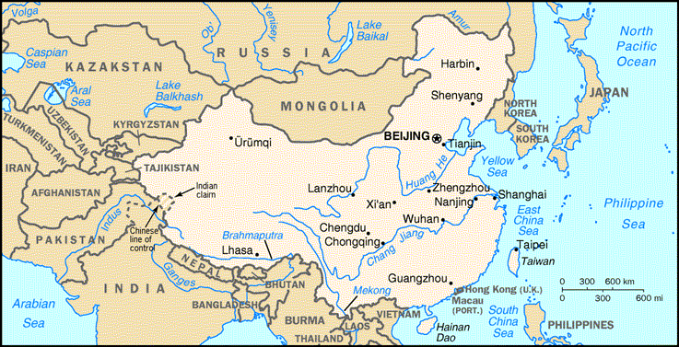

Slide 5
19.2 An Overview of China’s Geography
Modern China is the world’s ________ largest country.
3.7 ________________________ square miles
China has the world’s ______________ population with
1.2 ______________ people.
Inner China was much ______ than modern day China
Southwest China is bound by the ____________ Mtns.
The Tibet-Qinghai ________________is the world’s largest __________________ .
There are only 50 days a year without freezing temps!
The northwest contains the Northwest _____________.
Turfan Depression is _______________ below sea level!
The northeast has the Northeastern Plains.
Short ______ summers. Winters are long, dry and ____.

Slide 6
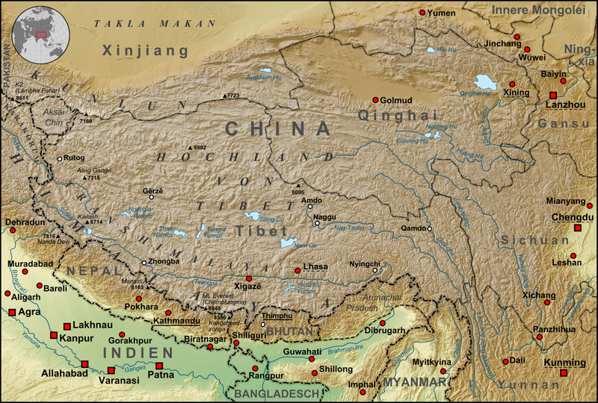

Slide 7
19.2 The Geography of Inner China
It is a land of rolling ________, river ___________ and _________________.
Rivers often ________________ the soil with flooding.

Slide 8
19.3 The Tibet-Qinghai Plateau
The Tibet-Qinghai plateau is called the “____________________________”
Average elevation is ________________________ feet .
Covers __________% of China.
The climate is very ________.
The air is thin and ________.
Snow falls even in the _____________ months!
The cold, rocky plateau and the high mountains made travel through this area to Inner China very ___________________.

Slide 9
19.4 The Northwestern Deserts
The only places to grow crops or raise animals such as sheep are the __________, where ______ can be found.
_________ – place where water can be found in a desert.
Taklimakan Desert
_____________________ square miles.
Name means “Once you go in, you will not come out.”
One of the world’s most _____________________deserts.
The Gobi Desert
World’s _____________ desert at ________ square miles
Most of the desert is stony, not sandy!

Slide 10
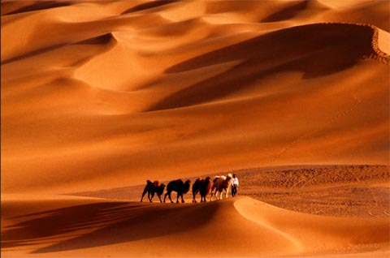

Slide 11
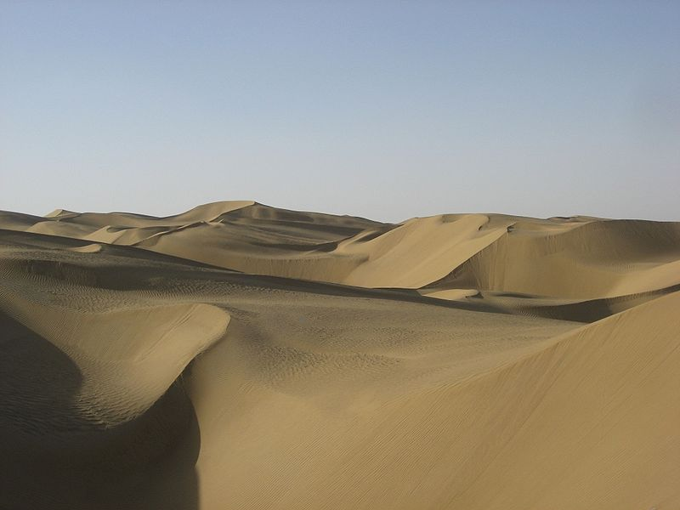

Slide 12
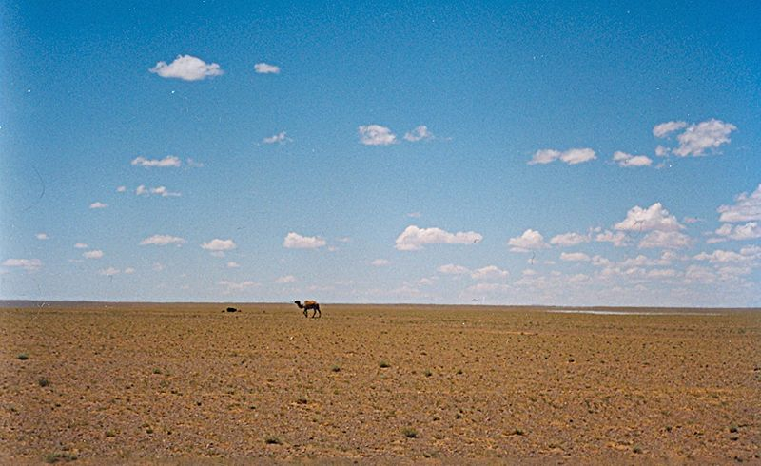

Slide 13
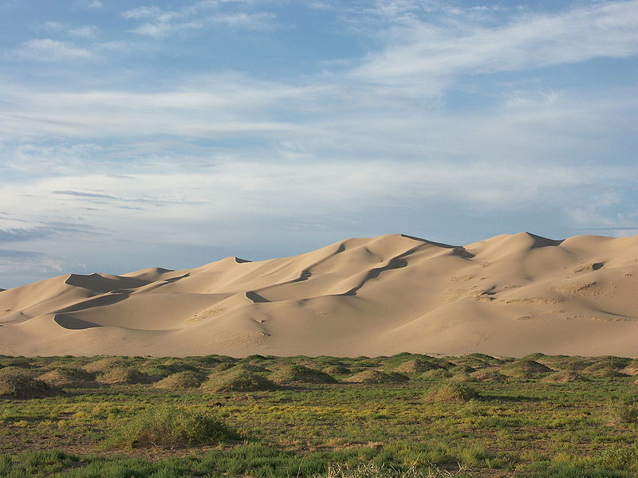

Slide 14
19.5 The Northeastern Plain
No _______________ for this page ☺

Slide 15
19.6 The North China Plain
This area is a flat region of ________________.
Called the “Land of the ____________ Earth” because of the ground is covered by yellow _____________ silt.
_______________ – fine particles of rock.
The yellow silt is how the Huang He (Yellow River) got its name.
The Huang He River is one of the _____________ rivers in the world.
The fresh water along with the rich silt helps to make the China Plain a good place to grow ______________.

Slide 16
19.7 The Middle and Lower Chang Jiang Basins
People use the river to move ___________ between eastern and western areas of the region.
_______________ – a stream that feeds into a larger river.
The river floods and leaves behind rich ___________.
The silt provides _______________ farm land.
The climate is warm and wet.
The basins were good for growing ____________, which needs lots of warmth and moisture.

Slide 17
19.8 Early Settlement in Ancient China
Archeologists believe that the first inhabitants of China lived in caves more than ___________ years ago.
When people in China began farming, they settled mostly on the _____________________ in Inner China.
They grew crops and lived in villages near the ___________________________.
This marked the _________________________ of settled Chinese society.

Slide 18
19.9 Ancient China’s Isolation
China’s geography kept the early settlements in Inner China ___________________.
These same geographical features also made it difficult to ___________________ China as one unified state.

Slide 19
19.10 Different Regions, Different Ways of Life
Life in Outer China
Fewer people settled in _________________ China.
Early settlers to the plains were _______________. They were constantly moving to find grass for their animals, so they lived in ____________.
In the Northwestern Deserts, people built homes of mud, grew cotton, wheat, and maize. They settled near a _____________________.
_________________ – a type of corn
_________________ – meat from sheep

Slide 20
19.10 Different Regions, Different Ways of Life (continued)
Life in Inner China
Most people settled on the fertile North China Plain.
They grew _____________ and ______________.
________________ – a type of grain.
People built _________________ homes and raised a variety of _____________________.

