Slide 1
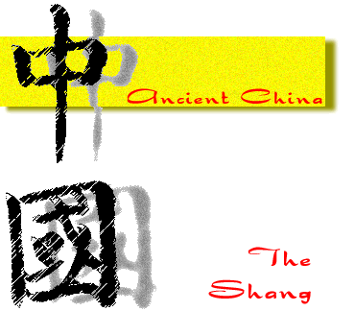
Chapter 20 China
History Alive!
The Shang Dynasty
Pages 195 - 203

Slide 2
20.1 Introduction
The _______________was a clan that became powerful enough to control all of ancient China.
The Shang (pronounced shung) was one such clan.
For _____________ of years, the Shang dynasty was considered to be a __________ by western scholars.

Slide 3
21.2 QUESTION
____________________________________________________________________________________________________________________________________________________________________________________________
ANSWER
________________________________________________________________________________________________________________________________________________________________________________________________________________________________________________________________________________________________________________________________________________________________________________________

Slide 4
20.2 A Shang Capital City
Archeologists unearthed many items at the Anyang ruins in 1928. Some of these items include:
_________________
_________________
_________________
_________________, ______________ and ___________
Human bones used during ________________________.
Historians believe that the Shang kings believed in an ________________________.

Slide 5
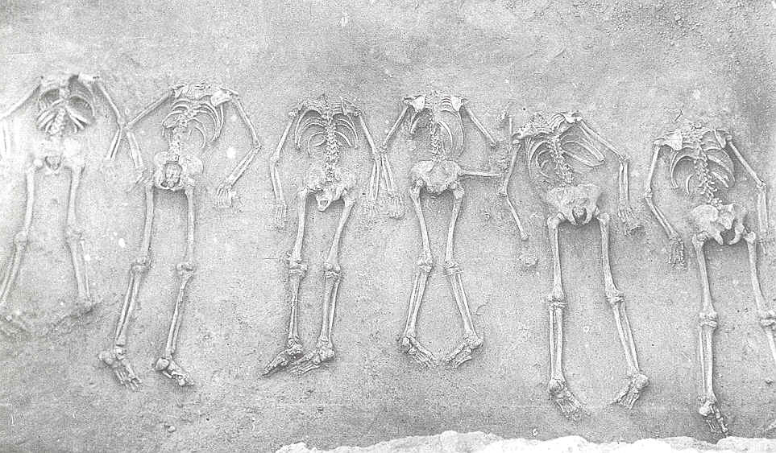

Slide 6
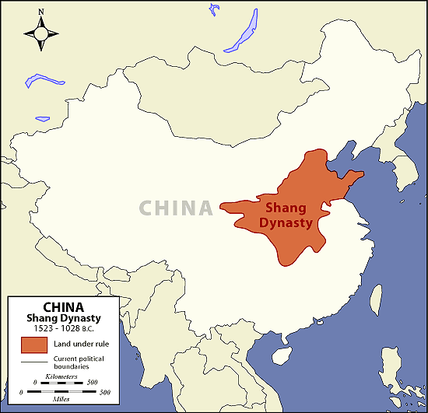

Slide 7
21.3 QUESTION
____________________________________________________________________________________________________________________________________________________________________________________________
ANSWER
________________________________________________________________________________________________________________________________________________________________________________________________________________________________________________________________________________________________________________________________________________________________________________________

Slide 8
20.3 Shang Government
The Shang government was led by a powerful _______ who controlled the _________________.
The Shang kings depended on __________________ to maintain their rule.
The king’s armies were especially powerful because Shang nobles had weapons made of _______________.
The armies were made up of large numbers of _____________, _________, ____________________ and __________________, and fighters in chariots.

Slide 9
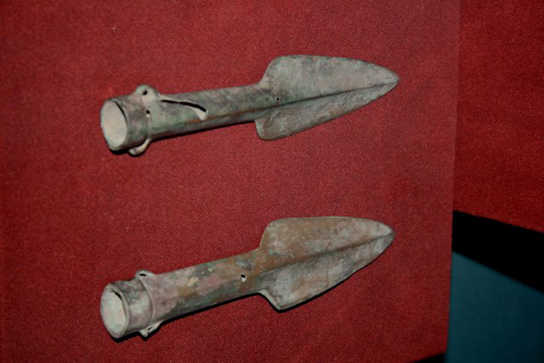

Slide 10
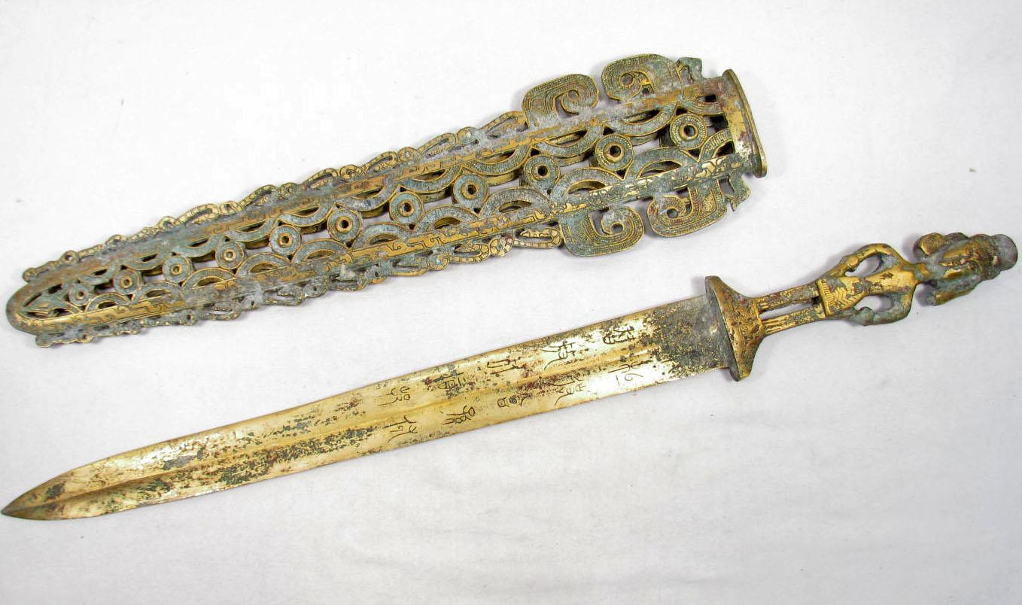

Slide 11
21.4 QUESTION
____________________________________________________________________________________________________________________________________________________________________________________________
ANSWER
________________________________________________________________________________________________________________________________________________________________________________________________________________________________________________________________________________________________________________________________________________________________________________________

Slide 12
20.4 Shang Social Classes
Shang society can be divided into _______ social classes.
The king and his family were at the ___________.
______________ made up the highest-ranking social class.
They enjoyed a life of luxury.
___________________________ formed a small social class.
They made the bronze weapons.
Traders
______________________
Largest social class in Shang society.
They did not own the land.
They were forced to give nearly all of their crops to the _________________ or _________________.
__________________
They were often captured in wars.
They spent their lives building tombs and ______________.
They would be ____________ when their masters died.

Slide 13
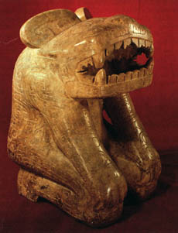

Slide 14
21.5 QUESTION
____________________________________________________________________________________________________________________________________________________________________________________________
ANSWER
________________________________________________________________________________________________________________________________________________________________________________________________________________________________________________________________________________________________________________________________________________________________________________________

Slide 15
20.5 Religion Under the Shang
The religion of the Shang centered on _________________ worship.
The Shang believed in a _______ after __________.
They belied that dead ancestors had power to help or ________ the living. Therefore, they believed it was important for people to honor their ancestors.
Kings used oracle bones to ask ancestors’ _________.
A holy man made a statement on the animal bones. He would then press a ____________ through the bones. The bones would _________. A holy many would then translate the “_______________”
Today, the oracle bones tell us much about life in ancient China.

Slide 16
20.5 QUESTION
____________________________________________________________________________________________________________________________________________________________________________________________
ANSWER
________________________________________________________________________________________________________________________________________________________________________________________________________________________________________________________________________________________________________________________________________________________________________________________

Slide 17
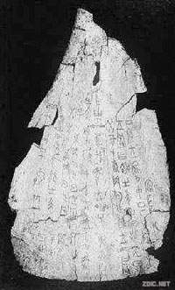
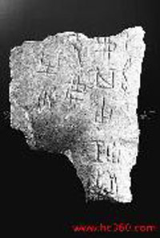
These are an example of __________________________________________

Slide 18
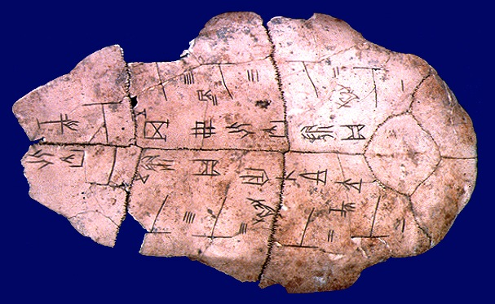

Slide 19
20.6 Writing Under the Shang
The inscriptions on oracle bones are among the earliest known examples of Chinese _______________.
Characters stand for ____________ rather than sounds.
People used logographs.
___________ – a written character that represents a word
Having a ___________ language helped to unify the Chinese people.

Slide 20
20.6 QUESTION
____________________________________________________________________________________________________________________________________________________________________________________________
ANSWER
________________________________________________________________________________________________________________________________________________________________________________________________________________________________________________________________________________________________________________________________________________________________________________________

Slide 21
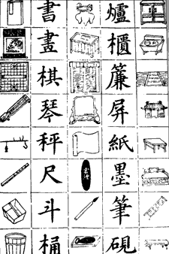

Slide 22
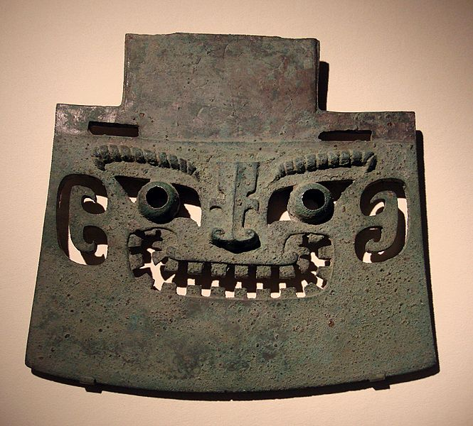
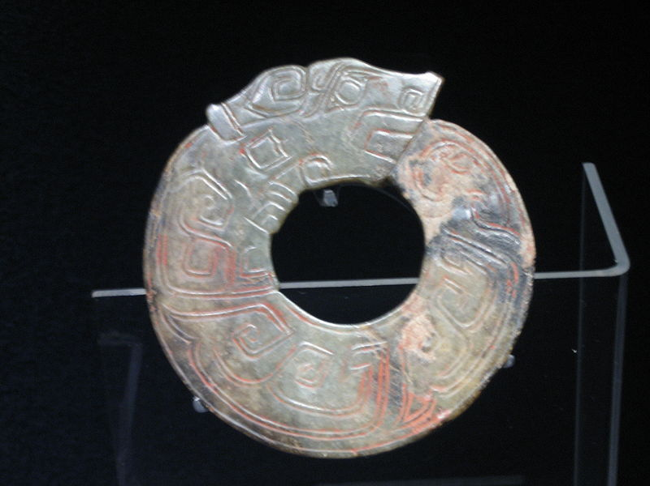
20.7 Art Under the Shang
Shang artists showed great skill in working with ________________.
Bronze is a metal made of ____________ and ________.
The Shang also produced outstanding jade pieces.
__________________ is a very hard stone.
Jade Circle Dragon
Bronze Ax

Slide 23
20.7 QUESTION
____________________________________________________________________________________________________________________________________________________________________________________________
ANSWER
________________________________________________________________________________________________________________________________________________________________________________________________________________________________________________________________________________________________________________________________________________________________________________________

Slide 24
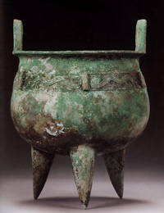
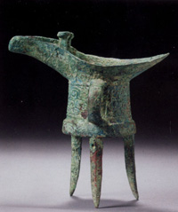
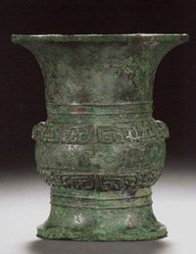
Ancient Chinese Bronze Craftsmanship

Slide 25
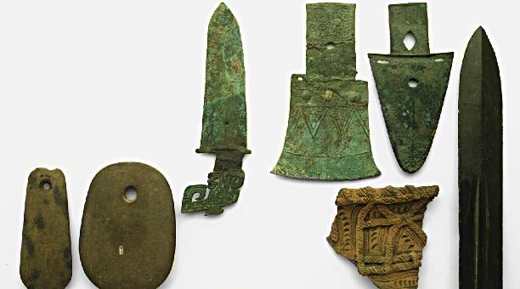
20.8 Technology Under the Shang
Many of their tools of war were made from _________.
It is one of the reasons that the Shang dynasty was able to remain in power for over _________ years!

Slide 26
20.9 The End of the Shang Dynasty
Fighting so many wars eventually ______________ the military power of the Shang.
The Shang kings spent enormous amounts of ____________ on lavish items. The spending may have weakened the ___________________.
_______________________ – a system of managing the wealth of a country or region.
Around 1045 B.C.E. the ___________ (pronounced joh) rose up against the dynasty.
The Zhoe armies under King _________ defeated the Shang armies.

Slide 27
20.8/ 20.9 QUESTION
____________________________________________________________________________________________________________________________________________________________________________________________
ANSWER
________________________________________________________________________________________________________________________________________________________________________________________________________________________________________________________________________________________________________________________________________________________________________________________

