Slide 1
Chapter 4 Section 2 Population
Pages 86-90

Slide 2
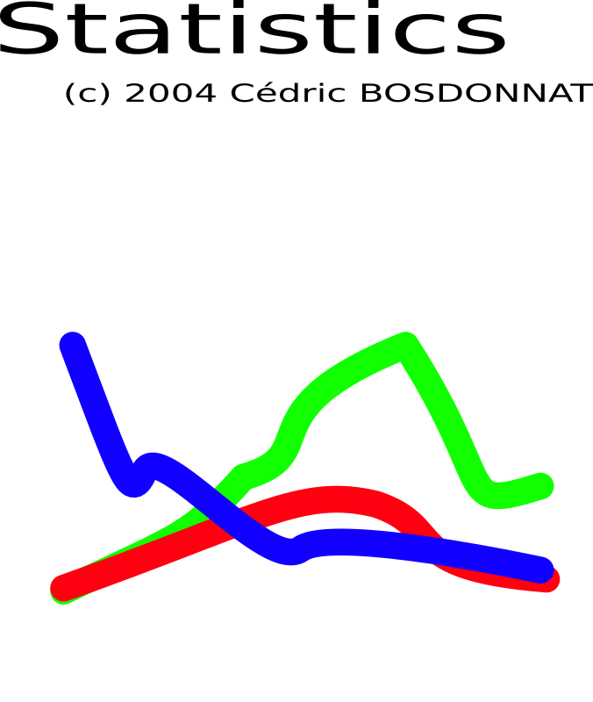
Main Ideas
The study of population patterns helps geographers learn about the world.
Population statistics and trends are important measures of population change.

Slide 3
The BIG Idea
Population studies are an important part of geography

Slide 4
Population Patterns
Population – total number of people living in a given area, determines a great deal about the place in which you live.
Population influences the variety of businesses, the types of transportation and the number of schools in your community.

Slide 5
Population Density
Population density – a measure of the number of people living in an area.
Population density is expressed as persons per square mile/kilometer.
1,000 live in 10 square miles = 100 people/mile
High population density:
Land is expensive
Roads are crowded/ more pollution
Buildings tend to be taller
Low population density:
Land is less expensive
More open spaces
Less traffic/ less pollution

Slide 6
3.45 acres in New York Manhattan area sold in the year 2000 for
$345 million!
You can get 2.35 acres near Kingman, Arizona, in the state’s northwest corner, for $1,310.
The land is dry, flat, and hot for most of the year.

Slide 7
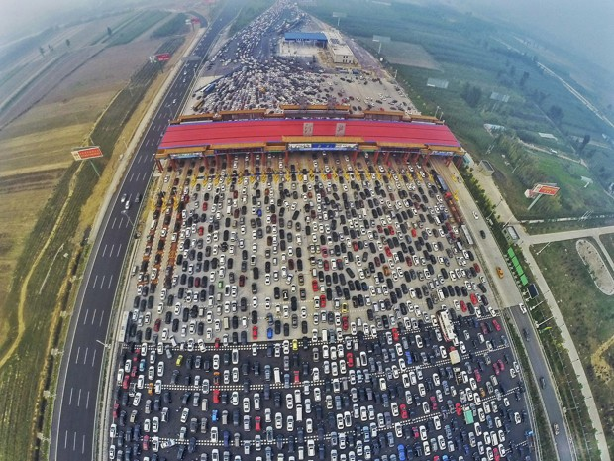

Slide 8
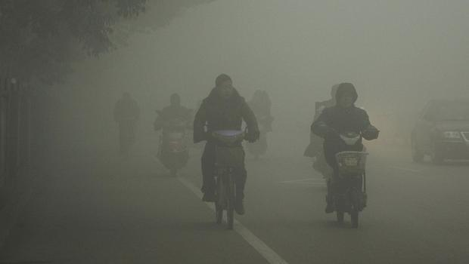

Slide 9
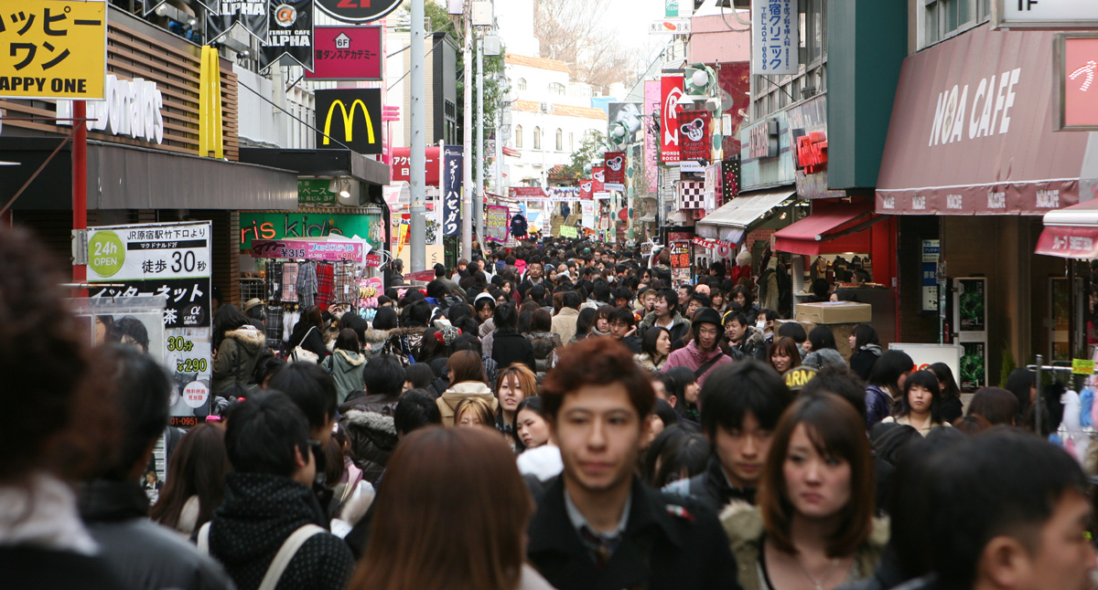

Slide 10
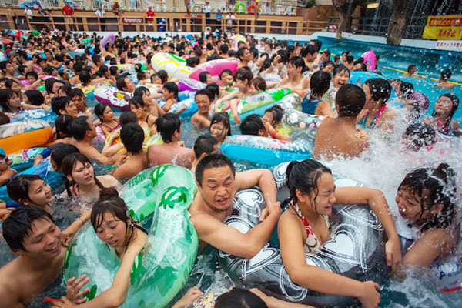

Slide 11
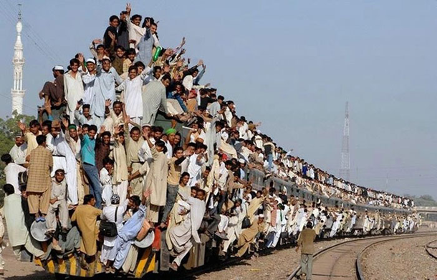

Slide 12
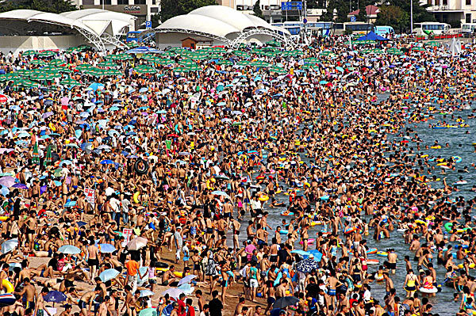

Slide 13
Where People Live
Where an area is thinly populated, it is often because the land does not provide a very good life.
Rugged mountains
Harsh deserts
Cannot grow crops/food
Frozen all year
No fresh water!
Very few people live in Greenland, northern Asia, Australia and parts of far North America.

Slide 14
Where People Live (Continued)
Large clusters of dense populations can be found in East and South Asia, Europe and eastern North America.
Fertile soil
Reliable sources of water! (i.e. river)
Good climate for crops

Slide 15
Population Change Tracking Population Changes
Geographers examine 3 key statistics to learn about population changes:
Birthrate – these add to a population.
Annual number of births per 1000 people is birthrate.
Death rate – these subtract from a population.
Annual number of deaths per 1000 people is death rate.
Natural Increase – # of births - # of deaths = natural increase.
For example, Denmark has an increase of .05%. This is very low and Denmark has a slight population increase.
Russia: 10.8 birth rate – 16.1 death rate = -5.5%
Russia has a negative rate of natural increase and a shrinking population!
Most countries populations are growing!
Mali’s population is growing at 3.3% = it will double in 21 years!

Slide 16
Migration
A common cause of population change is migration.
Migration - is the process of moving from one place to live in another.
As one country loses people other countries gain a population.

Slide 17
PUSH and PULL Factors
Some factors PUSH people to leave their country (warfare, lack of jobs, lack of good farm land).
For example, today, Syria’s people are leaving their country because of war.
Some factors PULL people to a new country (good jobs, fertile farm land, opportunity)
For example, USA has vast land and opportunities for immigrants.

Slide 18
World Population Trends
In 2012 the world’s population passed 7 billion people!
Better health care and improved food production have helped to support this population growth.
Two trends can be seen when analyzing populations around the world.
1. Some of the more industrialized nations populations have begun to slow.
2. Less industrialized nations often have high growth rates.

Slide 19
Ch. 4 Section 2 Assessment
1. What regions of the world have the highest levels of population density?
2. What information can be learned by studying population density?
3. What effect does migration have on human populations?
4. What patterns do you think world population might have in the future?
5. What is natural increase? What can it tell us about a country?
6. Would you prefer to live in a region with a dense or sparse population? Why?

