Slide 1
Chapter 4 Section 3 Government and Economy
Pages 91-95

Slide 2
Main Ideas
1. The governments of the world include:
Democracy
Monarchy
Dictatorship and
Communism
2. Different economic activities and systems exist throughout the world.
3. Geographers group the countries of the world based on their level of economic development

Slide 3
The BIG Idea
The world’s countries have different governments and levels of economic development.

Slide 4
Governments of the World
Without ways to establish order and ensure justice, life would be chaotic.
That explains why societies have governments.
Our governments make and enforce laws, regulate business and trade, and provide aid to people.
Governments help shape the culture and economy of a country as well as the daily lives of the people who live there.

Slide 5
Democratic Governments
A democracy is a form of government in which the people elect leaders and rule by majority.
In most democratic countries, citizens are free to choose representatives to make and enforce the laws.
Many countries- including the United States, Mexico and Canada have democratic governments.
Most democratic governments work to protect the freedoms and rights of their people.
Other democracies, however, restrict the rights and freedoms of their people.
NOT all democracies are completely free!

Slide 6
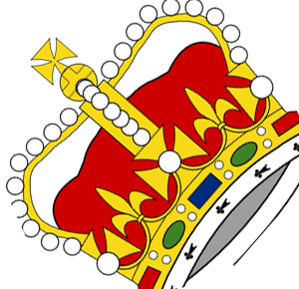
Other Types of Government
A monarchy is ruled by a king or queen, the head of a royal family.
Monarchy is the oldest type of government in the world.
Saudi Arabia is an example of a monarchy
The power varies depending on the type of monarchy.
Spain and Norway use many democratic practices.
Saudi Arabian King has all the power and people have none.

Slide 7
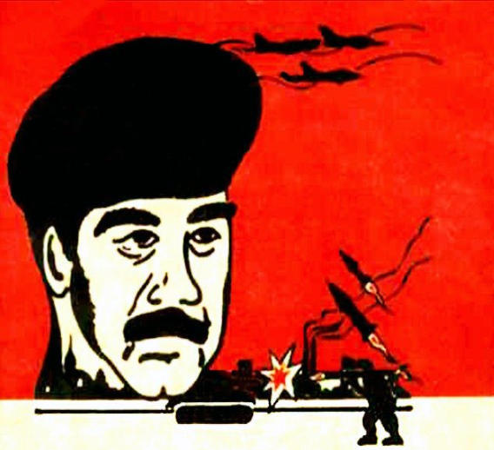
Other Types of Government (continued)
Dictatorship is a type of government in which a single, p0werful ruler has total control.
Often times this person rules by force
People are NOT free, have few rights and have no say in their own government.
Saddam Hussein was an example of a dictator.

Slide 8
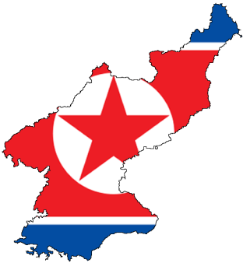
Other Types of Government (continued)
Communism is a political system in which the government owns all property and dominates all aspects of life in a country.
Leaders are not elected.
Cuba and North Korea are examples of current communist countries.
People have restricted rights and vary little freedoms.

Slide 9
 | DEMOCRACY | MONARCHY | DICTATORSHIP | COMMUNISM
Leaders take power |  |  |  | By force or election of Communist party
People’s freedoms |  | Vary
Economic Control | Little government control |  | Control by government

Slide 10
ECONOMIES OF THE WORLD
The economy is a system that includes all of the activities that people and businesses do to earn a living.
Countries today use a mix of different economic activities and systems.

Slide 11
Economic Activity
Geographers divide economic activities into four (4) different levels.
The primary industry, uses natural resources or raw materials.
Farming, fishing and mining are examples of primary industries
The secondary industry, use raw materials to produce or manufacture something new.
For example, the milk from dairy cows is used to make cheese. Automobile manufactures use steel, plastic, glass, and rubber to put together trucks and cars.

Slide 12
Economic Activity (continued)
3. The tertiary industries process and distribute information. Skilled workers research and gather information. People in tertiary industries sell the products made in secondary industries.
For example, doctors, teachers, store clerks are in this industry.
4. Quaternary industry, the highest level of economic activity, involves research and distribution of information.
Architects, lawyers and scientist all work in quaternary industries.

Slide 13
Economic Systems
Economic systems can be divided into three (3) types:
1. traditional
2. market
3. command
Most countries use a mix of these economic systems.

Slide 14
Economic Systems (continued)
Traditional economy, a system where people grow their own food and make their own goods.
Trade takes place through barter.
Rural and remote communities often have a mostly traditional economy.

Slide 15
Economic Systems (continued)
A market economy, the most common system used around the world today, is a system based on private ownership, free trade, and competition.
Prices are determined by the supply and demand for goods.
This is sometimes called capitalism
The United States is on of many countries that use this system.

Slide 16
Economic Systems (continued)
A command economy is a system in which the central government makes all the economic decisions.
The government decides what goods to produce, how much to produce, and what prices will be.
No country today uses a true command economy.
North Korea and Cuba are close to it.

Slide 17
Economic Development
Geographers often group countries into two (2) basic categories – developed and developing countries- based on their level of economic development.
A few economic indicators used by geographers:
1. Gross Domestic Product (GDP) is the value of all goods and services produced within a country in a single year.
2. Per Capita GDP, is total GDP divided by the number of people in a country.
3. Additionally, the overall quality of life and level of industrialization are used as indicators.

Slide 18
Developed and Developing Countries
Developed countries have:
strong economies
high quality of life
have a high per capita GDP
high levels of industrialization
health care and education are the best in the world
have access to technology.
United States and Germany are developed countries!

Slide 19
Developed and Developing Countries
Developing countries have:
less productive economies
lower quality of life
Lower per capita GDP
Most citizens work in farming or primary industries
Less access to health care or technology
Two-thirds of world’s population live in developing countries
Guatemala, Nigeria and Afghanistan are examples.

Slide 20
Name of Developed Country | Name of Developing Country
Per Capita (GDP): | Per Capita (GDP):
Life Expectancy at Birth: | Life Expectancy at Birth:
Literacy Rate: | Literacy Rate:
Physicians per 10,000 People: | Physicians per 10,000 People:
Other: | Other:

Slide 21
Did You Know?
It is possible to have a very large economy, but still be a relatively poor country. In 2005 China was rated as the second-largest economy in the world according to purchasing power. However, because it has so many people and its GDP per capita is sitll relatively low, China is generally considered a developing country.

Slide 22
Chapter 4 Section 3 Review Questions
1. What are some different types of government?
2. Under which type of government would you most want to live? Why?
3. What are the levels of economic activity?
4. Which economic system do you think is best? Explain your answer.
5. What is gross domestic product (GDP)?
6. In what ways do developed countries differ from developing countries?
7. What economic indicators do geographers use to evaluate a country’s development?
8. How do you think a low literacy rate affects economic development?
9. Why do societies have governments?
10. How do dictators rule?
11. How much control over people’s lives do democratic countries have compared to Communist countries?

