Slide 1
Chapter 5 History of the Fertile Crescent
Pages 114-139

Slide 2
The Main Idea
The rivers of Southwest Asia supported the growth of civilization
New farming techniques led to the growth of cities.

Slide 3
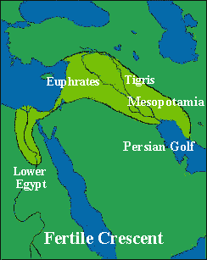
The BIG Idea
The valleys of the Tigris and Euphrates rivers were the site of the world’s first civilizations.

Slide 4
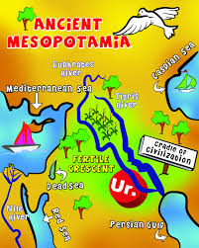

Slide 5
The Land Between the Rivers
The ___________ and ____________ rivers are the most important physical features of the region sometimes known as _____________.
Mesopotamia means “between the rivers” in _______________.
The region is part of the Fertile Crescent, a large arc of rich, or fertile, _____________.

Slide 6
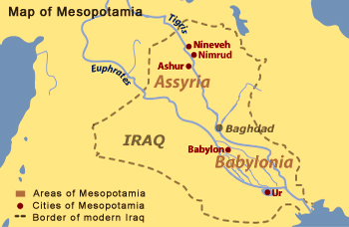

Slide 7
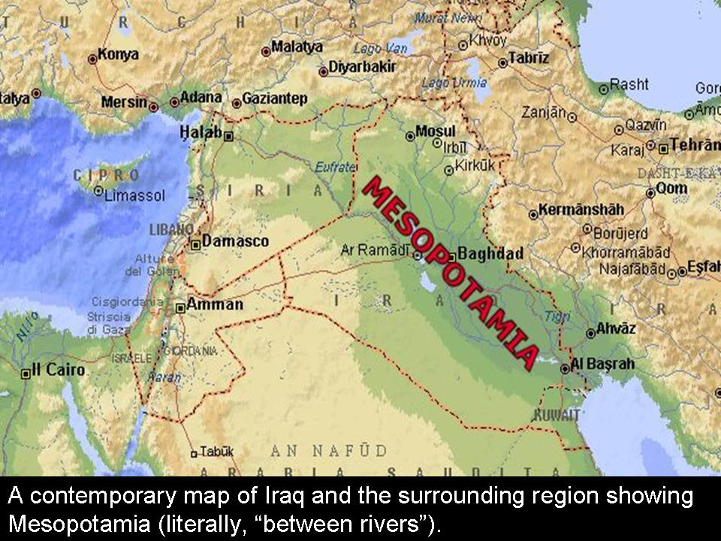

Slide 8
The Rise of Civilization
Hunter-gatherer groups first settled in Mesopotamia more than _____________ years ago.
Every year, floods on the Tigris and Euphrates rivers brought silt, a mixture of rich _________ and tiny _____________, to the land.
The fertile silt made the land ideal for ________.
Plentiful ___________ led to population growth, and __________________ formed.
Eventually, these early villages developed into the world’s first ____________________.

Slide 9
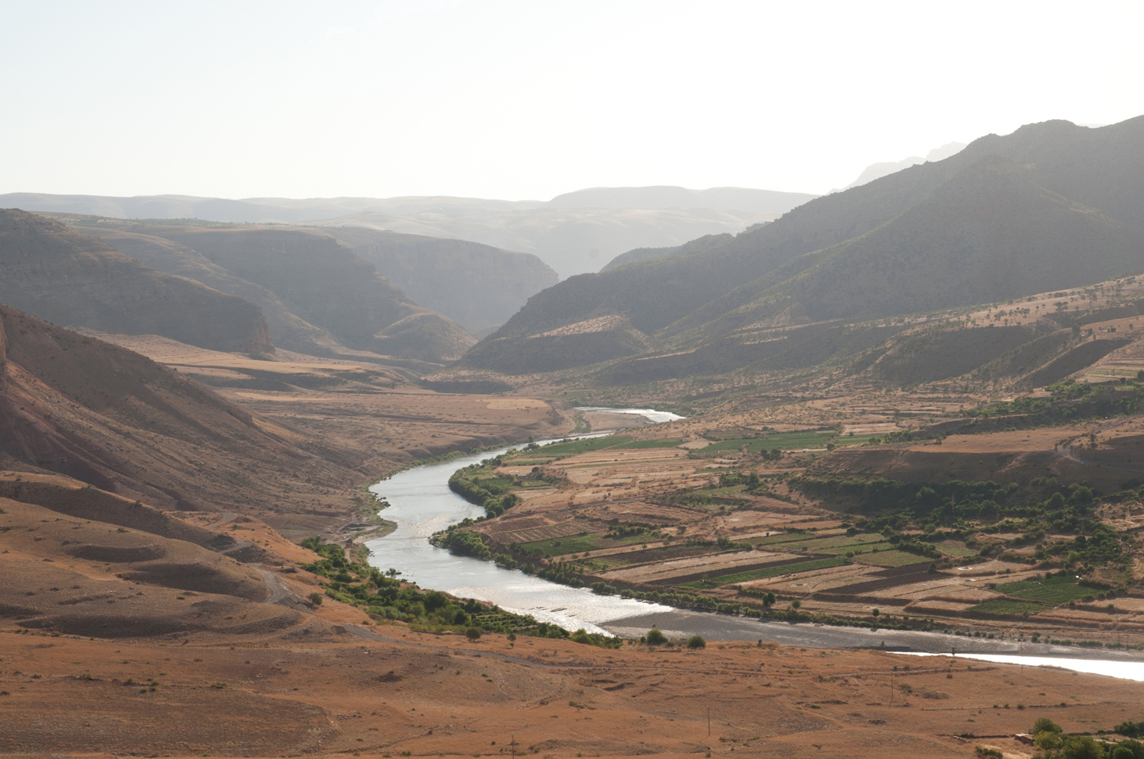

Slide 10
Farming and Cities
__________ in Mesopotamia was NOT easy.
The region receives little ___________.
The rivers would often times flood when there was too much _________ or go nearly dry when there was not enough rainfall.
Farmers knew that they needed to develop a way to control the rivers’ ___________.

Slide 11
Controlling Water
Mesopotamians used irrigation, a way of supplying ________ to an area of land, to solve their flooding/drought problems.
They dug canals, human-made ____________, that connect these basins to network of ditches.
Farmers built up the rivers’ banks or levees to help protect their farm ___________.

Slide 12
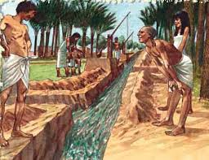
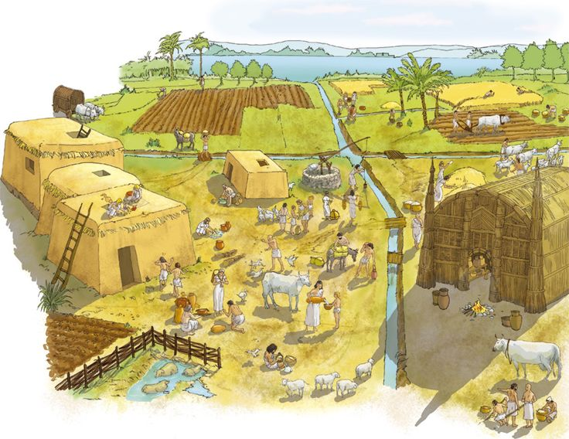
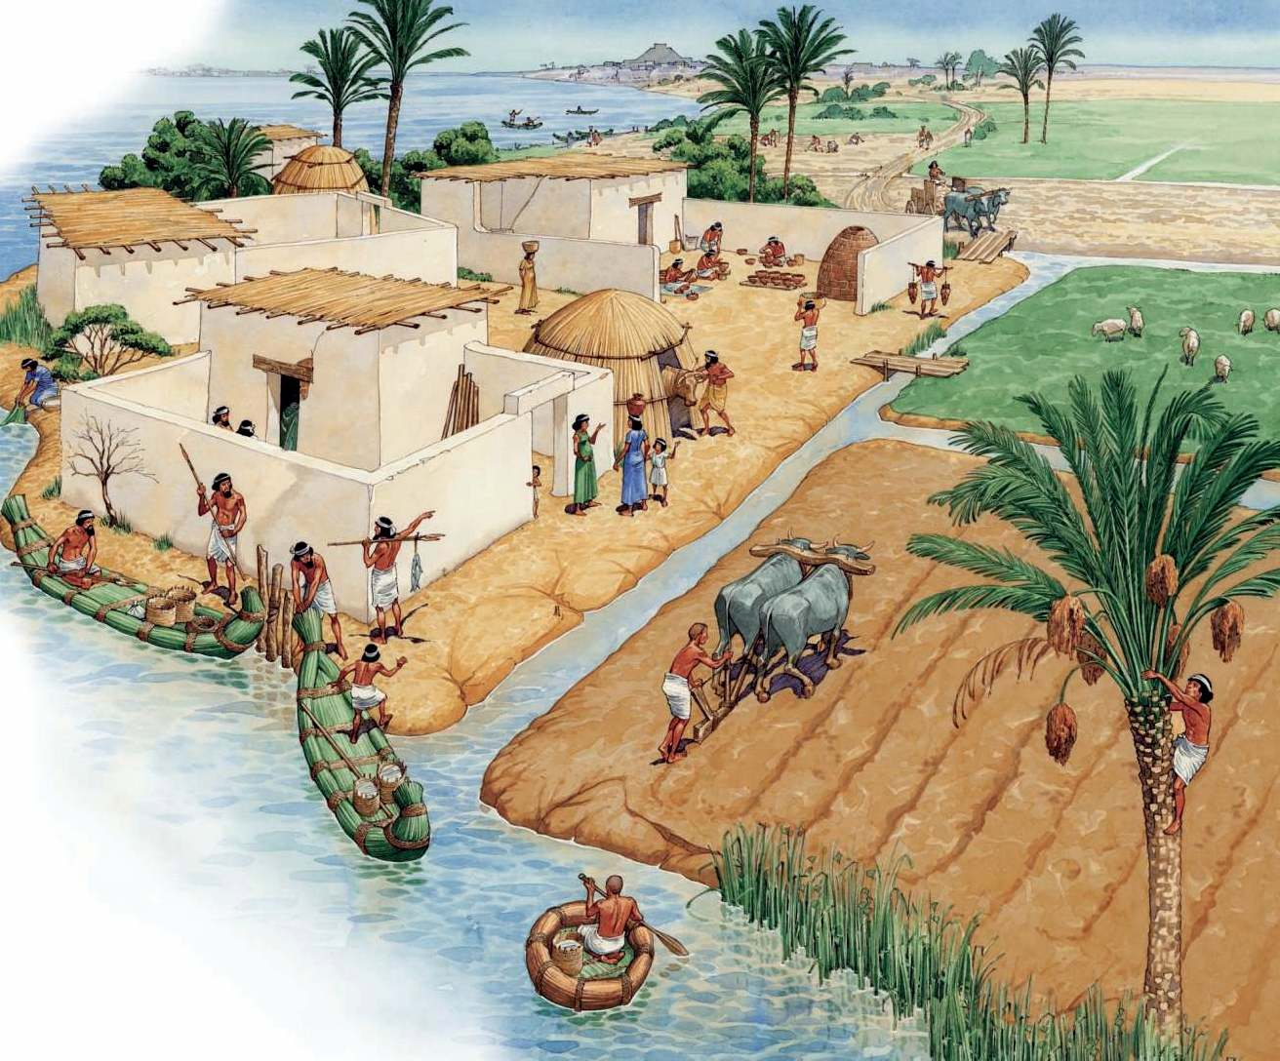
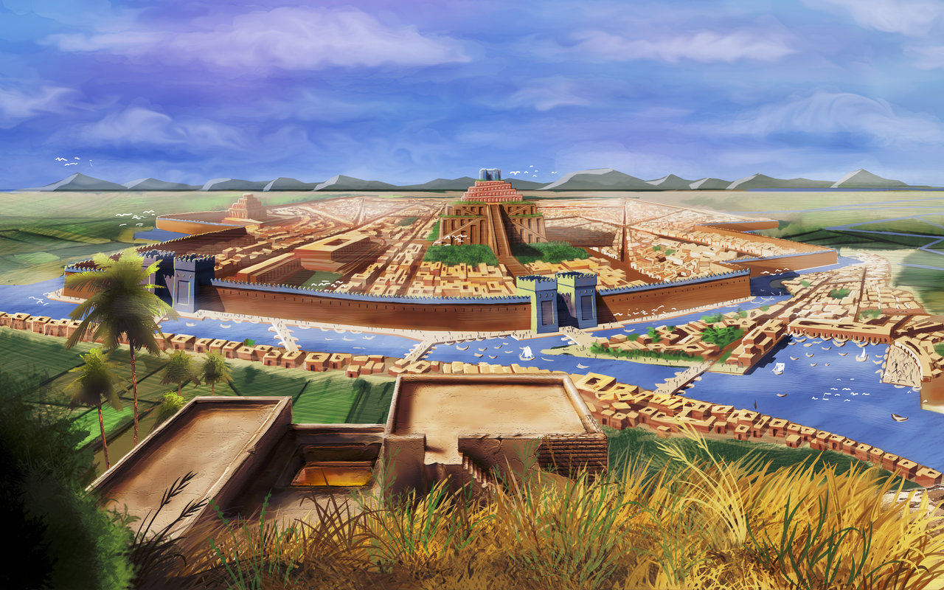

Slide 13
Food Surpluses
Irrigation _____________ the amount of food that could be grown.
Farmers produced a surplus, or more than they ___________.
Because irrigation made farmers more productive, _______ people needed to farm.
New __________________ developed.
The type of arrangement in which each worker specializes in a particular _________ or _____ is called a division of labor or job specialization.

Slide 15
Food Surpluses (continued)
Having people available to work on different jobs meant that society could ________________ more.
_____________ projects could be accomplished with the specialized workers.
Mesopotamians needed structure and ______.
These could be provided by laws and __________________.

Slide 16
Appearances of Cities
Over time, Mesopotamian settlements grew both in size and complexity.
They gradually developed into _________ between 4000 and 3000 BC.
The cities were still based on ____________.

Slide 17
Section 1 Assessment/Review
Where was Mesopotamia?
What does Mesopotamia mean?
On what rivers did Mesopotamia develop?
What is the Fertile Crescent?
When and how were farming settlements established in Mesopotamia?
How did the Fertile Crescent get its name?
What was the most important factors in making Mesopotamia’s farmland fertile?
Why did farmers need to develop a system to control their water supply?
In what ways did a division of labor contribute to the growth of the Mesopotamian civilization?
How did irrigation help farmers?
What effects did irrigation have on farming settlements?
How might big construction projects like the building of canals and large buildings lead to laws and government?

