Slide 1
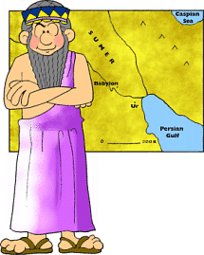
Chapter 5 Section 3 & 4 Sumerian Achievements & Later Peoples of the Fertile Crescent
Pages 127-133

Slide 2
Main Ideas
The Sumerians invented the world’s first writing system.
Advances and inventions changed Sumerian lives.
Many types of art developed in Sumer.
The Babylonians conquered Mesopotamia and created a code of law.

Slide 3
The BIG Ideas
The Sumerians made many advances that helped their society develop.
After the Sumerians, many cultures ruled parts of the Fertile Crescent.

Slide 4
Invention of Writing
Sumerians made one of the greatest cultural advances in history.
They developed cuneiform, the world’s first system of _____________.
They wrote on clay ________________ with a special tool called a ____________.
Cuneiform symbols could represent syllables, or basic parts of words.
They could express more complex ______________.
Earlier written communication had used pictographs, or ____________ symbols that represented an object.

Slide 5
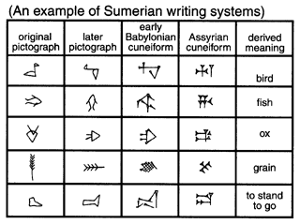

Slide 6
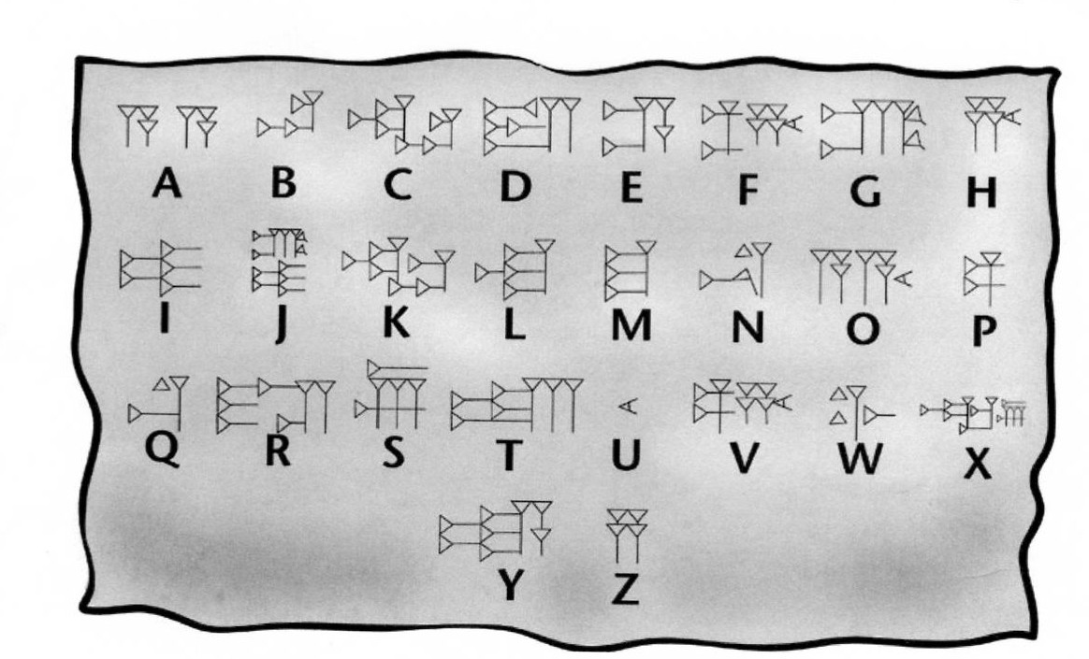

Slide 7
Invention of Writing (continued)
Cuneiform was first used to keep ___________ records.
A scribe, or writer, would be hired to keep track of the items people ______________.
Becoming a scribe was a way to move up in social classes.
They wrote works on history, law, grammar and math.
One famous epic, long poems that tell the stories of heroes, was The Epic of Gilgamesh about a legendary Sumerian ___________.

Slide 8
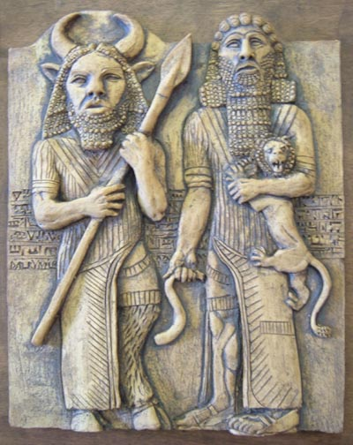

Slide 9
Advances and Inventions Technical Advances
One of the Sumerians’ most important developments was the wheel.
The plow was another important Sumerian invention.
The plow greatly ________ farm/food production!
They invented sewer systems, makeup, glass jewelry, bronze and a _________ using water.
These inventions greatly improved daily life.

Slide 10
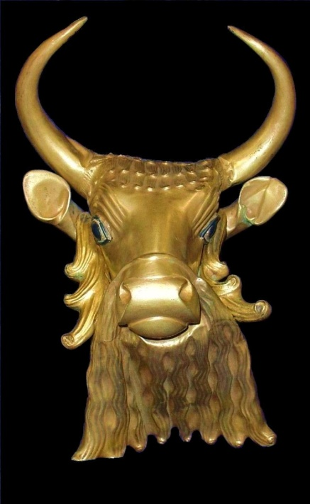
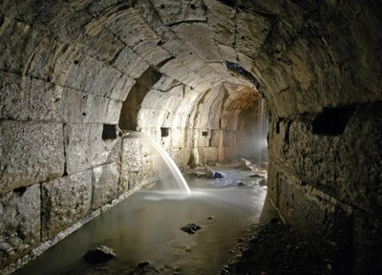

Slide 11
Math and Science
The Sumerians develop a _________ system based on the number 60.
They divided a circle into _________ degrees.
Divided a year into __ months – a factor of 60.

Slide 12
The Arts of Sumer Architecture
Sumerians’ skills in the field of art, metalwork, and architecture-the science of building-are well known to us.
Wealthy Sumerians lived in large _____________.
_____ Sumerians lived in small one-story houses.
City centers were dominated by their temples, the largest and most impressive buildings in Sumer.
A ziggurat, a __________-shaped temple, rose high above the city.

Slide 13
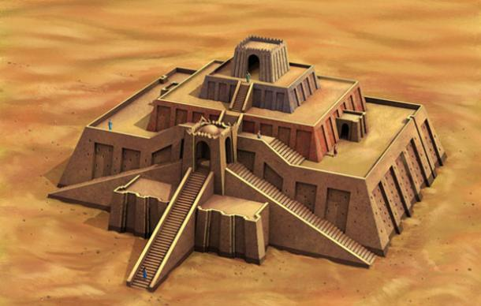

Slide 14
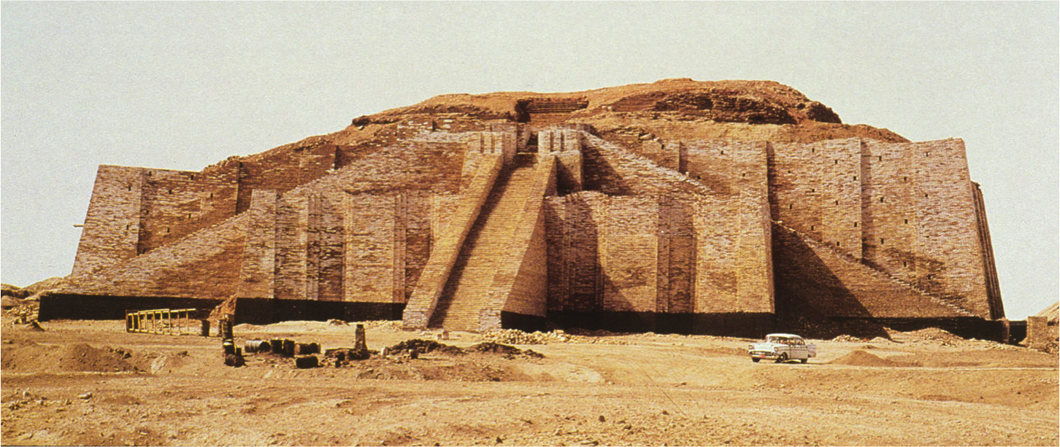

Slide 15
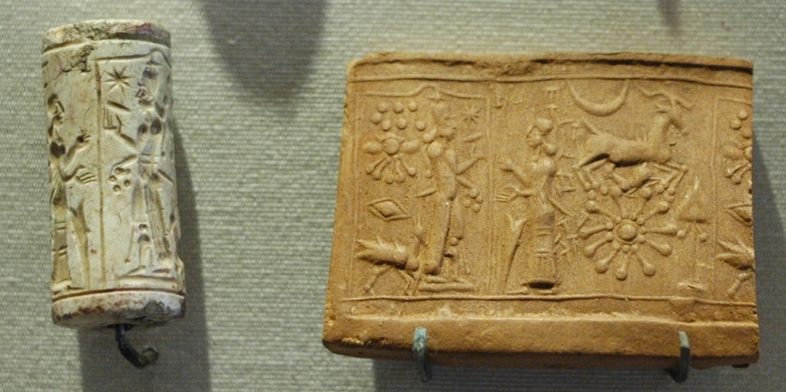
The Arts
Sumerian ____________ produced many fine works.
Statues of ________, jewelry, pottery and cylinder seals are just a few examples of the Sumerian artists works.
Cylinder _________ are perhaps Sumer’s most famous works of art. These small objects were stone cylinders engraved with designs.
People could use the seals to “sign” documents or for decorations.

Slide 16
Chapter 5 Section 4 Later Peoples of the Fertile Crescent
In 1792 BC, Hammurabi became Babylon’s _____
He would become the city’s greatest ruler.
He was a brilliant ____________ leader.
He is best known for his code of laws.
Hammurabi’s Code was a set of _______ laws that dealt with almost every part of daily life.
It contained some ideas that are still found in ________ today.
It was important it was written down for all to _____. People all over the empire could read exactly what was ___________ the law.

Slide 17
Review Questions
The Sumerians based their mathematical system on what number ?
What was the center of most Sumerian cities?
What different types of art did the Sumerians create?
Why do you think writing is one of history’s most important cultural advances?
What was the basic Sumerian building material? Why?
Which invention or legacy of the Sumerians do you think was the most important? Why?

