Slide 1
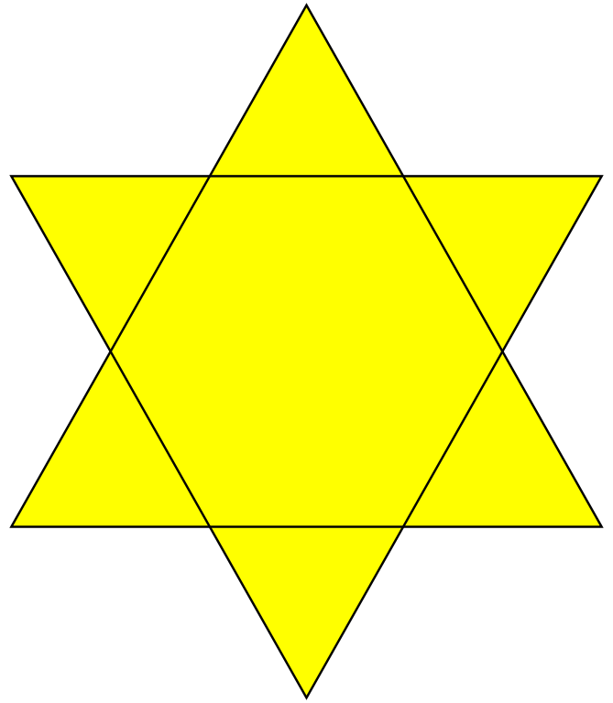
Chapter 6 section 1 Origins of Judaism
Pages 144-150

Slide 2
The Main Idea
The Jews’ early history began in Canaan and ended when the Romans forced them out of Israel.
Jewish beliefs in God, justice and law anchor their society.
Jewish sacred texts describe the laws and principles of Judaism
Traditions and holy days celebrate the history and religion of the Jewish people

Slide 3
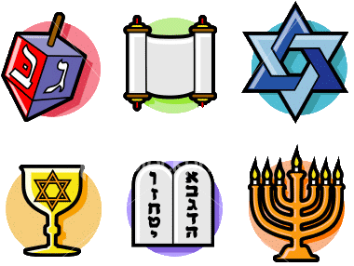
The BIG Idea
The Israelites formed a great kingdom in Israel and started a religion called Judaism.

Slide 4
Early History
Between 2000 BC and 1500 BC a new people appeared in Southwest Asia.
They were the Hebrews, ancestors of the Israelites and Jews.
Judaism – the religion of the Hebrews.
It is the worlds oldest monotheistic religion.

Slide 5
Beginnings in Canaan and Egypt
The Bible traces the Hebrews back to a man named Abraham.
God promised to lead Abraham to a new land and make his descendants into a mighty nation.
Many Israelites lived well in Egypt.
As their population grew, the pharaoh worried they would become too powerful.
The Egyptian pharaoh made the Israelites slaves.

Slide 6
The Exodus
A leader named Moses appeared among the Israelites in Egypt.
God told Moses to lead the Israelites out of Egypt.
Moses led the Israelites out of Egypt in a journey called the Exodus.
On their way to Canaan, they reached a mountain called Sinai.
On the mountain, God gave Moses two stone tables – the Ten Commandments- These laws shape Jewish society.

Slide 7
Jewish Beliefs
Much of Jewish culture is based directly on Jewish beliefs.
The central concepts of Judaism are:
belief in one God,
justice and righteousness,
observance of religious and moral law.

Slide 8
Belief in One God
Most importantly, Jews believe in one God.
Belief in one and only one God is called monotheism.
Many believe that Judaism was the world’s first monotheistic religion.

Slide 9
Justice and Righteousness
To Jews, justice means kindness and fairness in dealing with other people.
Jews are expected to give aid to those that need it including the poor, the sick and orphans.
To Jews, righteousness refers to doing what is proper.
Righteous behavior is more important than rituals or ceremonies.

Slide 10
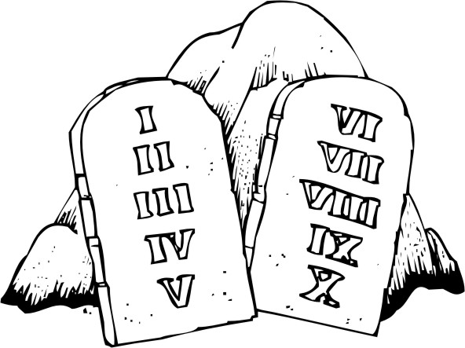
Observance of Religious and Moral Law
The most important Jewish laws are the Ten Commandments.
The commandments require that Jews worship only one God.
They also do not allow Jews to do bad things like murder, steal or lie.

Slide 11
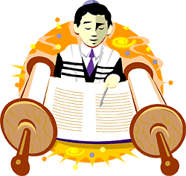
Jewish Texts
The laws and principles of Judaism are described in several sacred texts.
Among the main texts are:
the Torah,
the Hebrew Bible
the commentaries.

Slide 12
The Torah
The ancient Jews recorded most of their laws in five books.
Together, these books are called the Torah.
The Torah is the most sacred text of Judaism.
The Torah includes a history of the Jewish people.
Jews believe the contents of the Torah were revealed to Moses by God.
Nearly every synagogue, or Jewish house of worship, has at least one Torah.

Slide 13
The Hebrew Bible
The Torah is the first of three parts of a group of writing called the Hebrew Bible.
The second part is made up of eight books that describe the messages of Hebrew prophets
The third part includes the Book of Psalms. A collection of songs of praise to God.
The final part of the Hebrew Bible is 11 books of poetry, songs, stories, lessons and history.

Slide 14
Traditions and Holy Days
Jews feel that understanding their history will help them better follow the Jewish teachings.
Their traditions and holy days help Jews connect with their past and celebrate their history.
Hanukkah
The celebration of a victory that had convinced their rulers to let them keep their religion.
Celebrated during 8 days in December.
Passover
More important to Jews than Hanukkah, Passover is celebrated.
Jews honor the Exodus, the journey of the Israelites out of slavery.

