Slide 1
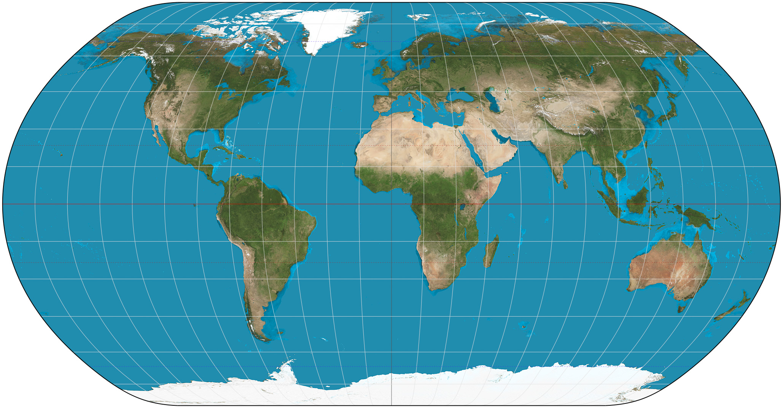
Mapping the Earth Using Latitude and Longitude
Eastern World Book
Pages H1-H11

Slide 2
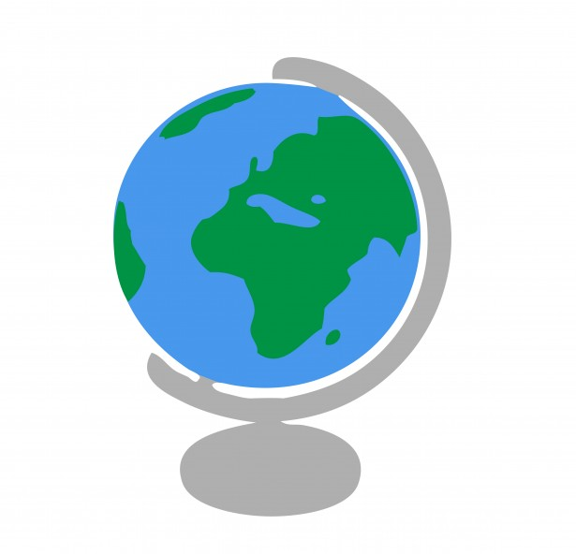
Mapping the Earth Using Latitude and Longitude
A globe is a scale model of the Earth.
It is useful for showing the entire Earth or studying large areas of Earth’s surface.
Geographers use a pattern of imaginary lines that circles the globe in east-west and north-south directions. It is called a grid.
Where these lines intersect helps us find places on Earth.

Slide 3
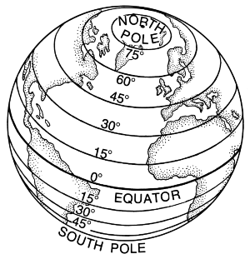
Mapping the Earth Using Latitude and Longitude
East-west lines in the grid are lines of latitude.
Lines of latitude are called parallels.
These lines measure distance north and south of the equator.
The equator is an imaginary line that circles the globe halfway between the North and South Poles.

Slide 4
Mapping the Earth Using Latitude and Longitude
Parallels measure the distance from the equator in degrees.
The symbol for degrees is .
Degrees are further divided into minutes.
The symbol for minutes is ‘.
There are 60 minutes in a degree.

Slide 6
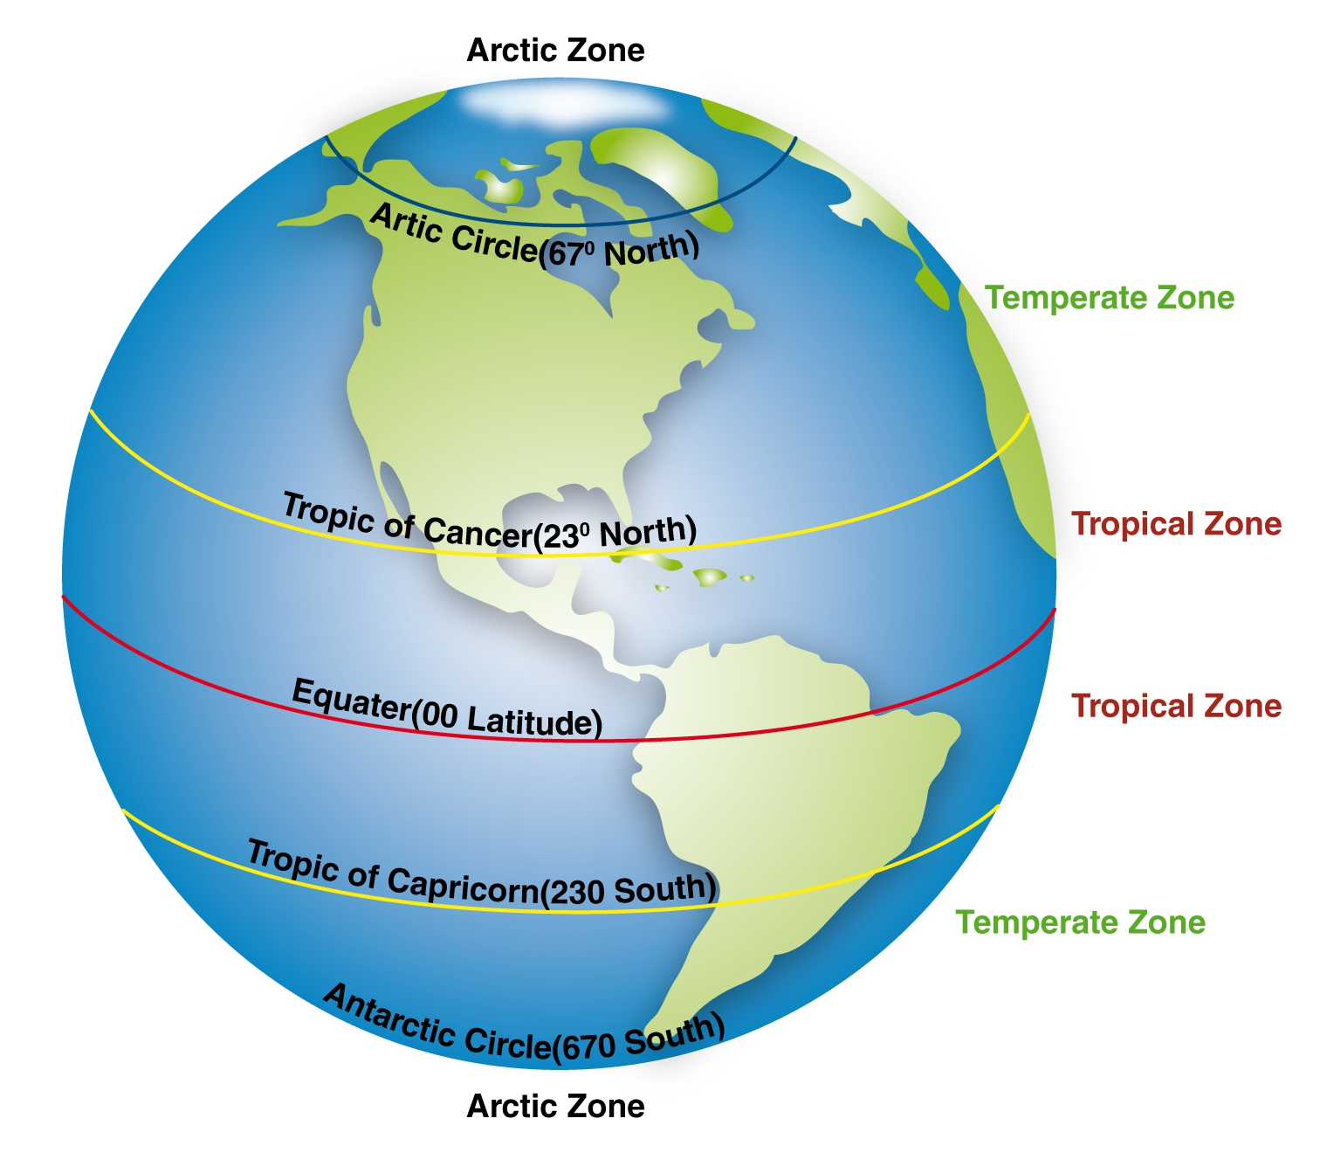

Slide 7
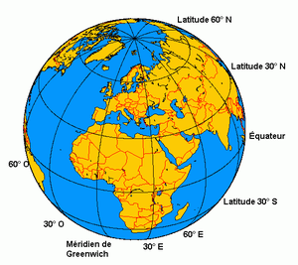

Slide 8
Mapping the Earth Using Latitude and Longitude
The north-south imaginary lines are lines of longitude.
Lines of longitude are called meridians.
These lines pass through the poles.
They measure distance east and west of the prime meridian.
The prime meridian represents 0 longitude.
It runs through Greenwich, England.

Slide 9
Mapping the Earth Using Latitude and Longitude
Lines of latitude range from 0, for locations on the equator, to 90 N or 90 S, for locations at the poles.
Lines of longitude range from 0 on the prime meridian to 180 on a meridian in the mid-Pacific Ocean.
Meridians west of the prime meridian to 180 are labeled with a W.
Those east of the prime meridian to 180 are labeled with an E.

Slide 10
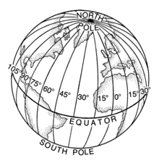

Slide 12
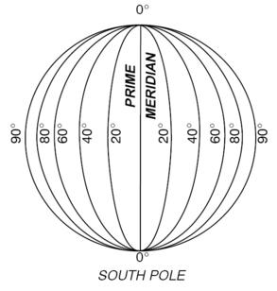

Slide 13
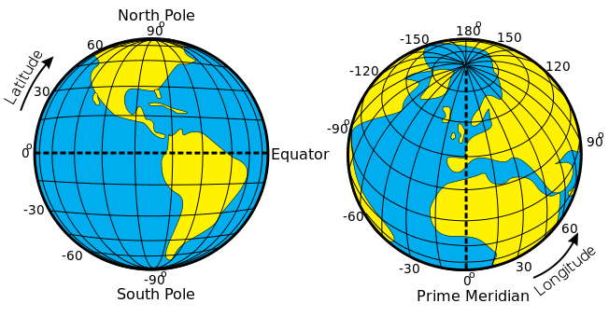

Slide 14
Mapping the Earth Using Latitude and Longitude
The equator divides the globe into two halves, called hemispheres.
The half north of the equator is the Northern Hemisphere.
The half south of the equator is the Southern Hemisphere.
The prime meridian divides the world into Eastern and Western Hemispheres.

Slide 15
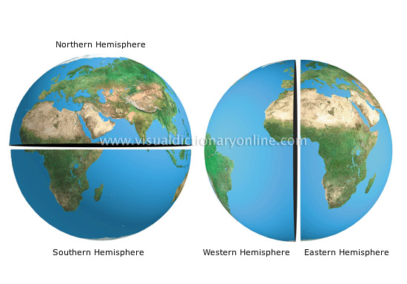

Slide 16
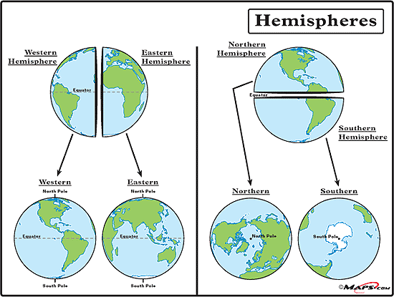

Slide 17
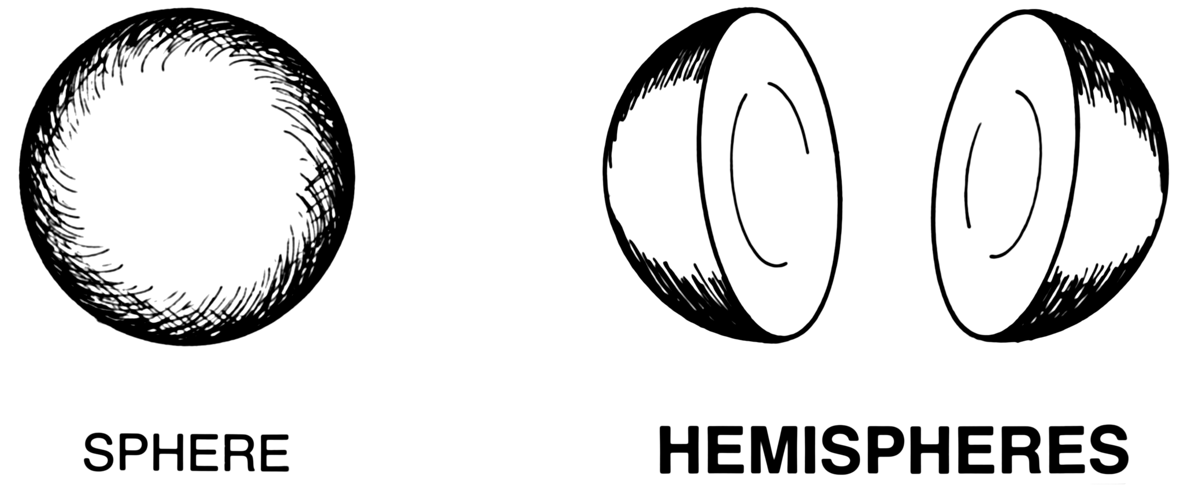

Slide 18
Mapping the Earth Using Latitude and Longitude
Earth’s land surface is divided into seven large landmasses, called continents.
Landmasses smaller than continents and completely surrounded by water are called islands.
Geographers divide the world ocean into the Pacific, Atlantic, Arctic, Southern and Indian.

Slide 19
Mapmaking Understanding Map Projections
Mapmakers have created different ways of showing our round planet on flat maps.
These different ways are called map projections.
All flat maps are distorted in some way.
Many map projections are one of three kinds: cylindrical, conic or flat-plane.

Slide 20
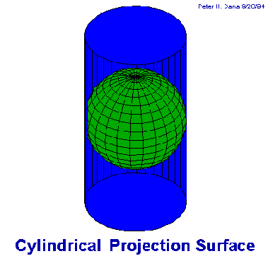
Mapmaking Understanding Map Projections
Cylindrical projections are based on a cylinder wrapped around the globe.
Often used by navigators.
It shows true direction and shape.

Slide 21
Mapmaking Understanding Map Projections
Conic Projections are based on a cone place over the globe.
Most accurate along the lines of latitude where it touches the globe.

Slide 22
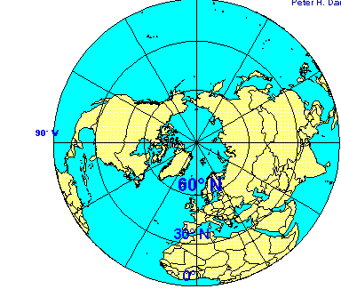
Mapmaking Understanding Map Projections
Flat-Plane Projections are based on a plane touching the globe a one point, such as the North Pole.
Shows true directions for planes and ship navigators.

Slide 23
Map Essentials How to Read a Map
Most all maps have a title, compass rose, a scale, and a legend.
A map’s title shows what the subject of the map is.
The directional indicator shows which way north, south, east and west lie on a map. A compass rose has arrows that point to all four principal directions.

Slide 24
Map Essentials How to Read a Map
Mapmakers use scales to represent the distances between points on a map.
The legend, or key, explains what the symbols on the map represent.
A locator map shows where in the world the are on the map is located.

Slide 25
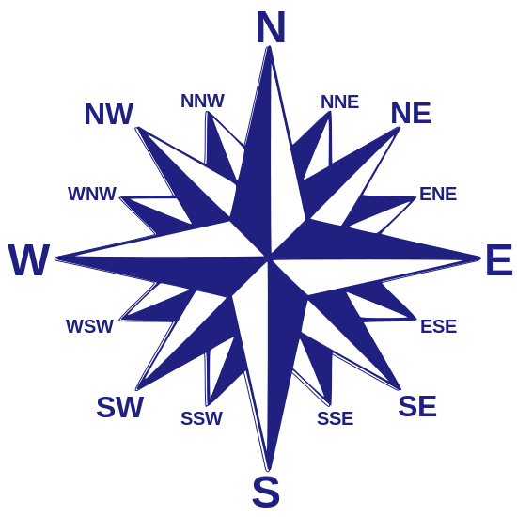
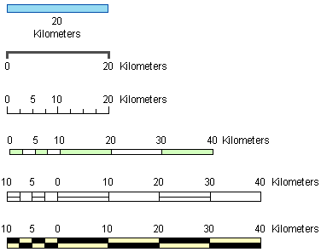

Slide 26
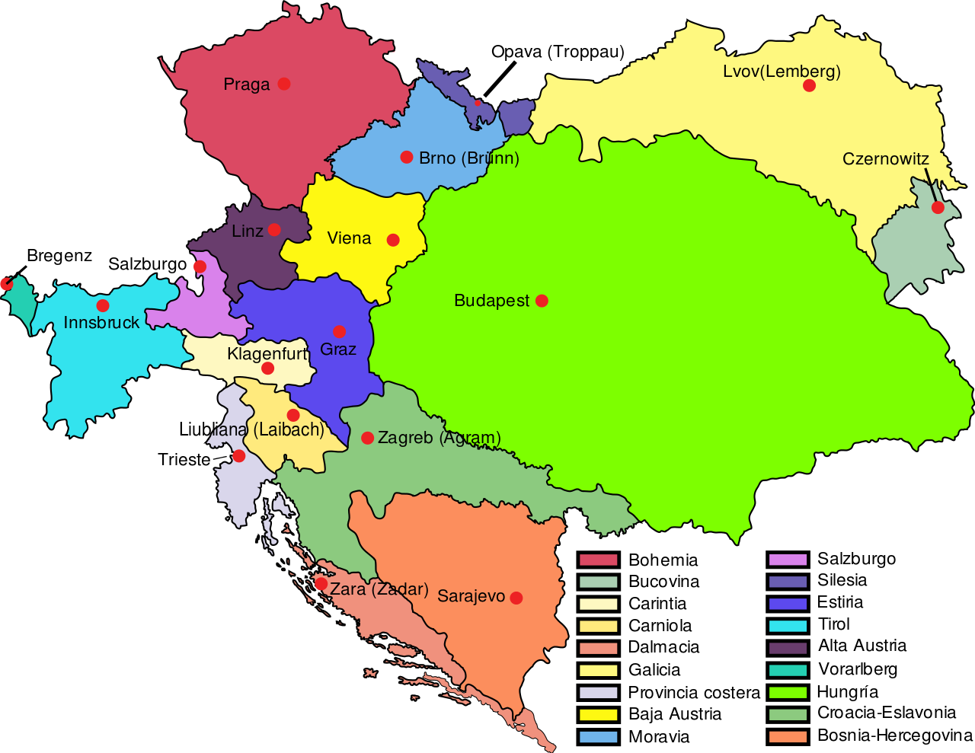

Slide 27
Working with Maps Using Different Kinds of Maps
Political maps show the major political features of a region.
These include: country borders, capital cities and other places.
Political maps use different colors to represent countries and capital cities are often show with a special star symbol.

Slide 28
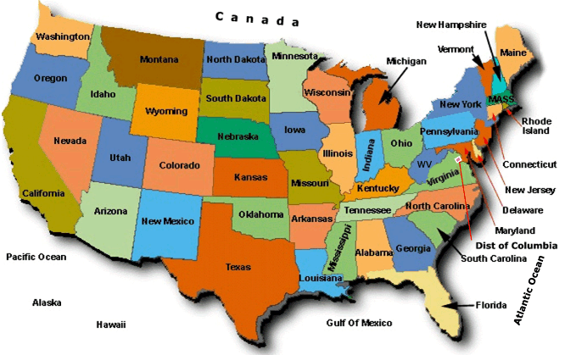

Slide 29
Working with Maps Using Different Kinds of Maps
Physical maps show the major physical features of a region.
These features may include mountain ranges, rivers, oceans, islands, deserts and plains.
These maps use different colors to represent different elevations of land.

Slide 30
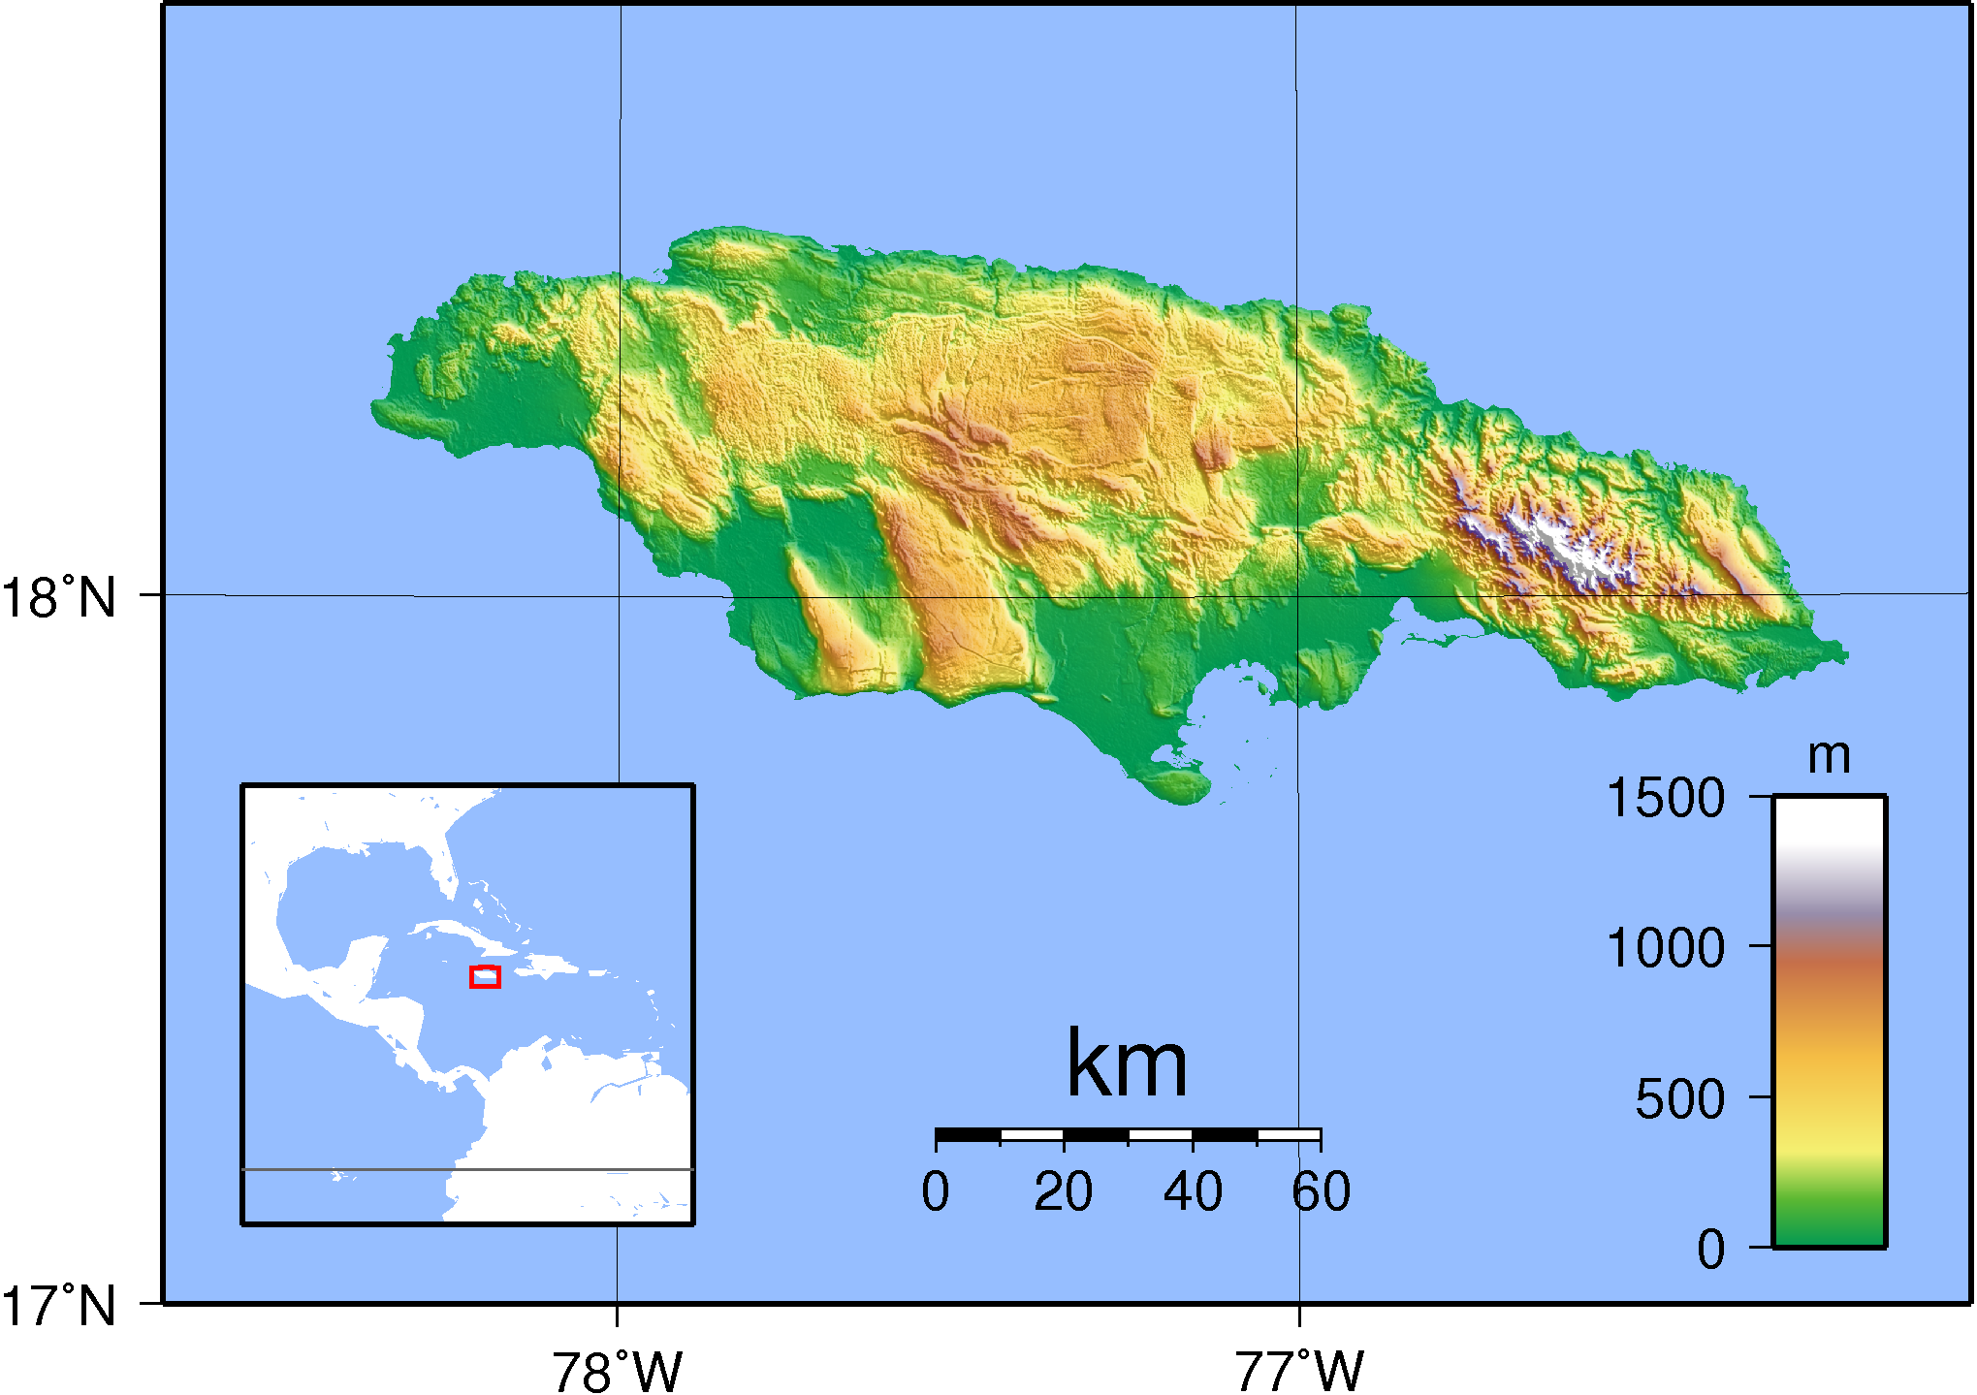

Slide 31
Working with Maps Using Different Kinds of Maps
Special-purpose maps focus on one special topic, such as climate, resources, or population.
Depending on the type of special-purpose map, the information may be shown with different colors, arrows, dots, or other symbols.

Slide 32
