Slide 1
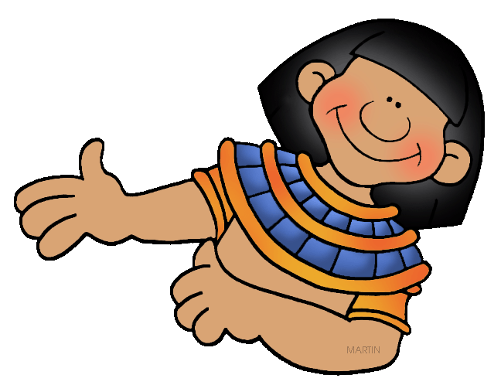
Geography and Early Egypt
Chapter 11
Pages 278 - 282

Slide 2
MAIN IDEAS
Egypt was called the gift of the Nile because the Nile River was so important.
Civilization developed after people began farming along the Nile River.
Strong kings unified all of ancient Egypt.

Slide 3
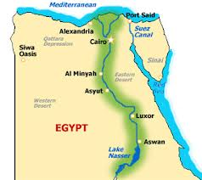
The BIG Idea
The water and fertile soils of the Nile Valley enabled a great civilization to develop in Egypt.

Slide 4
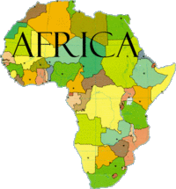
The Gift of the Nile
The Nile River brought life to Egypt and enabled it to thrive.
Greek historian Herodotus called Egypt the gift of the Nile.

Slide 5
Location and Physical Features
The Nile is the longest river in the world (4,000 miles long).
The Nile sliced through the desert of Upper Egypt.
The river created a fertile valley about 13 miles wide.
The Nile contained cataracts (rapids) that were very difficult to sail through.
The Nile delta fanned out across the land where the Nile and Mediterranean meet.
Delta – a triangle-shaped area of land made from soil deposited by a river.
2/3 of Egypt’s fertile farmland was located in the Nile Delta.

Slide 6
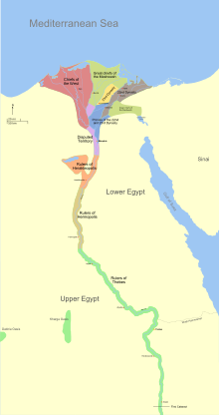
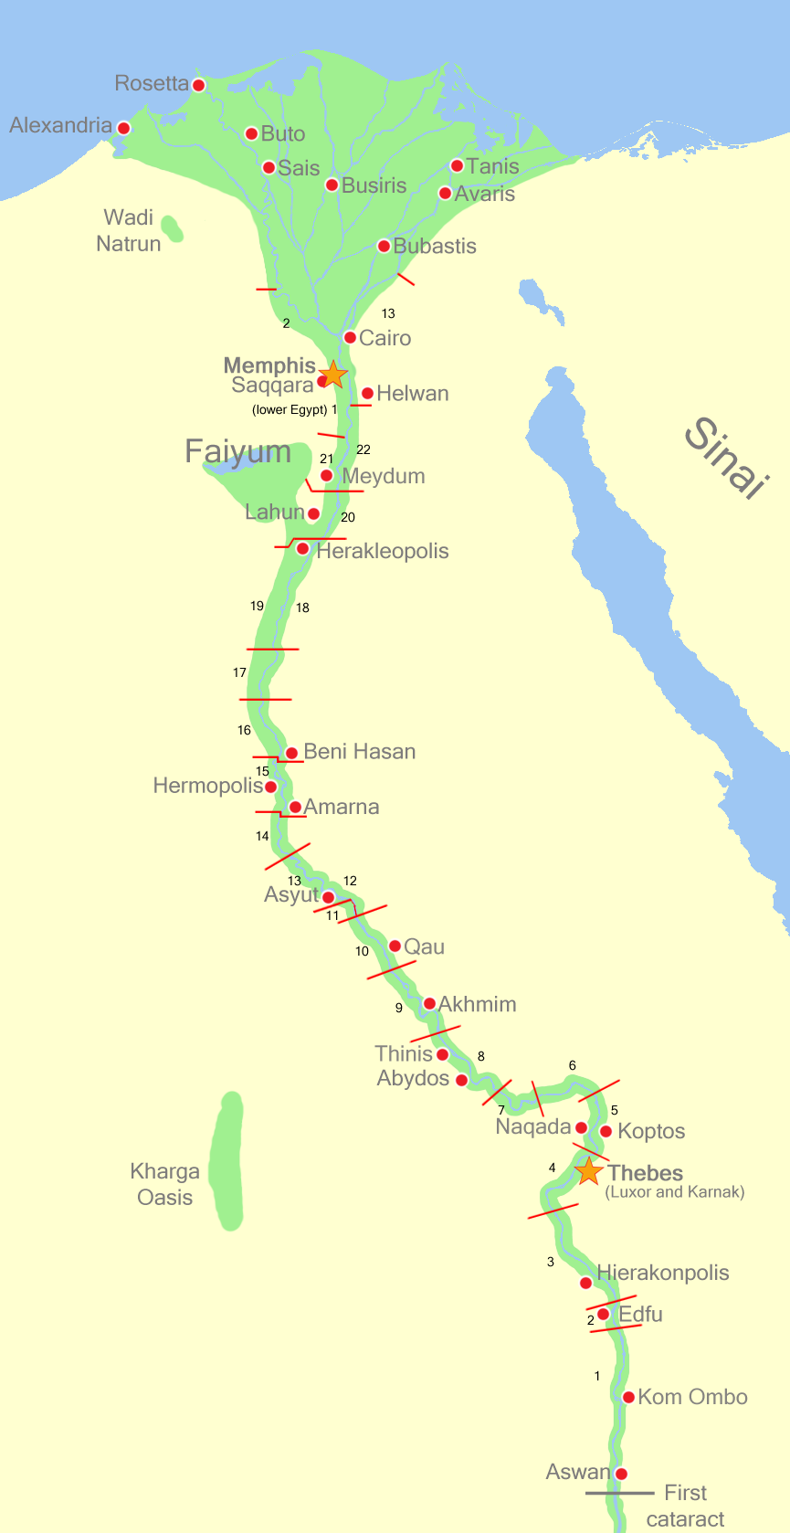

Slide 7
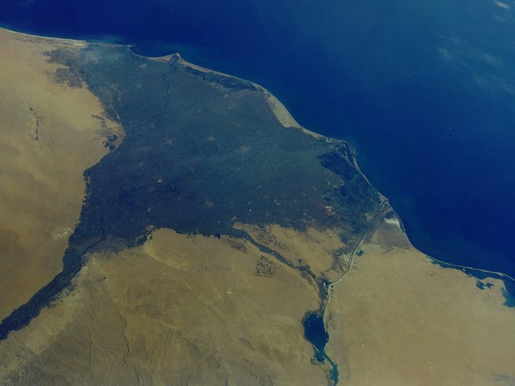

Slide 8
The Floods of the Nile
The rain that fell in the south of Egypt caused the Nile River to flood.
The Nile’s flooding coated the land around with rich silt.
Without the Nile’s regular flooding, people never could have farmed in Egypt.
The Nile truly was a gift to Egypt!

Slide 9
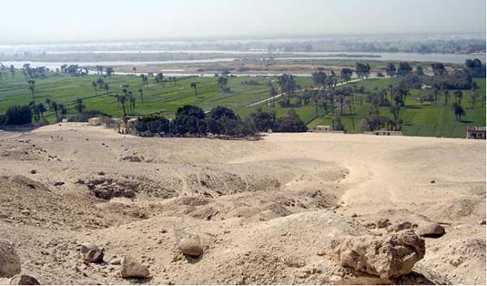

Slide 10
Civilization Develops in Egypt
The Nile provided both water and fertile soil for farming.
Over time, scattered farms grew into villages and cities.
Eventually, an Egyptian civilization developed.

Slide 11
Increased Food Production
Hunter-gatherers first moved into the Nile Valley more than 12,000 years ago.
Over time, farmers in Egypt developed an irrigation system.
Farmers grew wheat, barley, fruits and vegetables.
They enjoyed a wide variety in their diet.

Slide 12
Two Kingdoms
Egypt had natural barriers which made it hard to invade.
West – deserts
North – Mediterranean Sea
East – Red Sea and deserts
South – cataracts along the Nile River
These natural barriers helped Egypt grow and become very wealthy.
In time, two kingdoms emerged.
Upper Egypt – the king wore a cone shaped white crown.
Lower Egypt – the king wore a red crown.

Slide 13
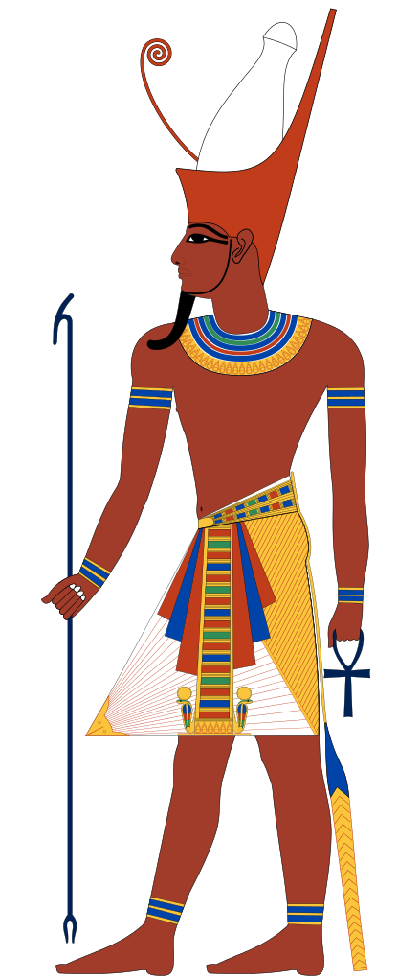
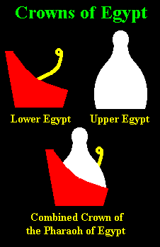

Slide 14
Kings Unify Egypt
Menes rose to power around 3100 BC.
Menes wanted to unify the kingdoms of Upper and Lower Egypt.
Menes wore both the white and red crown to symbolize his leadership over both kingdoms.
Many consider Menes to be the first pharaoh of Egypt.
Menes also founded Egypt’s first dynasty, or series of rulers from the same family.
Egypt’s First Dynasty was a theocracy (a government ruled by religious leaders thought to be divine).
In time, some 30 dynasties would rule ancient Egypt over a span of more than 2500 years!

