Slide 1

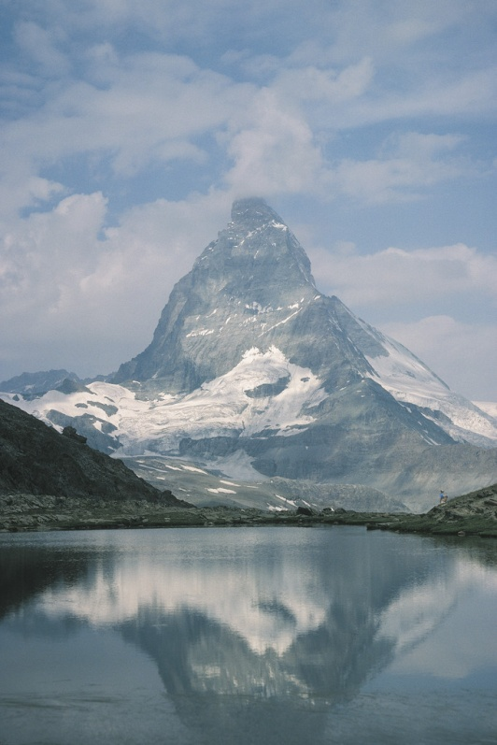

Iceman of the Alps
World Book
Pages 32 - 37

Slide 2

The Iceman was discovered in 1991 in the Alps Mountains.
  The Alps are Europe’s highest mountain range.
  They are covered with ice slabs called glaciers.

Slide 3
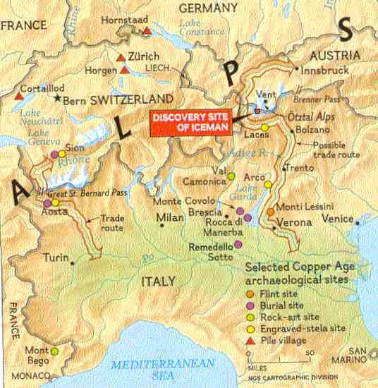

Slide 4
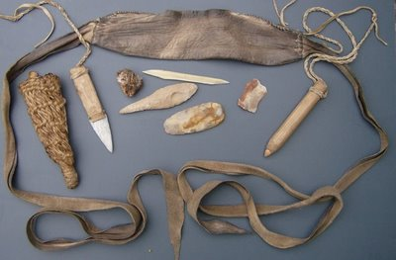
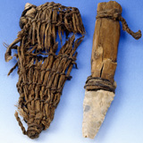

Slide 5
When the police recovered the body they collected some items that were scattered around the body.
  The items included:
    Knife
    Arrows
    Small net
    Bits of rope
    Leather
    Ax
  The ax looked hundreds of years old!

Slide 6
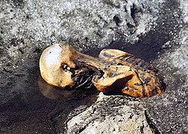

Slide 7
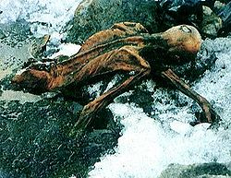

Slide 8
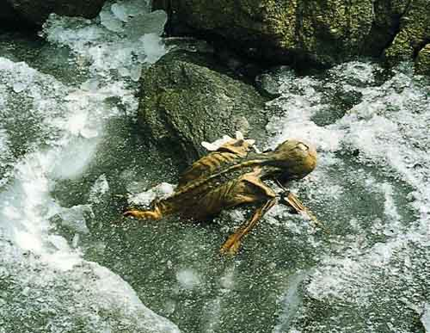

Slide 9
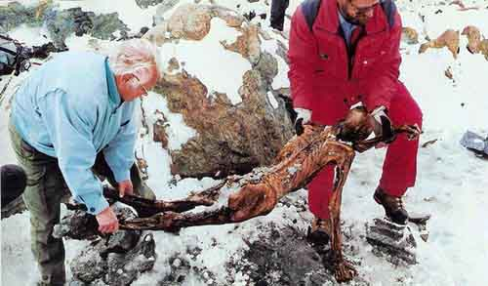

Slide 10
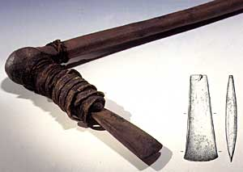

Slide 11
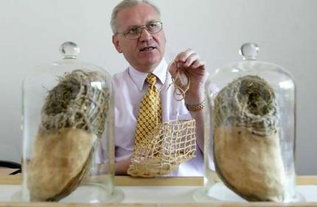

Slide 12
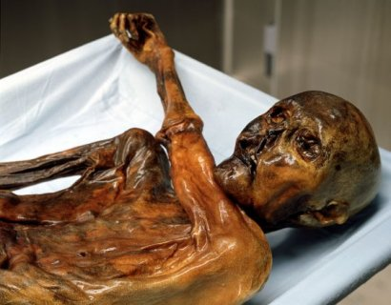
Konrad Spindler came to investigate the discovery and determine his age– he announced his conclusion “Roughly 4,000 years old!”
  Later, detailed testing would prove that the Iceman was actually 5,300 years old.
  The Iceman lived during the prehistoric time.

Slide 13
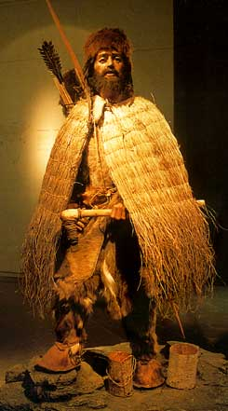

Slide 14
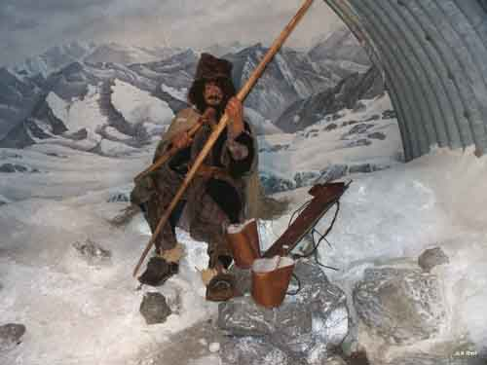
The amazing part of the find is that he was found with tools and clothes he used every day.
  He brought priceless artifacts into the 1990s.

Slide 15

Archaeologists’ first task was to map the site.
Next, they melted the snow.
  The melted snow was filtered three times.
    They found flecks of wheat.
      This proved he had contact with a village where wheat was grown.
    They found 2000 grains of pollen from the alder and pine trees.
      Scientists reason he died during the spring when pine and alder trees give off most pollen.

Slide 16
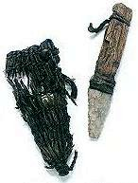
Equipped for Survival
  Scientists believe the Iceman was equipped for survival. He was carrying a small net to catch birds, a pouch that held a bone needle to repair clothing, flint blades, a fire starter and a “medicine chest.”
  His “medicine chest” consisted of two small beads of fungus on a leather strap.
  His fire starter was tiny crystals of sulfur and iron attached to black fungus

Slide 17
Examining the Evidence
The Iceman was 5 feet 2 inches tall.
Due to the wear on his teeth, they reasoned he was between 35 – 40 years old.
Wavy dark-brown hair and a beard.
He had 57 tattoos.
He had an arrow head stuck in his shoulder.
He may have been a shepherd.
He was encased in ice for over 5000 years!

Slide 18
Carbon-14
All living things contain carbon.
When a living thing dies, a special type of carbon called carbon-14 slowly begins to break down at a known rate.
By measuring the amount of carbon-14, scientists can then determine its age.
Four independent labs concluded that the Iceman was between 5000 – 5300 years old.

Slide 19


Slide 20


Slide 21
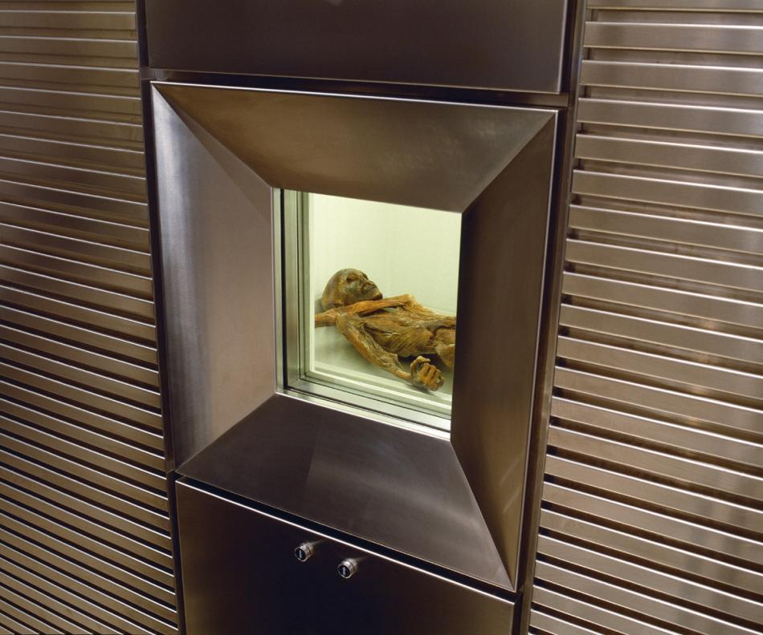

Slide 22
